Slide 1
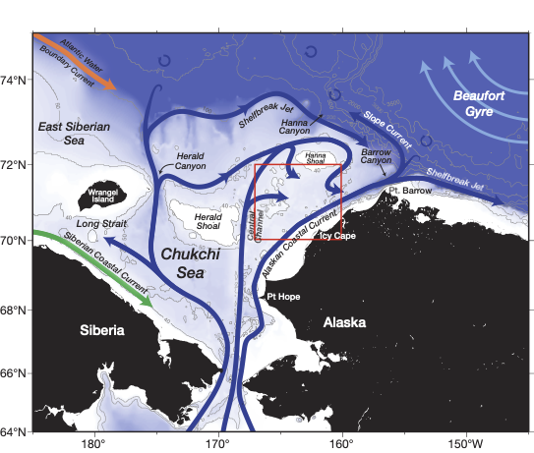

Slide 3
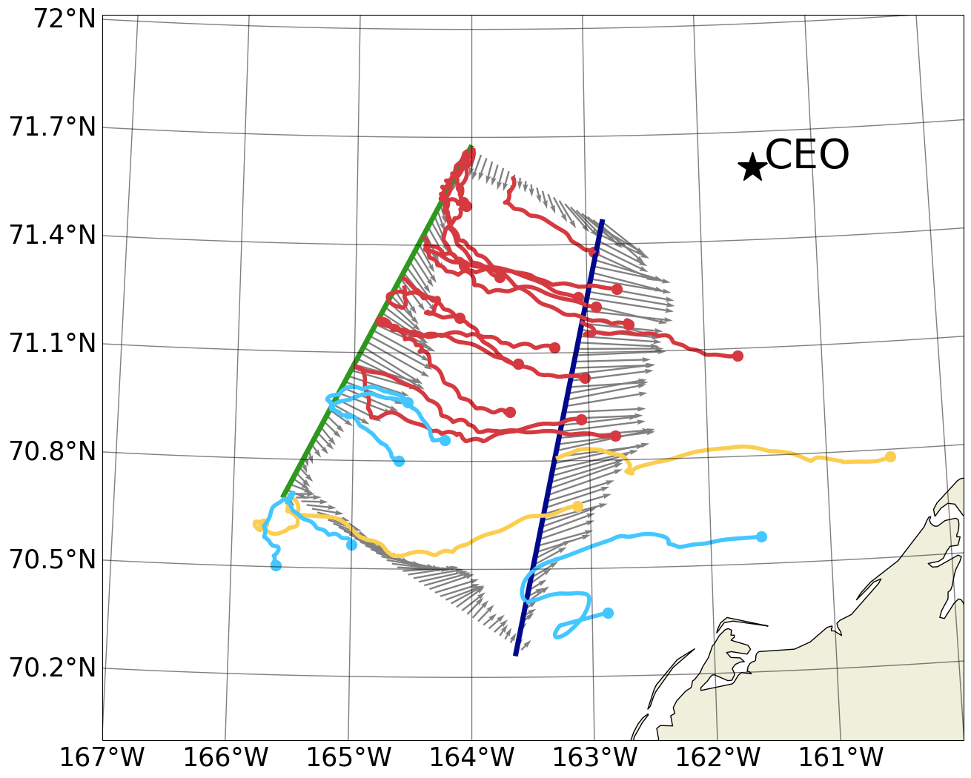
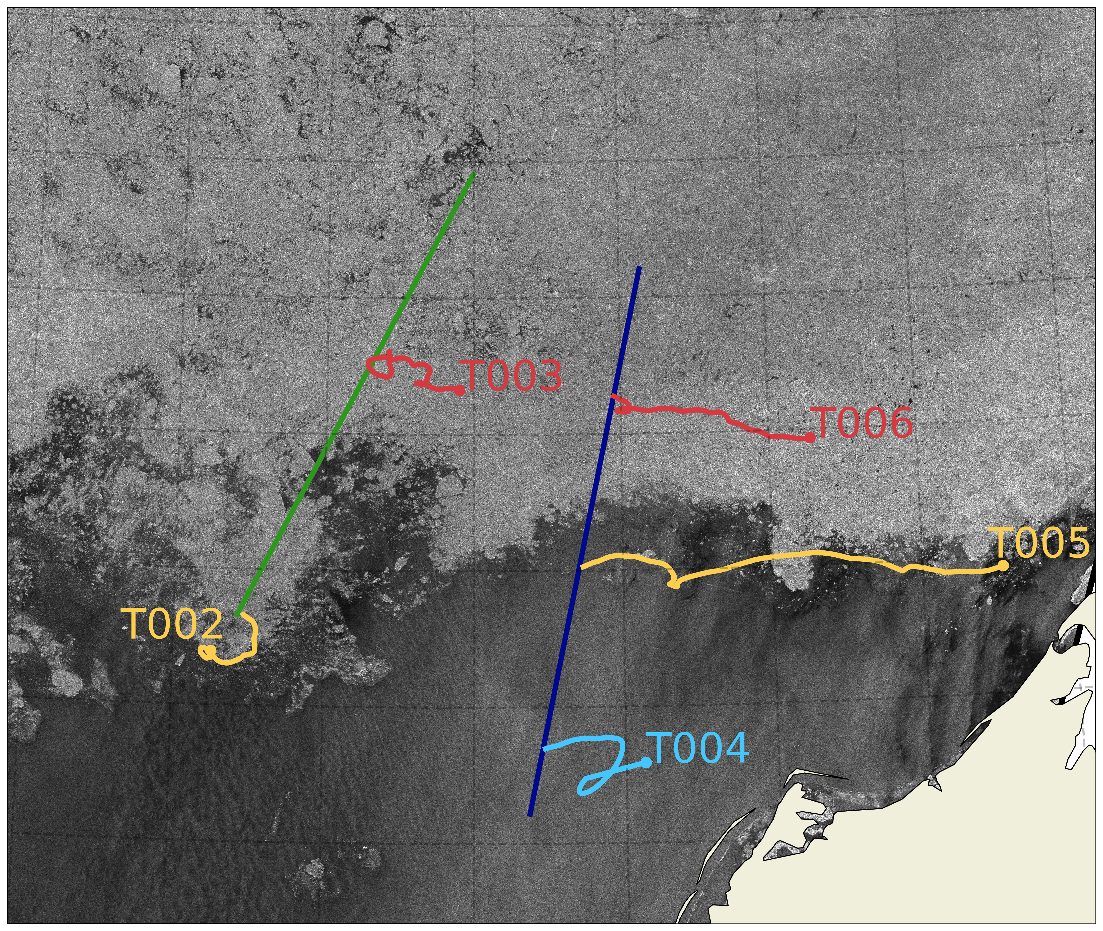
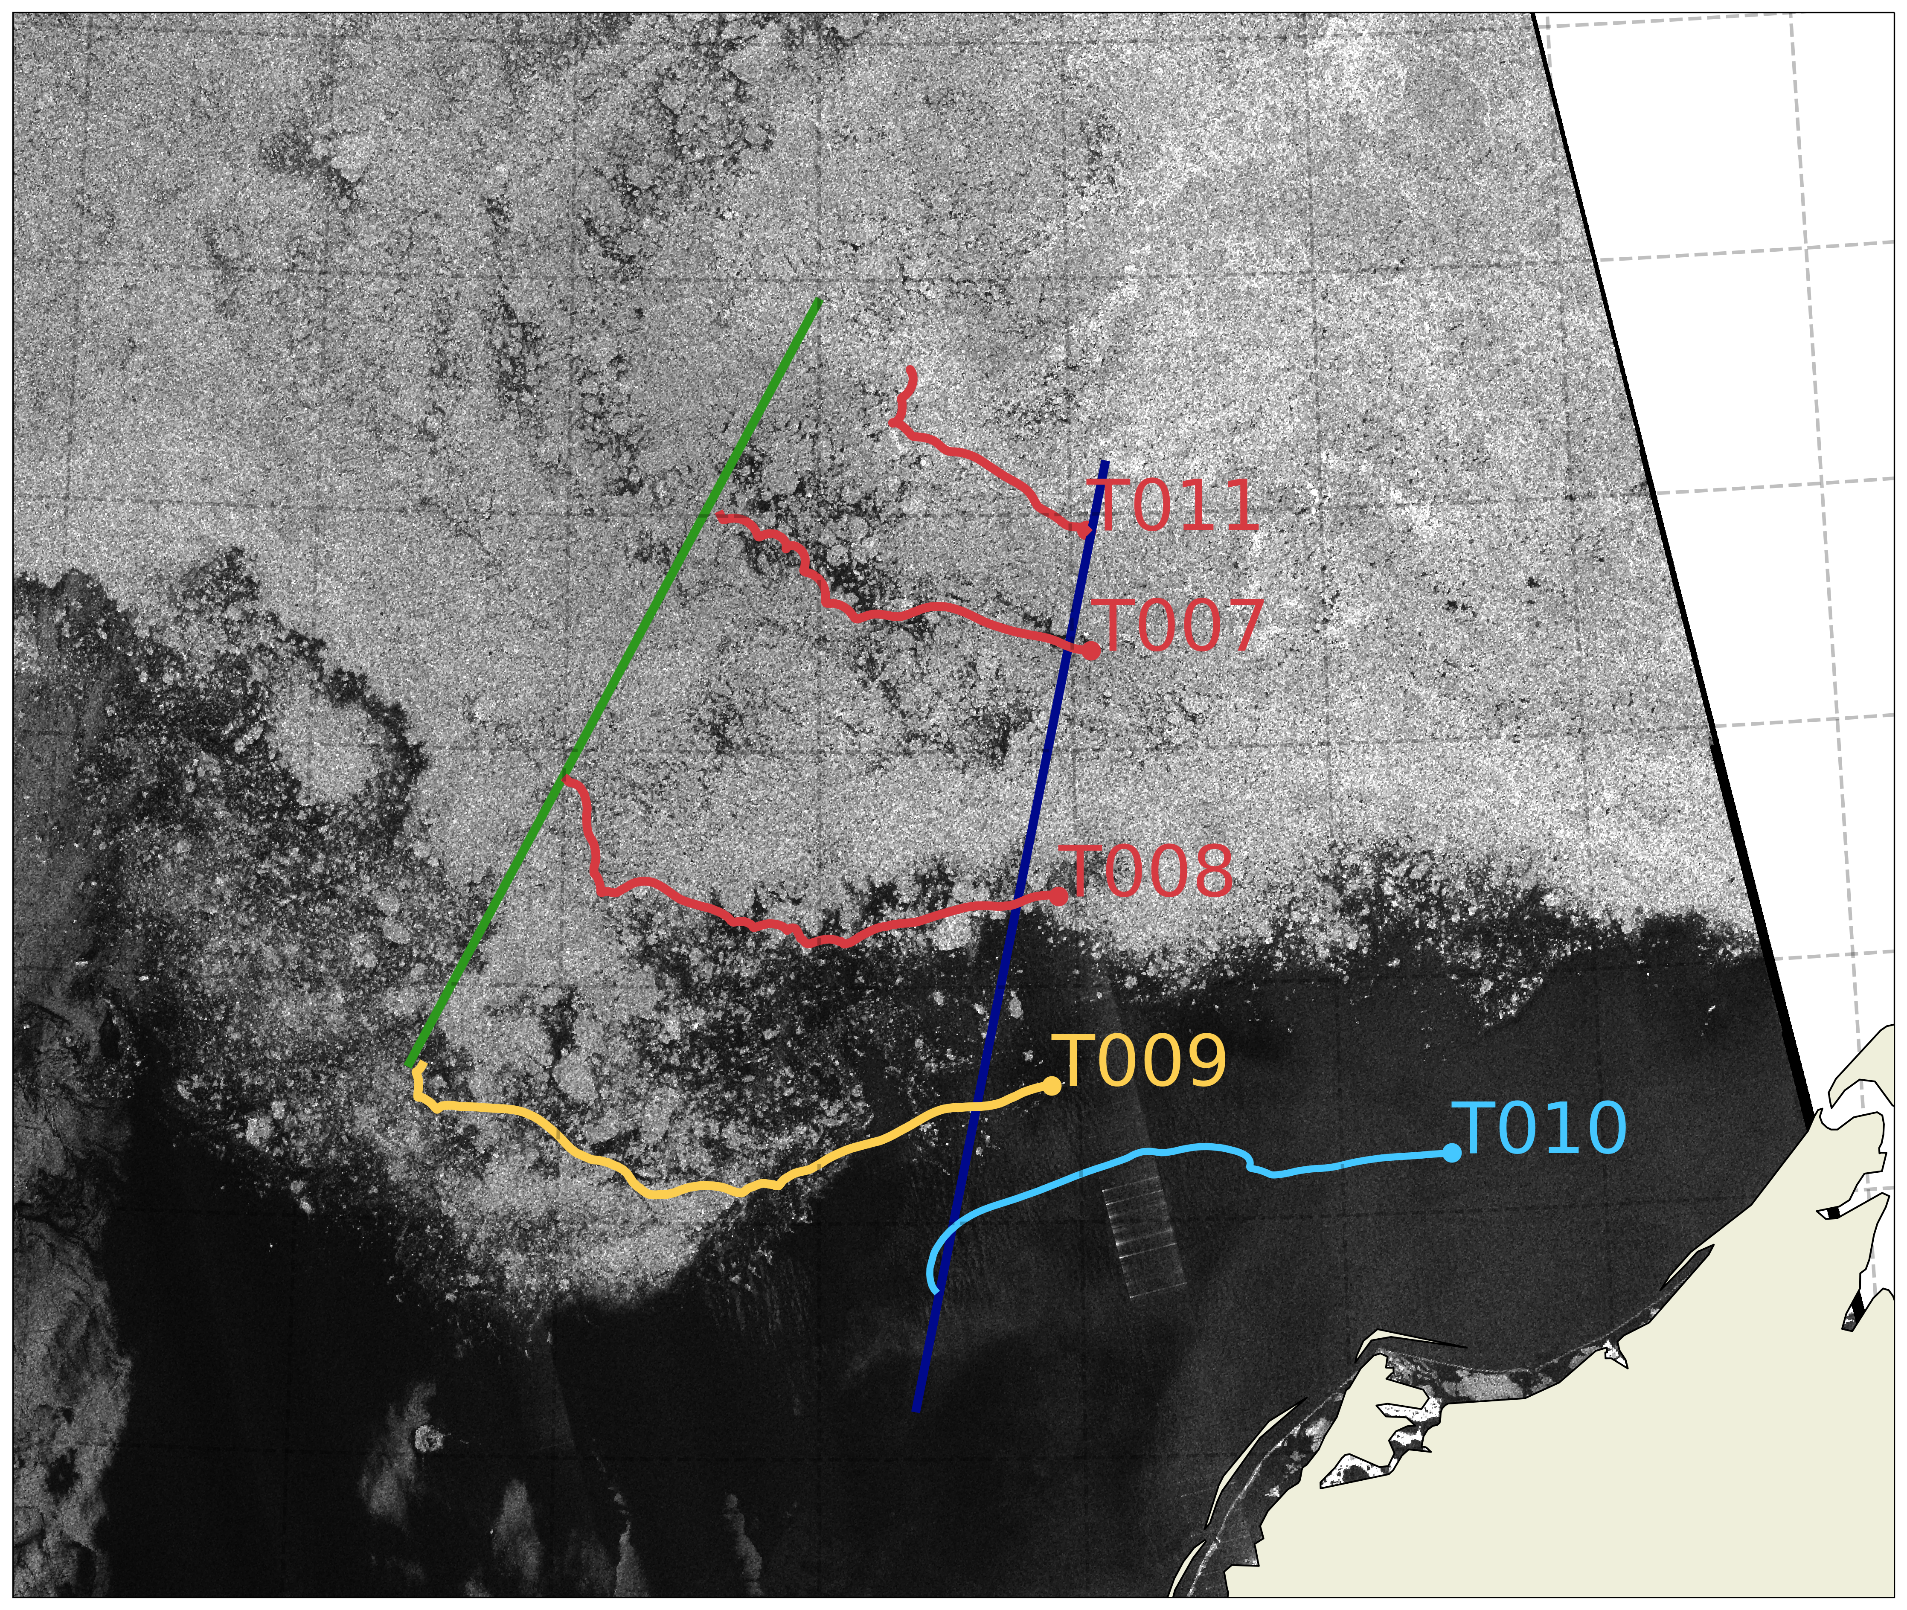
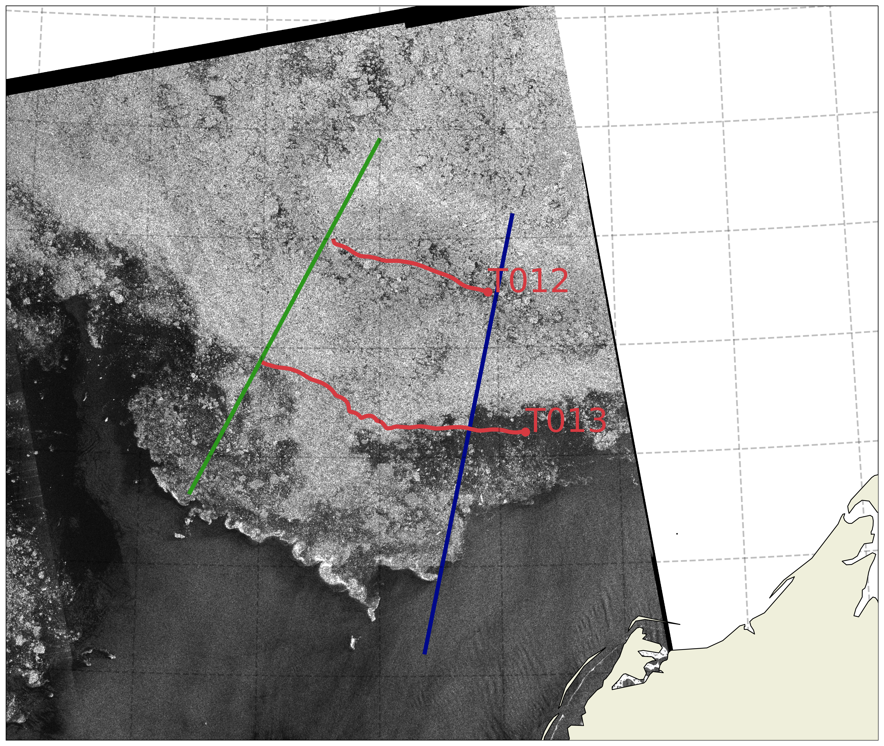
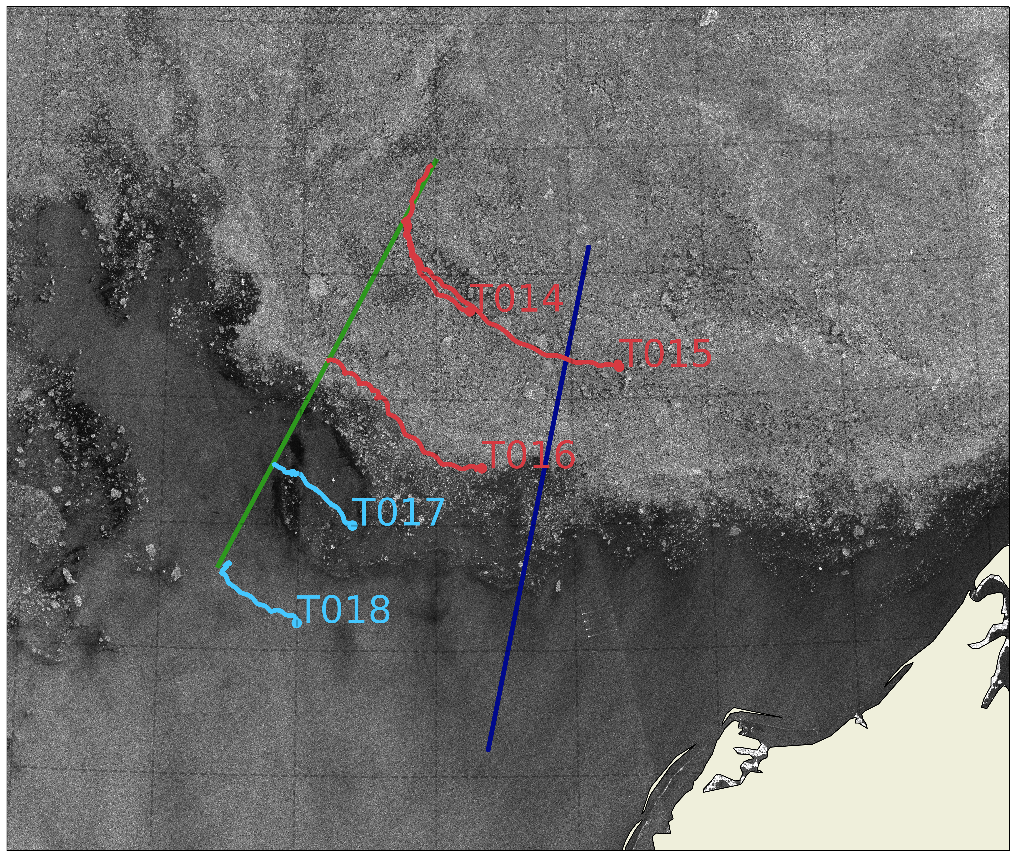
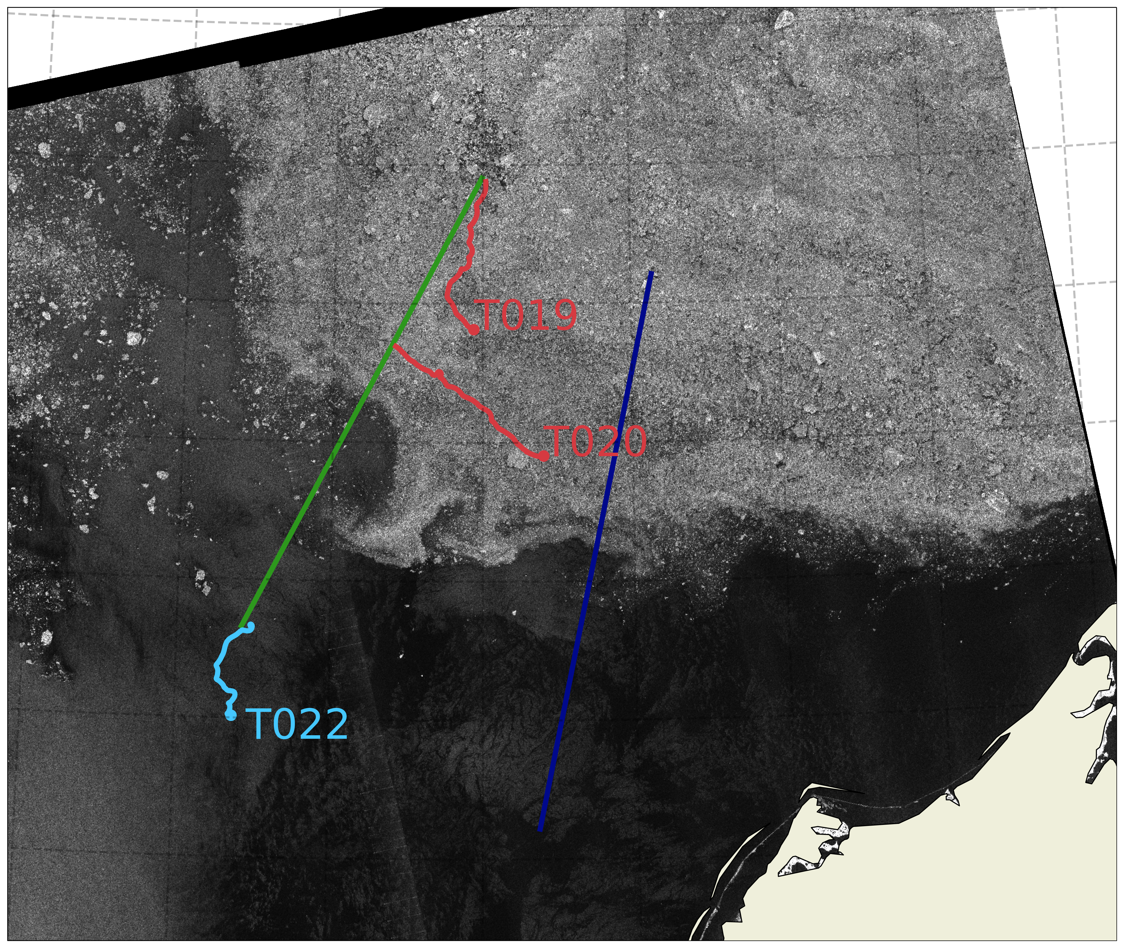
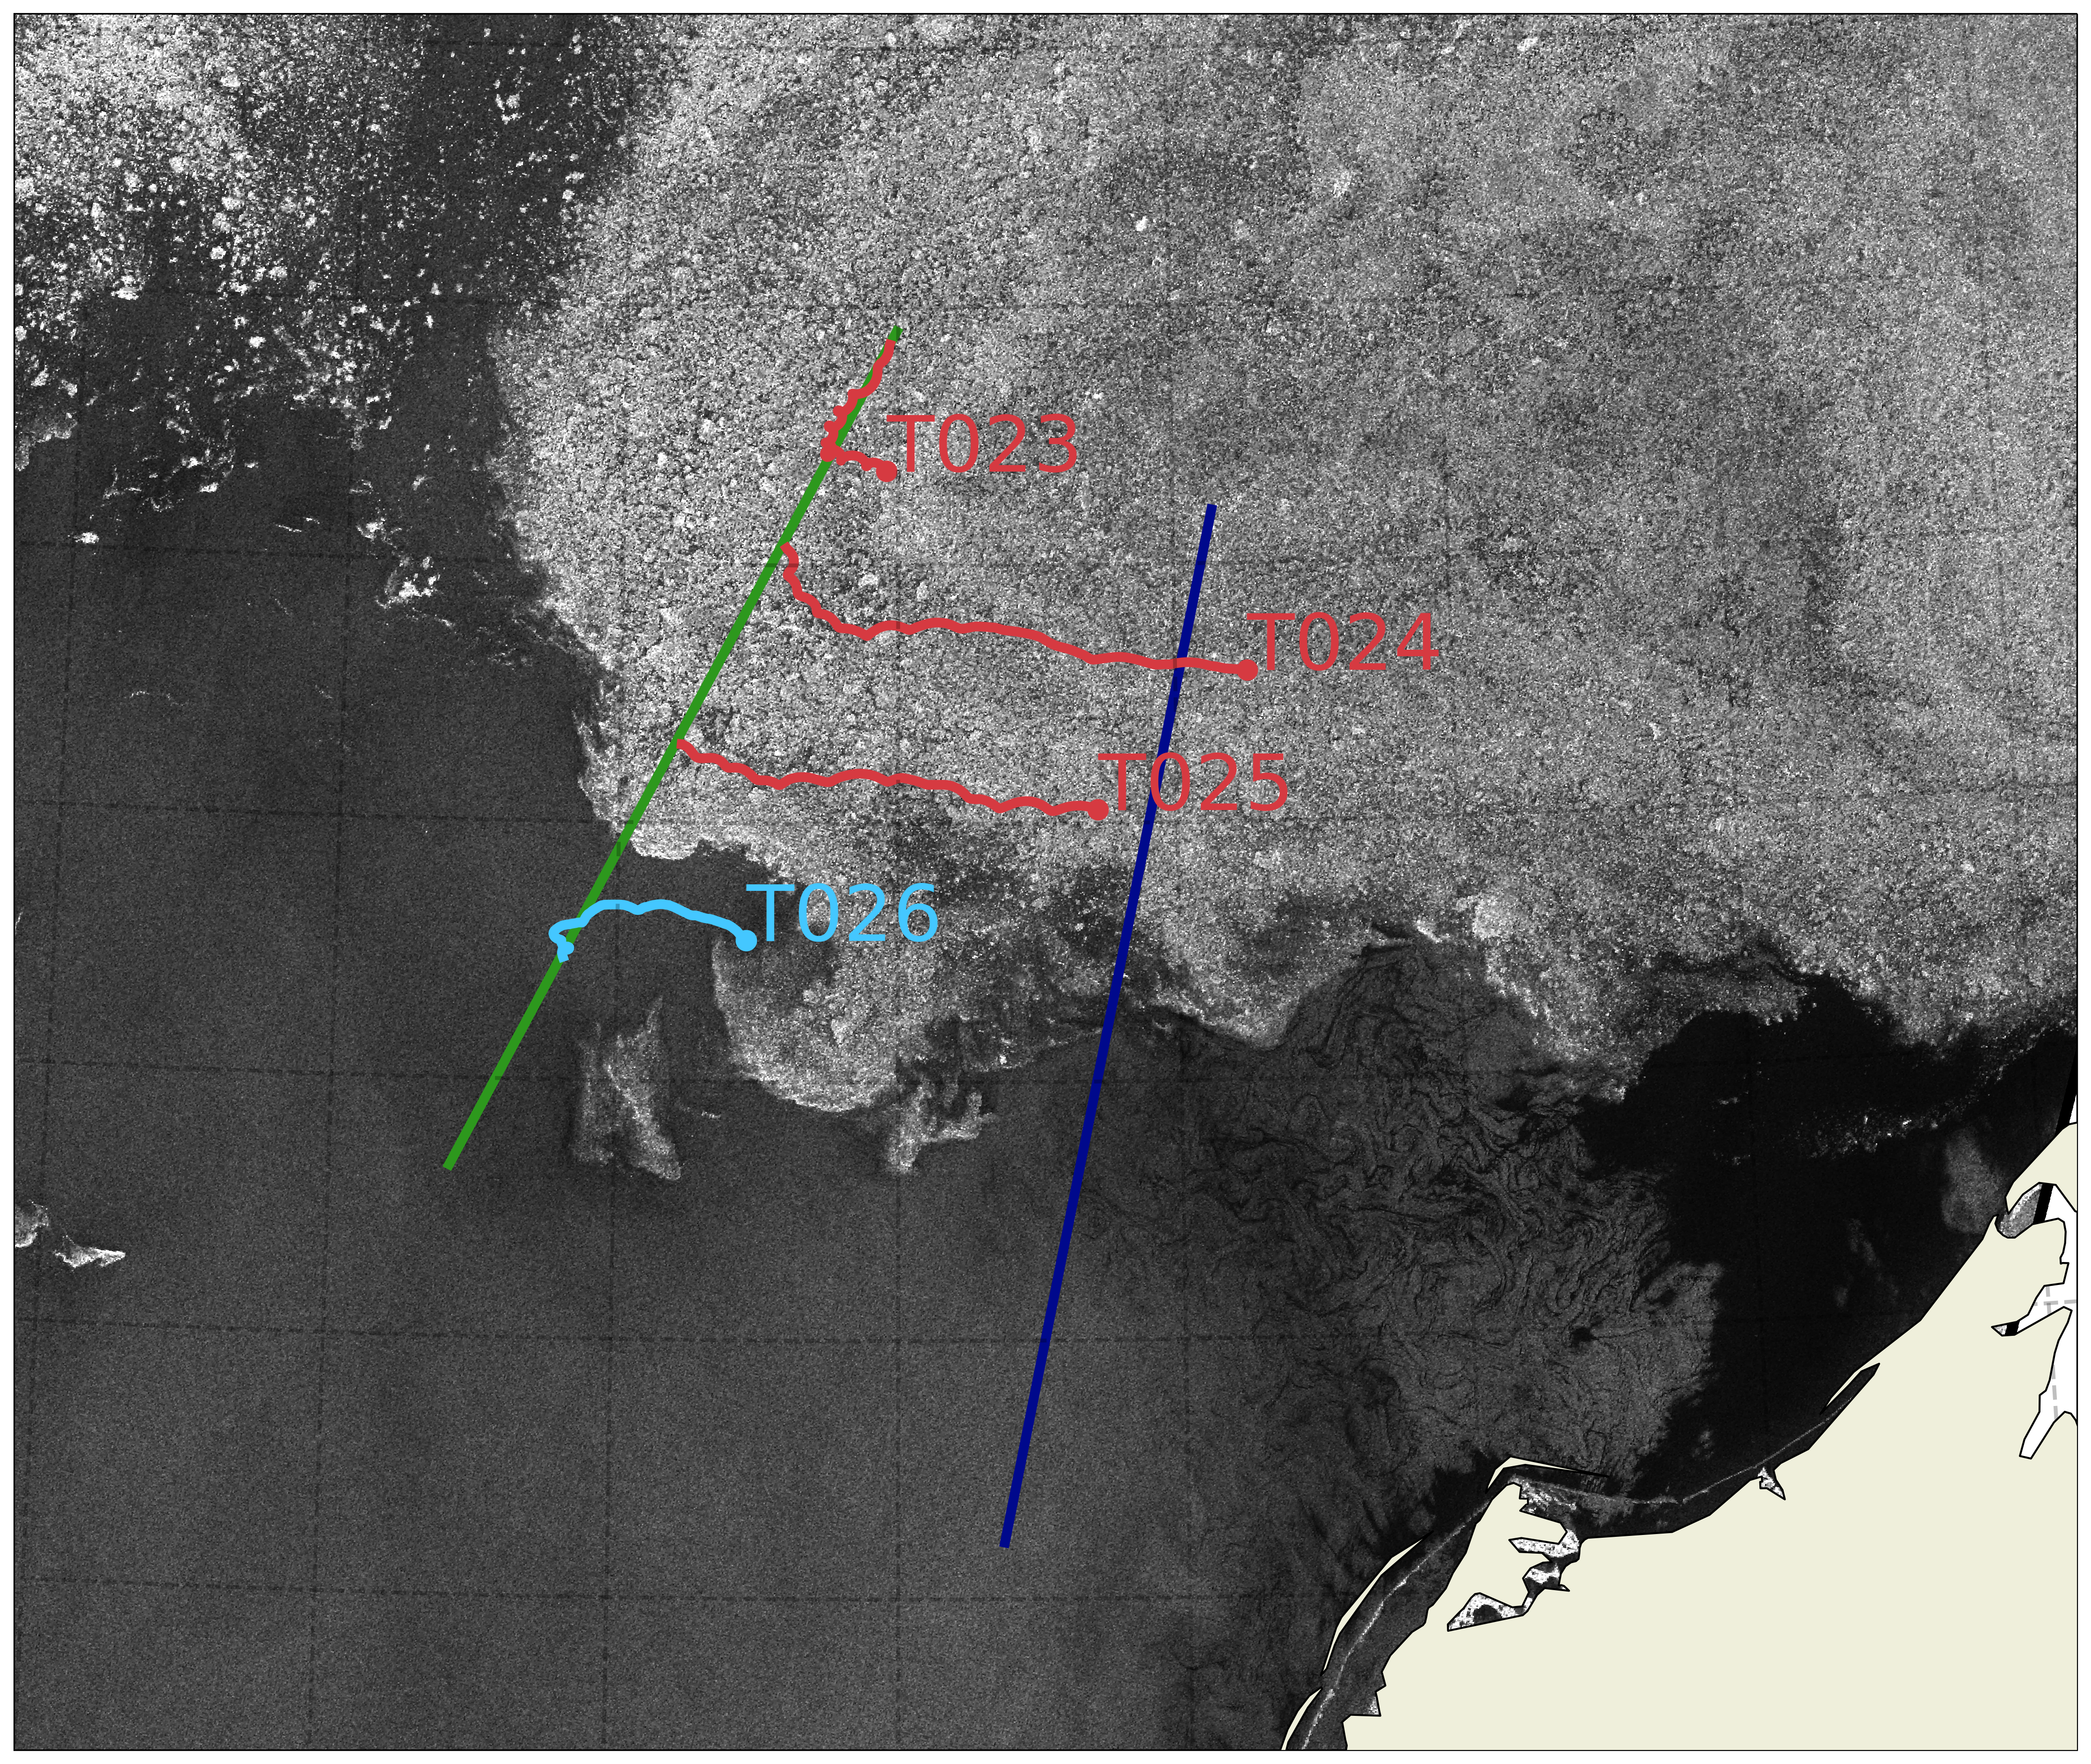
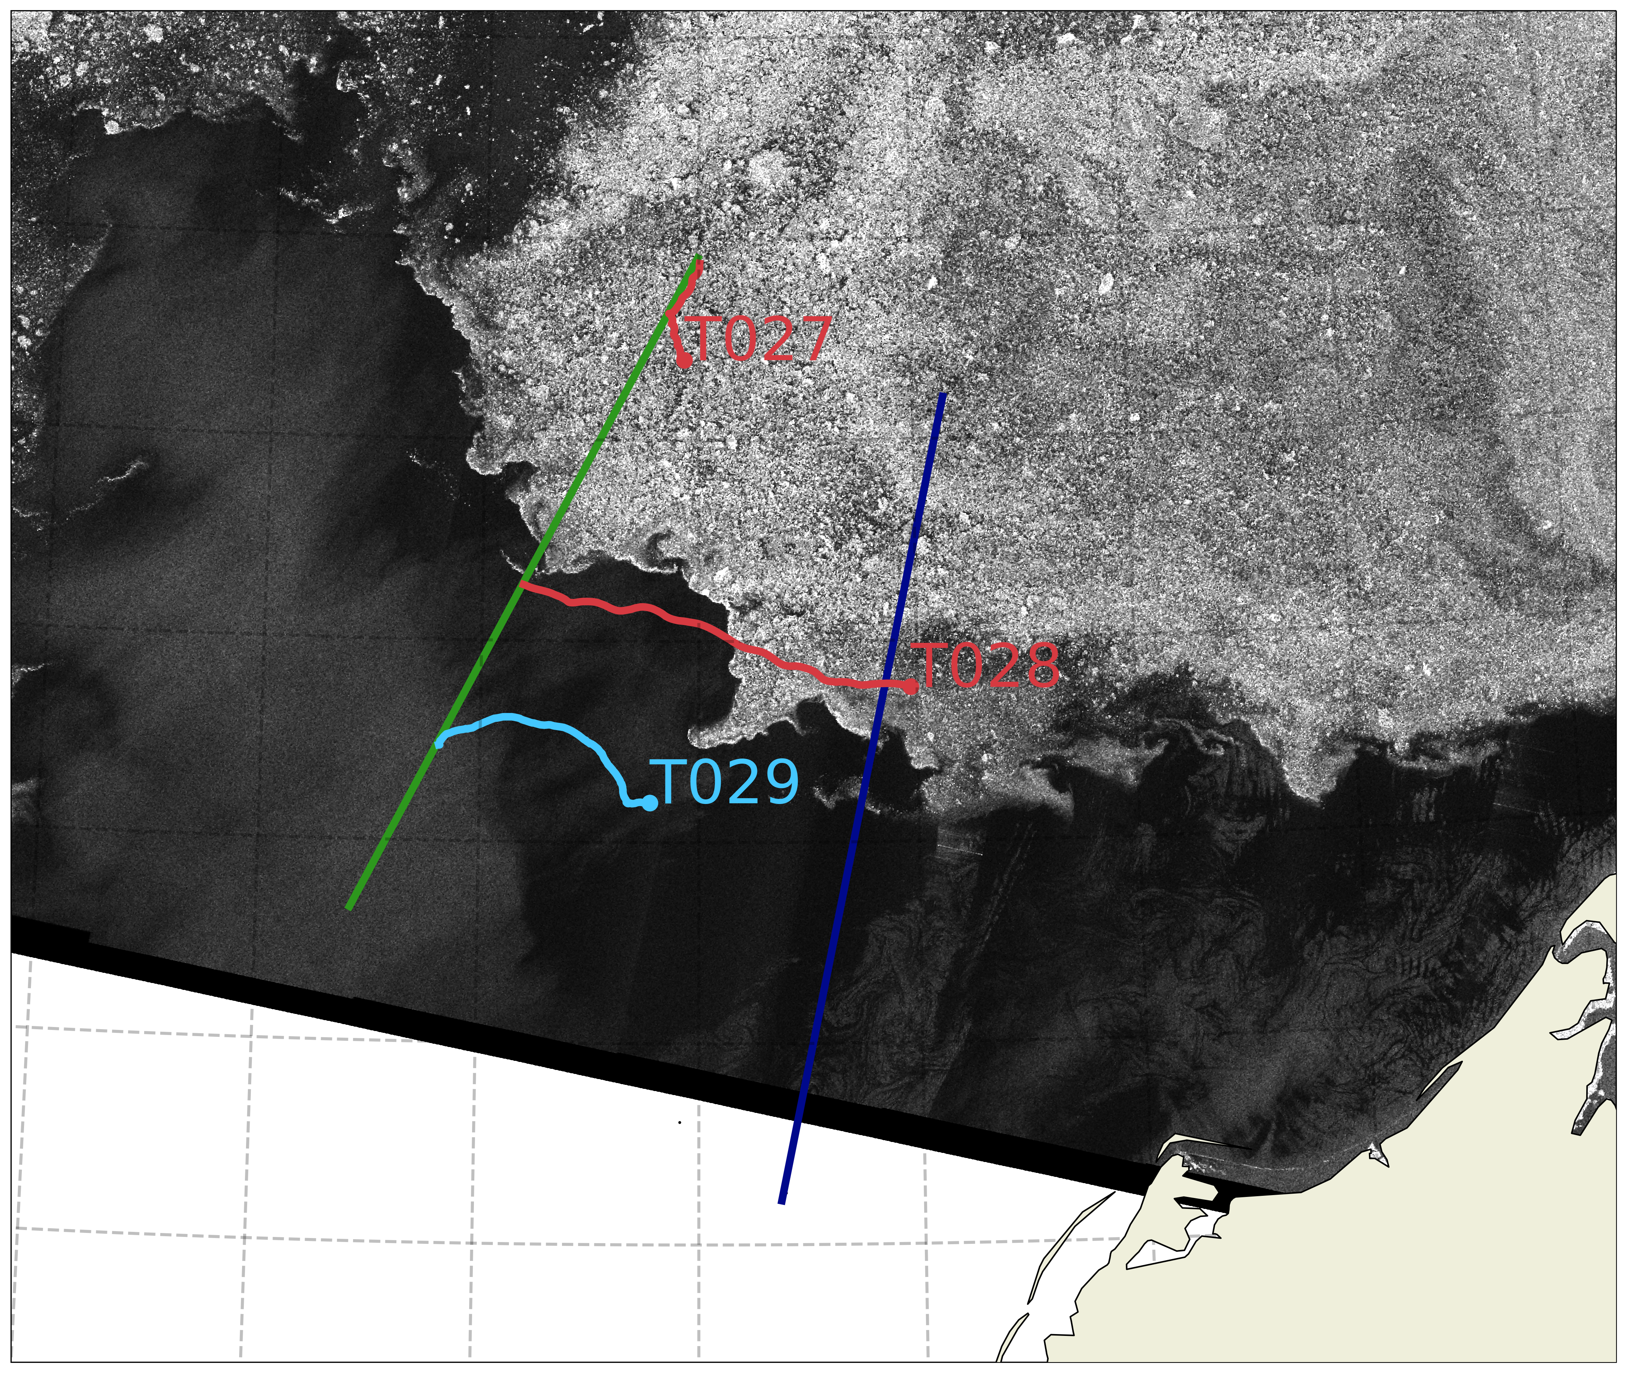
a
b
Fig 1: (A) All trap drift trajectories, colored in red if deployed in consolidated ice, yellow if deployed in the MIZ, and light blue if deployed in open water. HR and HRE transects are shown in green and dark blue, respectively. The black star marks the position of the CEO mooring. (B-H) SAR image of sea ice at the beginning of the occupation overlaid with all drift trajectories of traps deployed during the (first – seventh) occupations of the HR and HRE lines on (B) 06/25/2023 (C) 06/30/2023 (D) 07/02/2023 (E) 07/08/2023 (F) 07/13/2023 (G) 07/19/2023 (H) 07/22/2023
c
d
e
f
g
h

Slide 4
A
B
Fig 1: (A) All trap drift trajectories, colored in red if deployed in consolidated ice, yellow if deployed in the MIZ, and light blue if deployed in open water. HR and HRE transects are shown in green and dark blue, respectively. The black star marks the position of the CEO mooring. (B-H) SAR image of sea ice at the beginning of the occupation overlaid with all drift trajectories of traps deployed during the (first – seventh) occupations of the HR and HRE lines on (B) 06/25/2023 (C) 06/30/2023 (D) 07/02/2023 (E) 07/08/2023 (F) 07/13/2023 (G) 07/19/2023 (H) 07/22/2023
C
D
E
F
G
H

Slide 5
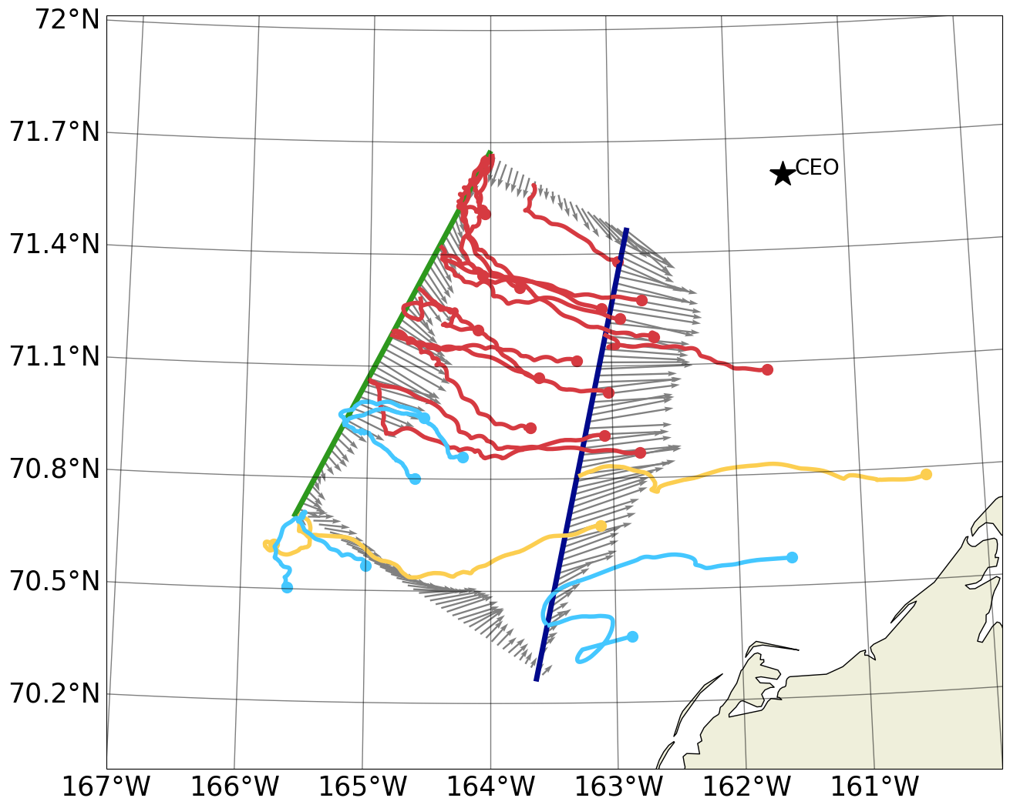

Slide 6
Table 1: Deployment and recovery dates and positions for all trap arrays deployed on the ToTS cruise, trap depths and ice conditions upon trap recovery. Tables are organized by type of deployment (free drifting or ice tethered) and by ice coverage at the deployment station.
(NOTE: Green highlight is in the front by threshold used in paper. Yellow highlight indicates additional traps that are in the front if we drop to a lower threshold (10 kg m^-4).

Slide 7
Table 2: Chl a, POC, and PON flux measurements from all trap arrays deployed on the ToTS cruise.

Slide 8
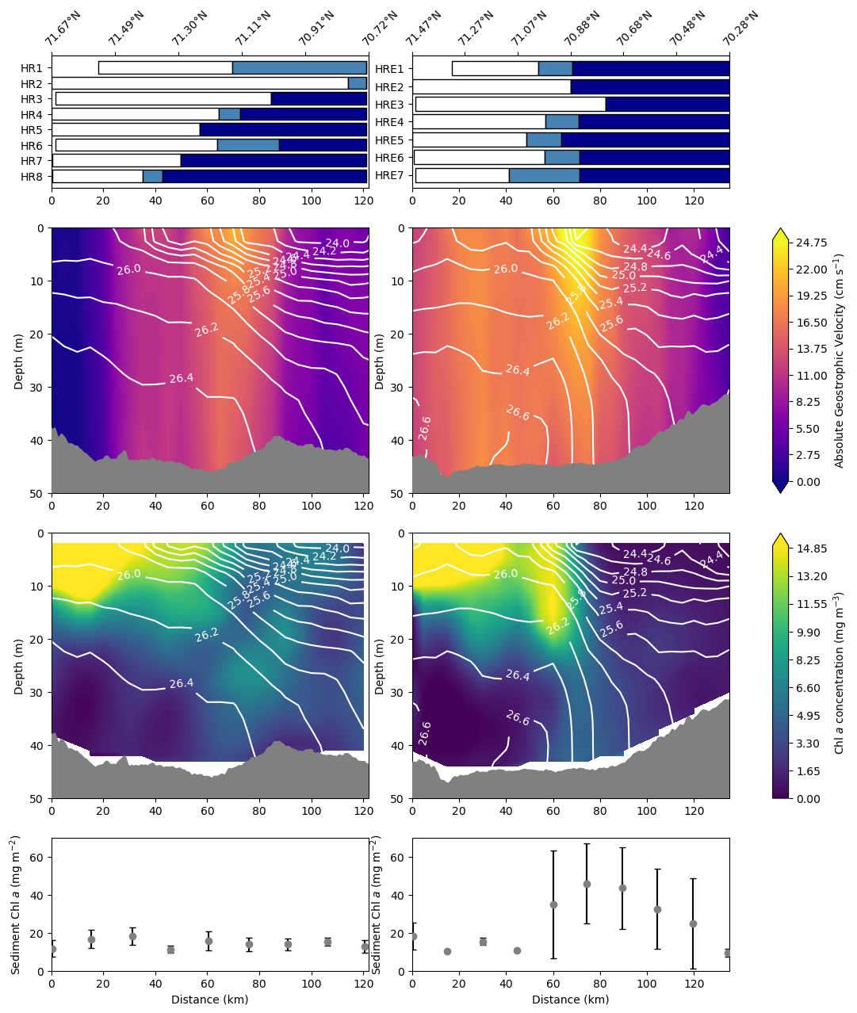
a
b
c
d
e
f
g
h

Slide 9
A
B
C
D
E
F
G
H

Slide 10
Figure 2: Sea ice coverage from 8 transits of the HR line (A) and 7 transits of the HRE line (B). White indicates consolidated (>85%) sea ice coverage, light blue indicates MIZ conditions, and dark blue indicates open water (<15% sea ice). Latitude is indicated on the upper axis and distance in km from the northernmost point on each transect is indicated on the bottom axis. Mean sections of absolute geostrophic velocity from 8 transits of the HR line (C) and the HRE line (D) overlaid with potential density contours in white. Mean sections of bottle measured Chl a from 8 transits of the HR line (E) and seven transits of the HRE line (F), both overlaid with potential density contours in white. Mean sediment Chl a concentration from from 8 transits of the HR line (G) and the HRE line (H). Error bars indicate one standard deviation.

Slide 11
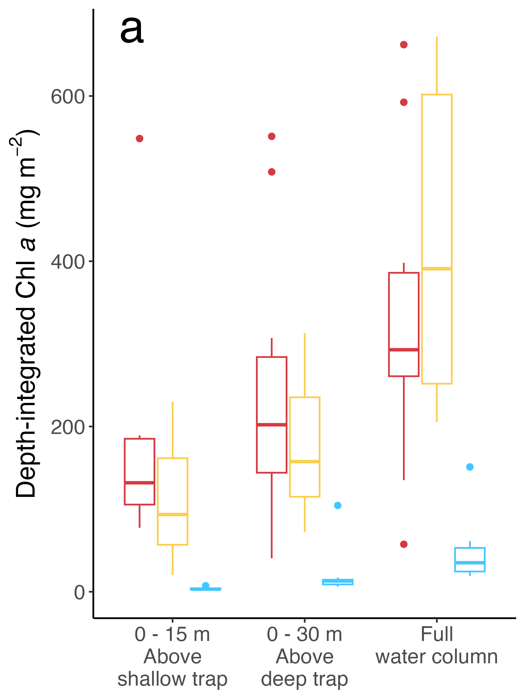
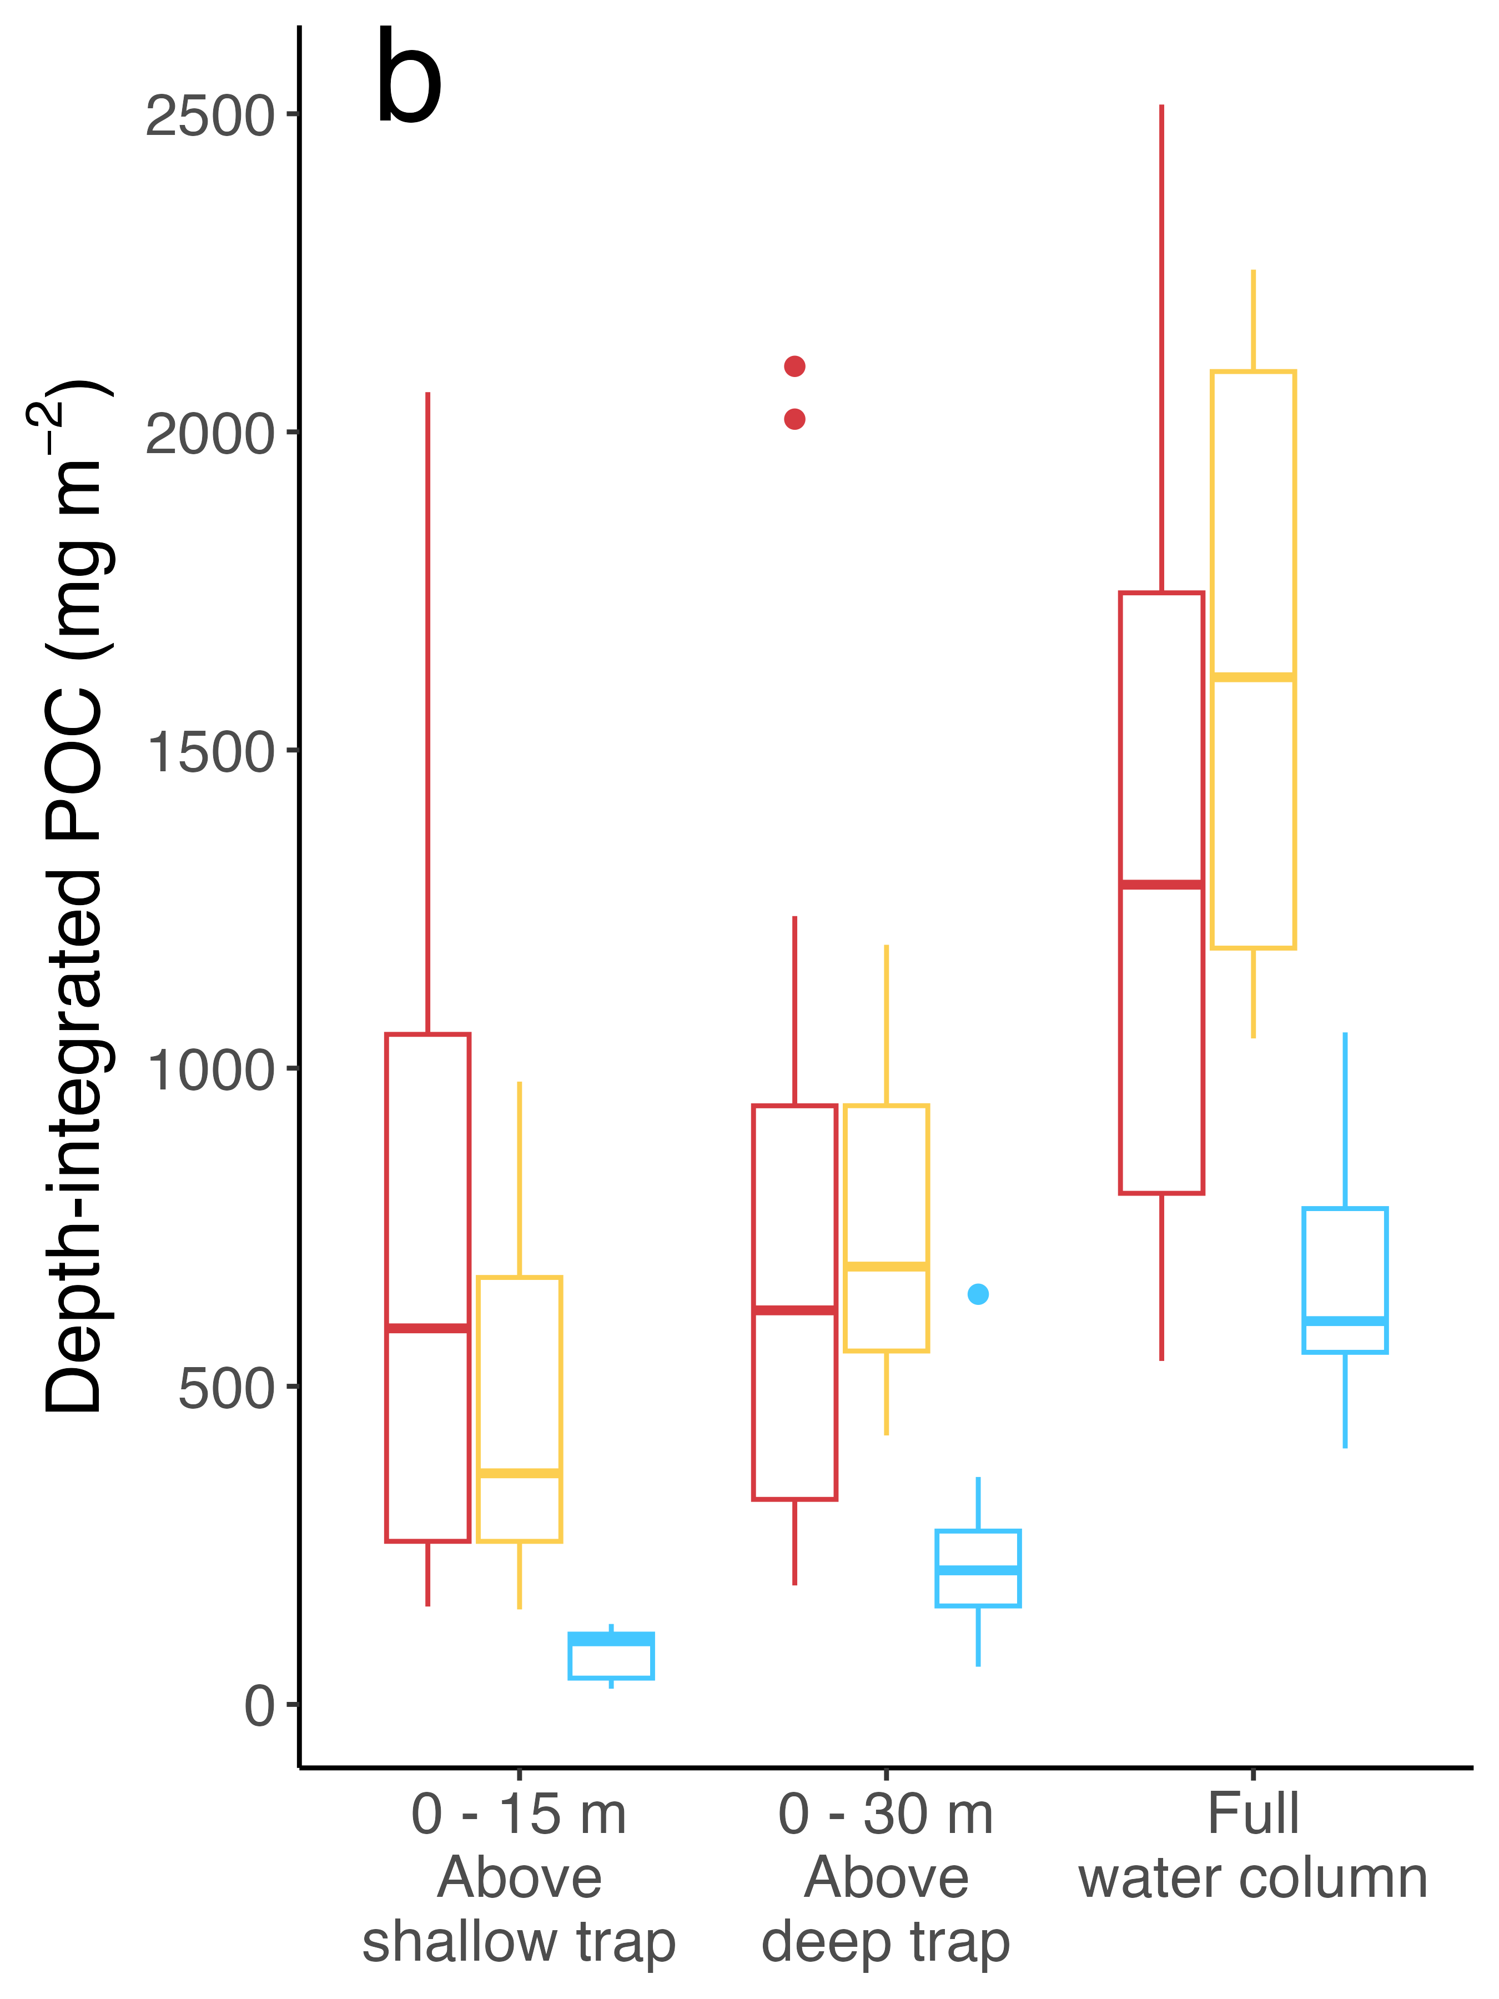
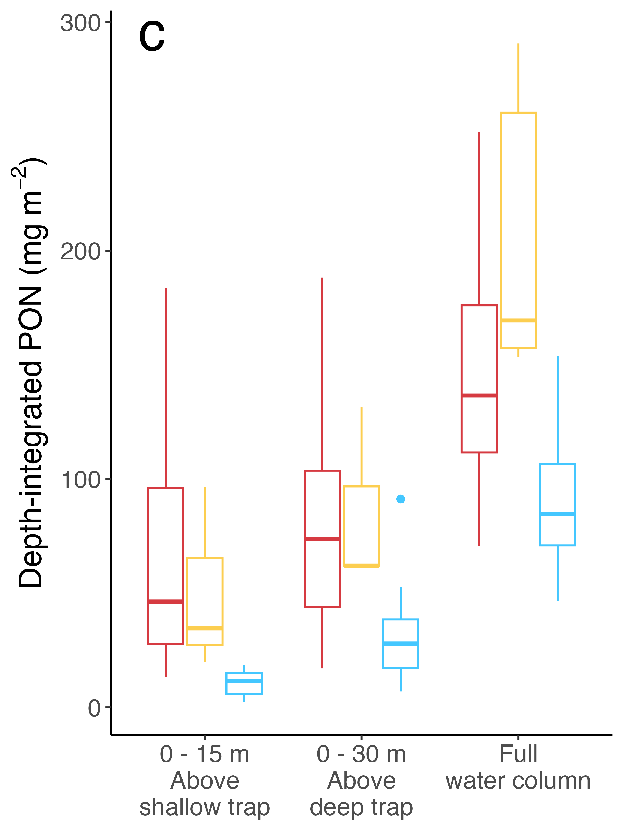
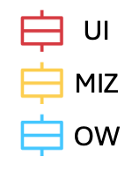
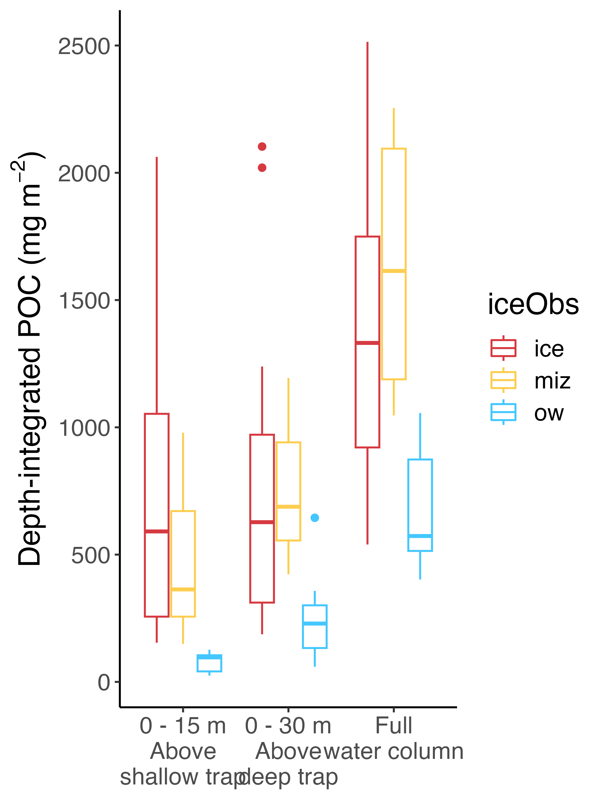
UI
MIZ
OW
Fig. 3: Depth-integrated (A) Chl a, (B) POC, and (C) PON by integration depth. UI stations are shown in blue, MIZ stations are shown in yellow, and OW stations are shown in red
NEEDS LEGEND: Blue UI, yellow MIZ, red OW
NEEDS ABC labels for panels

Slide 12
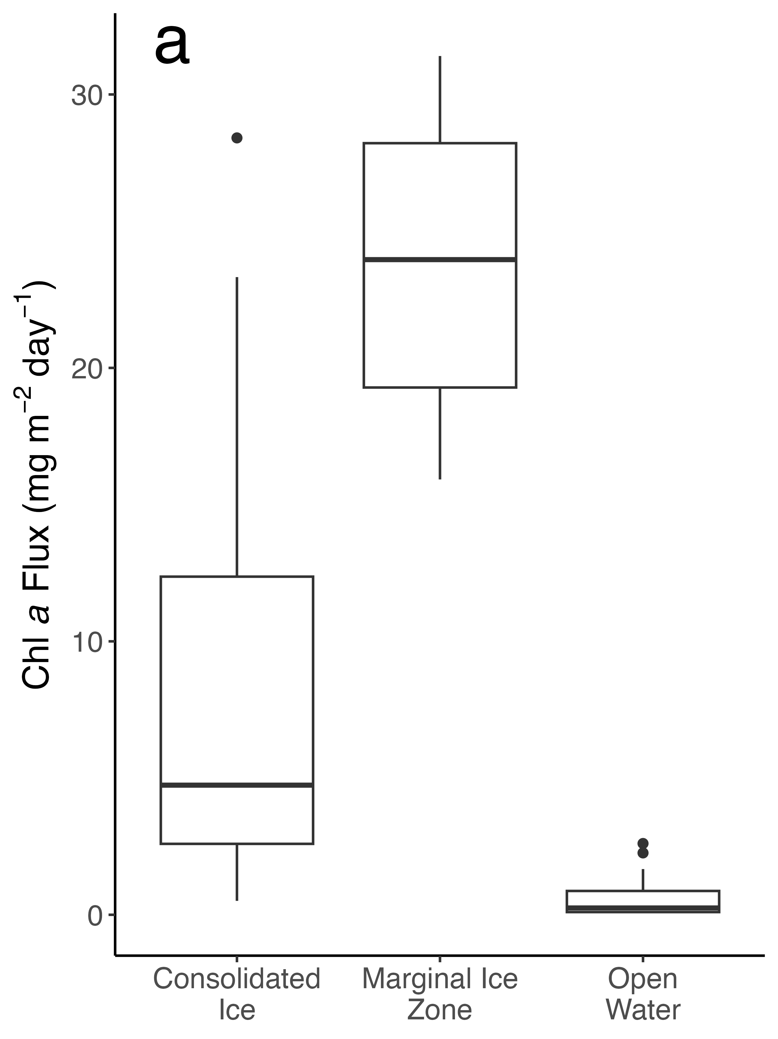
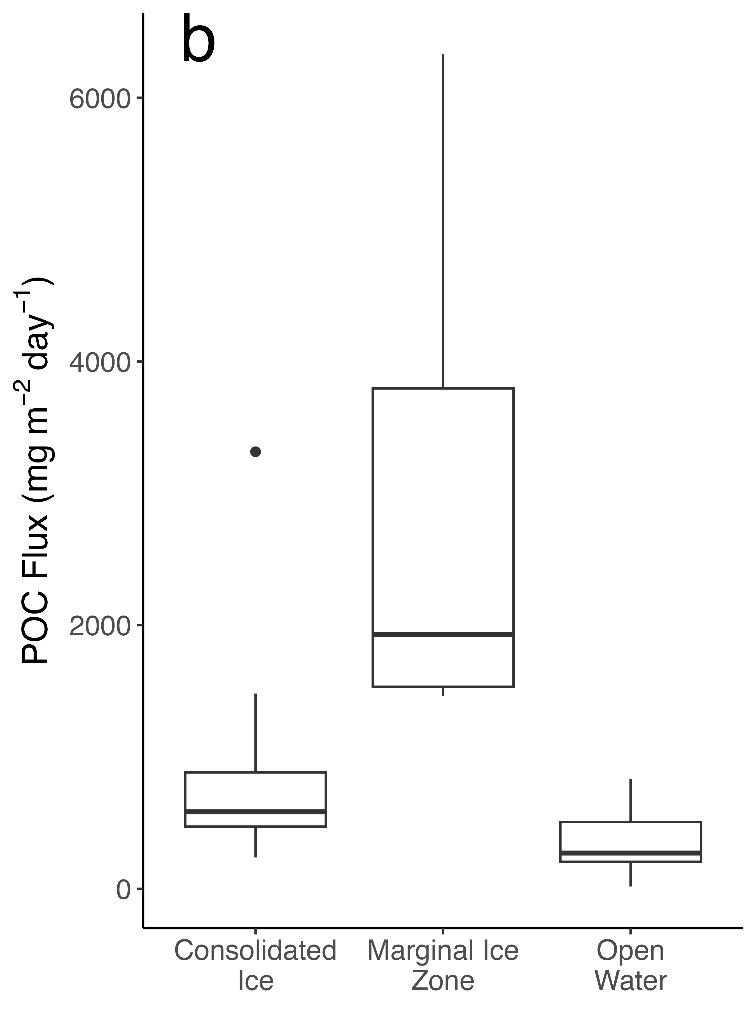
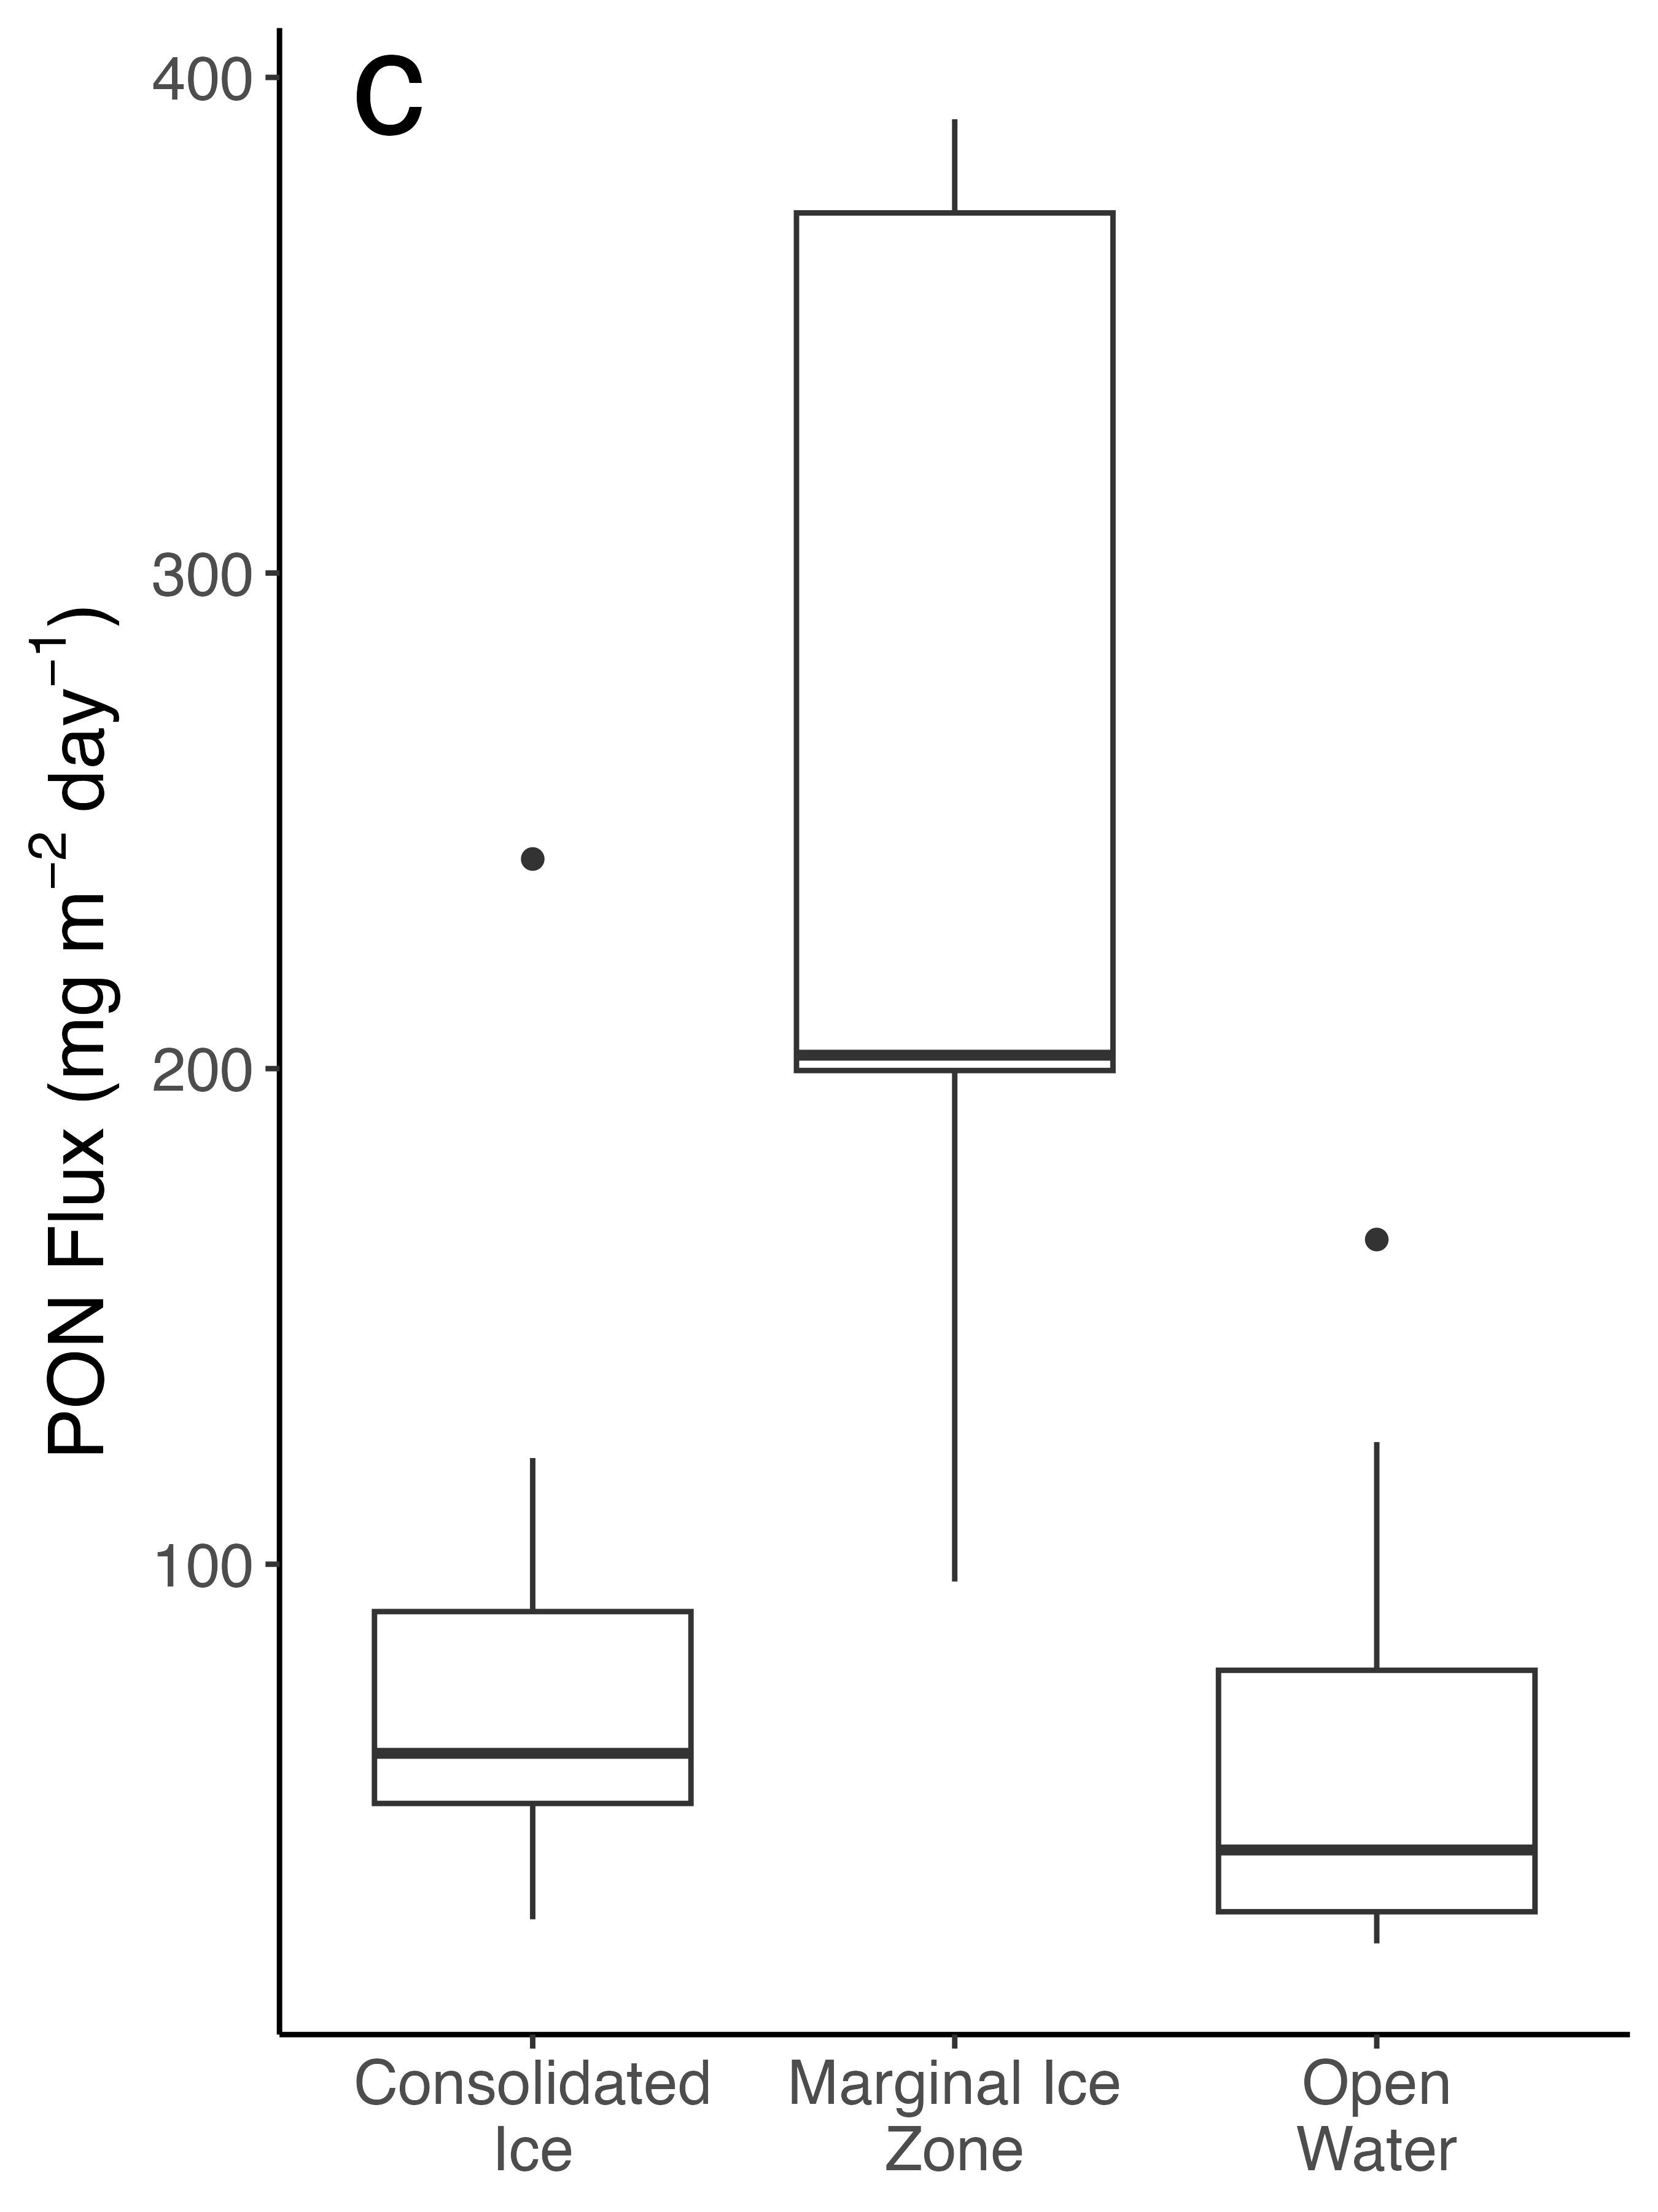
Fig 4: Export fluxes of Chl a (A), POC (B), and PON (C) from traps deployed in consolidated ice, the MIZ, and in open water. Traps at all depths are pooled.

Slide 13
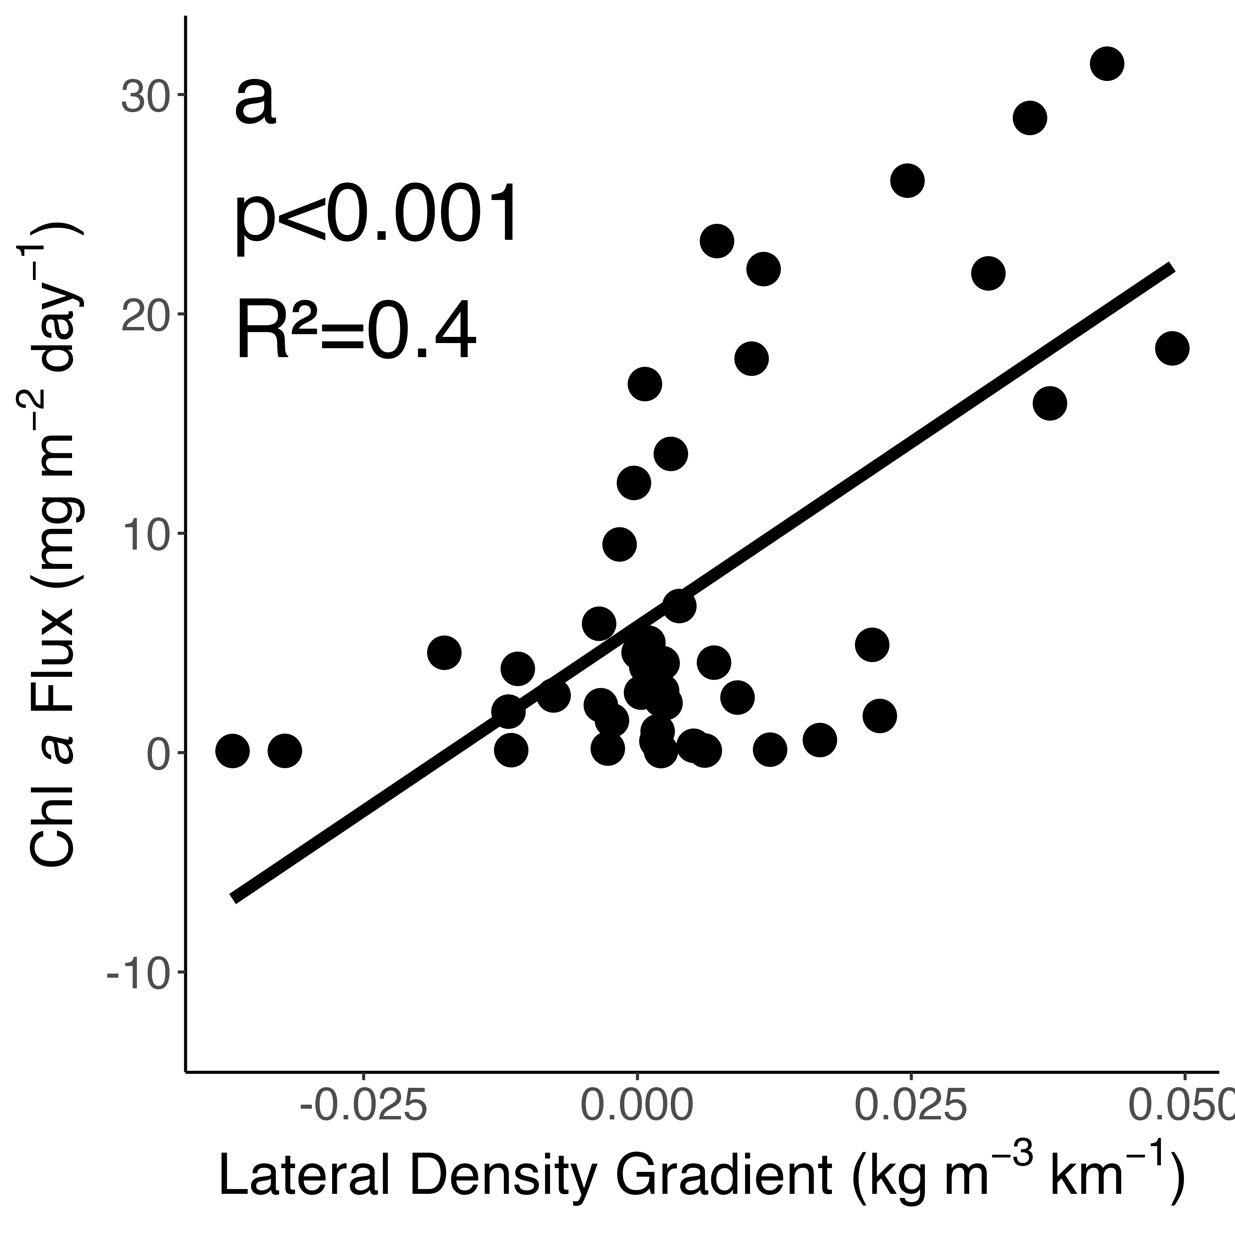
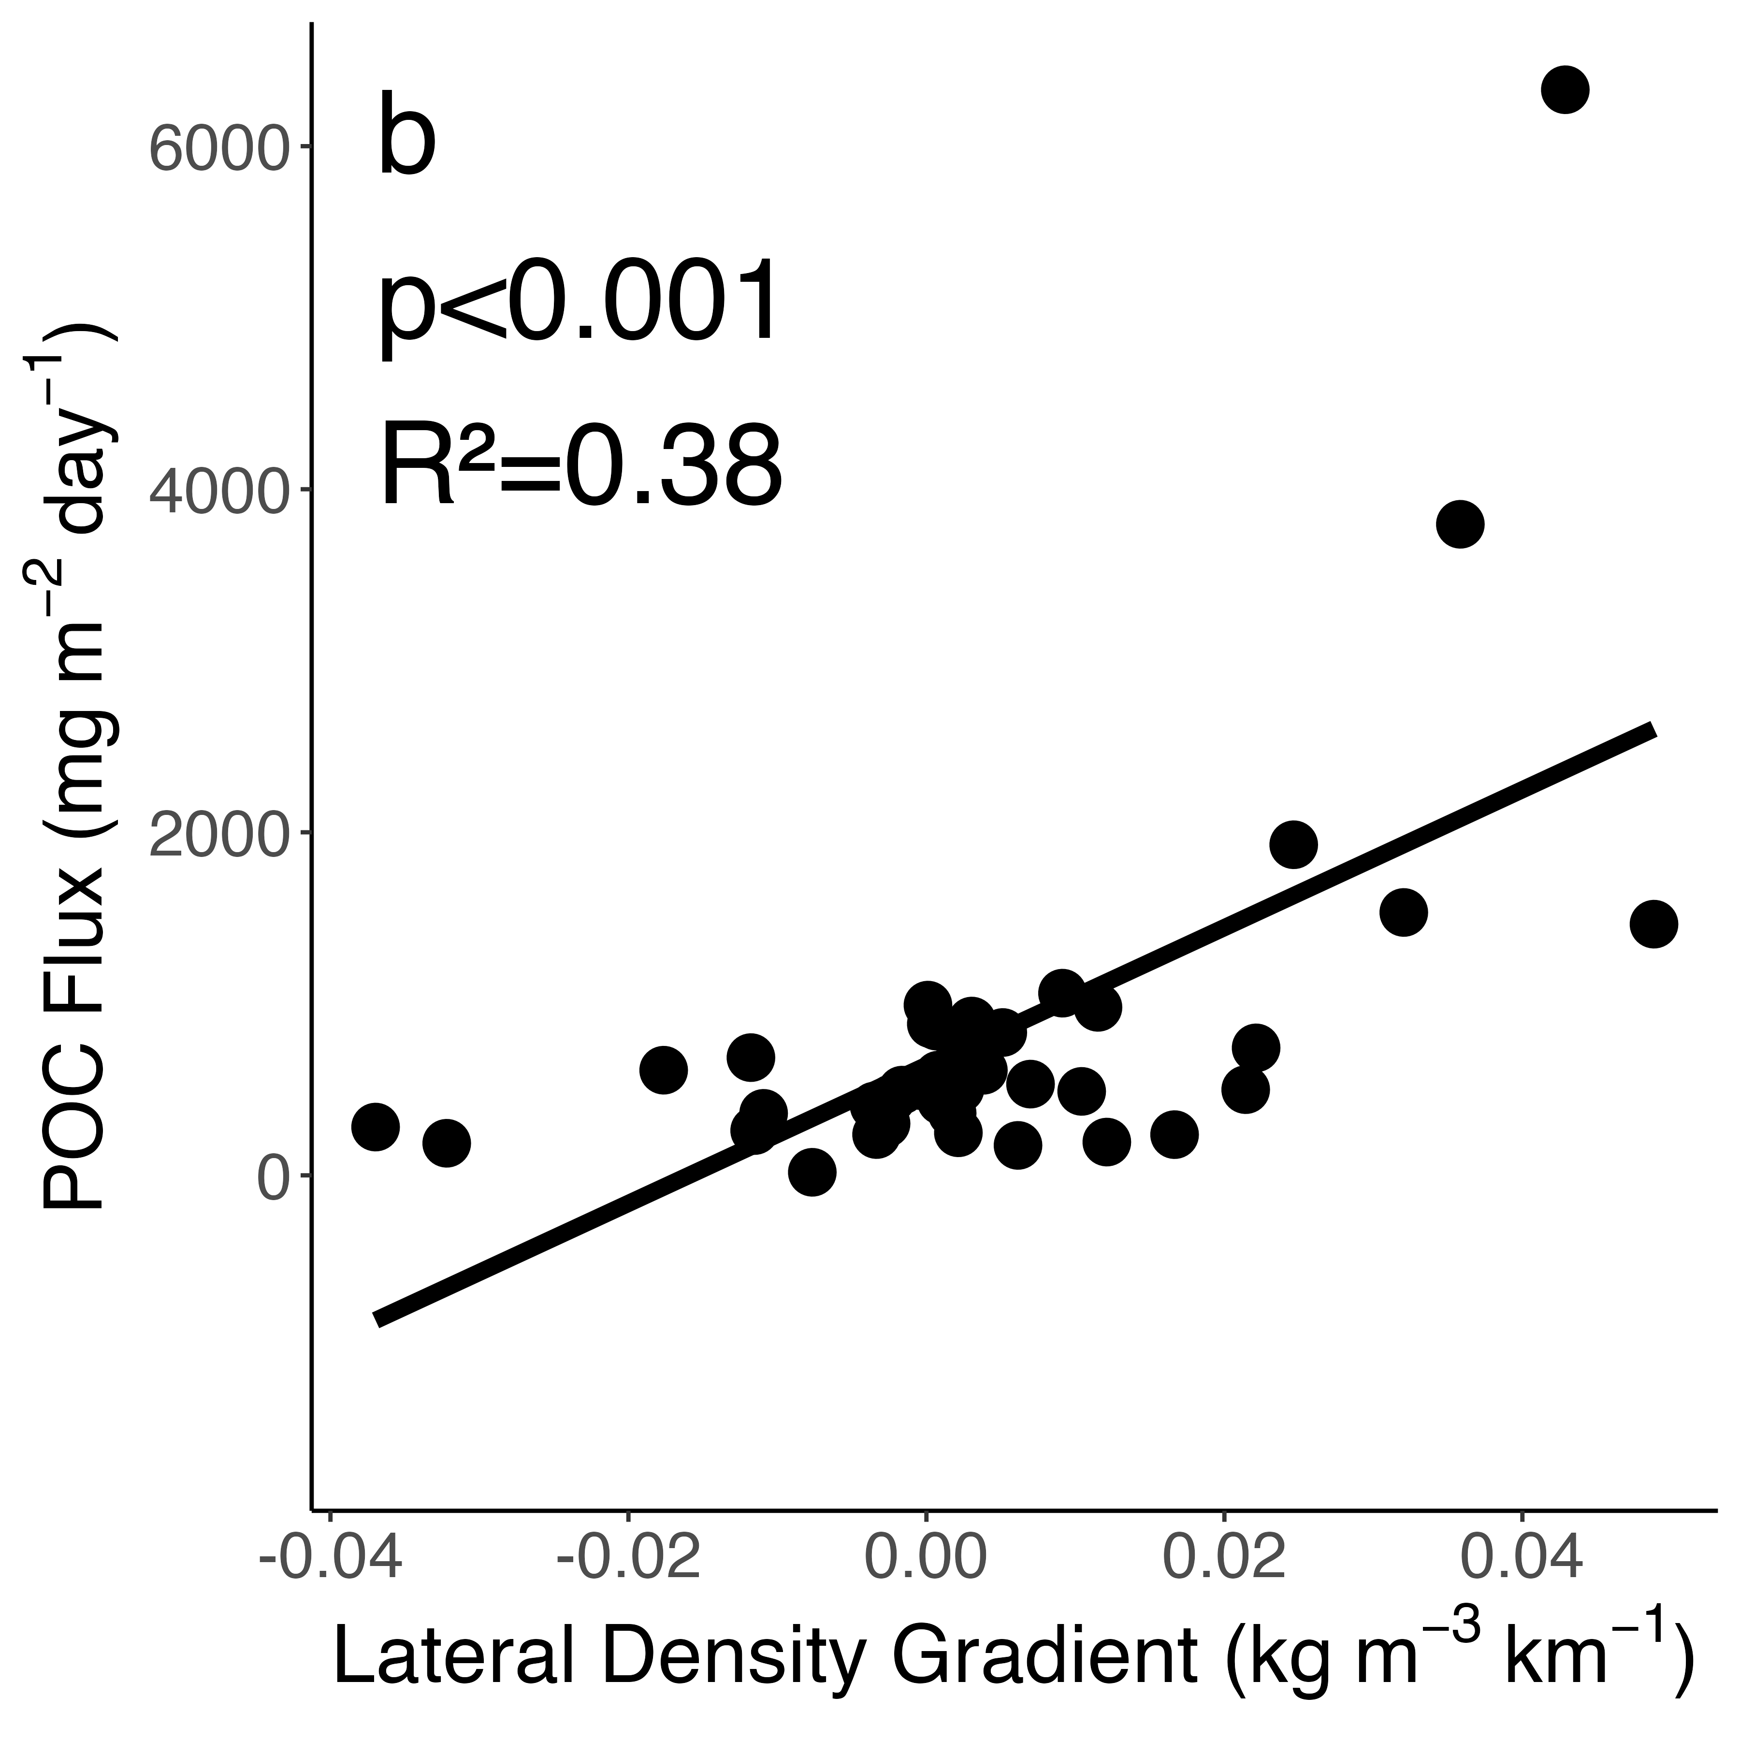
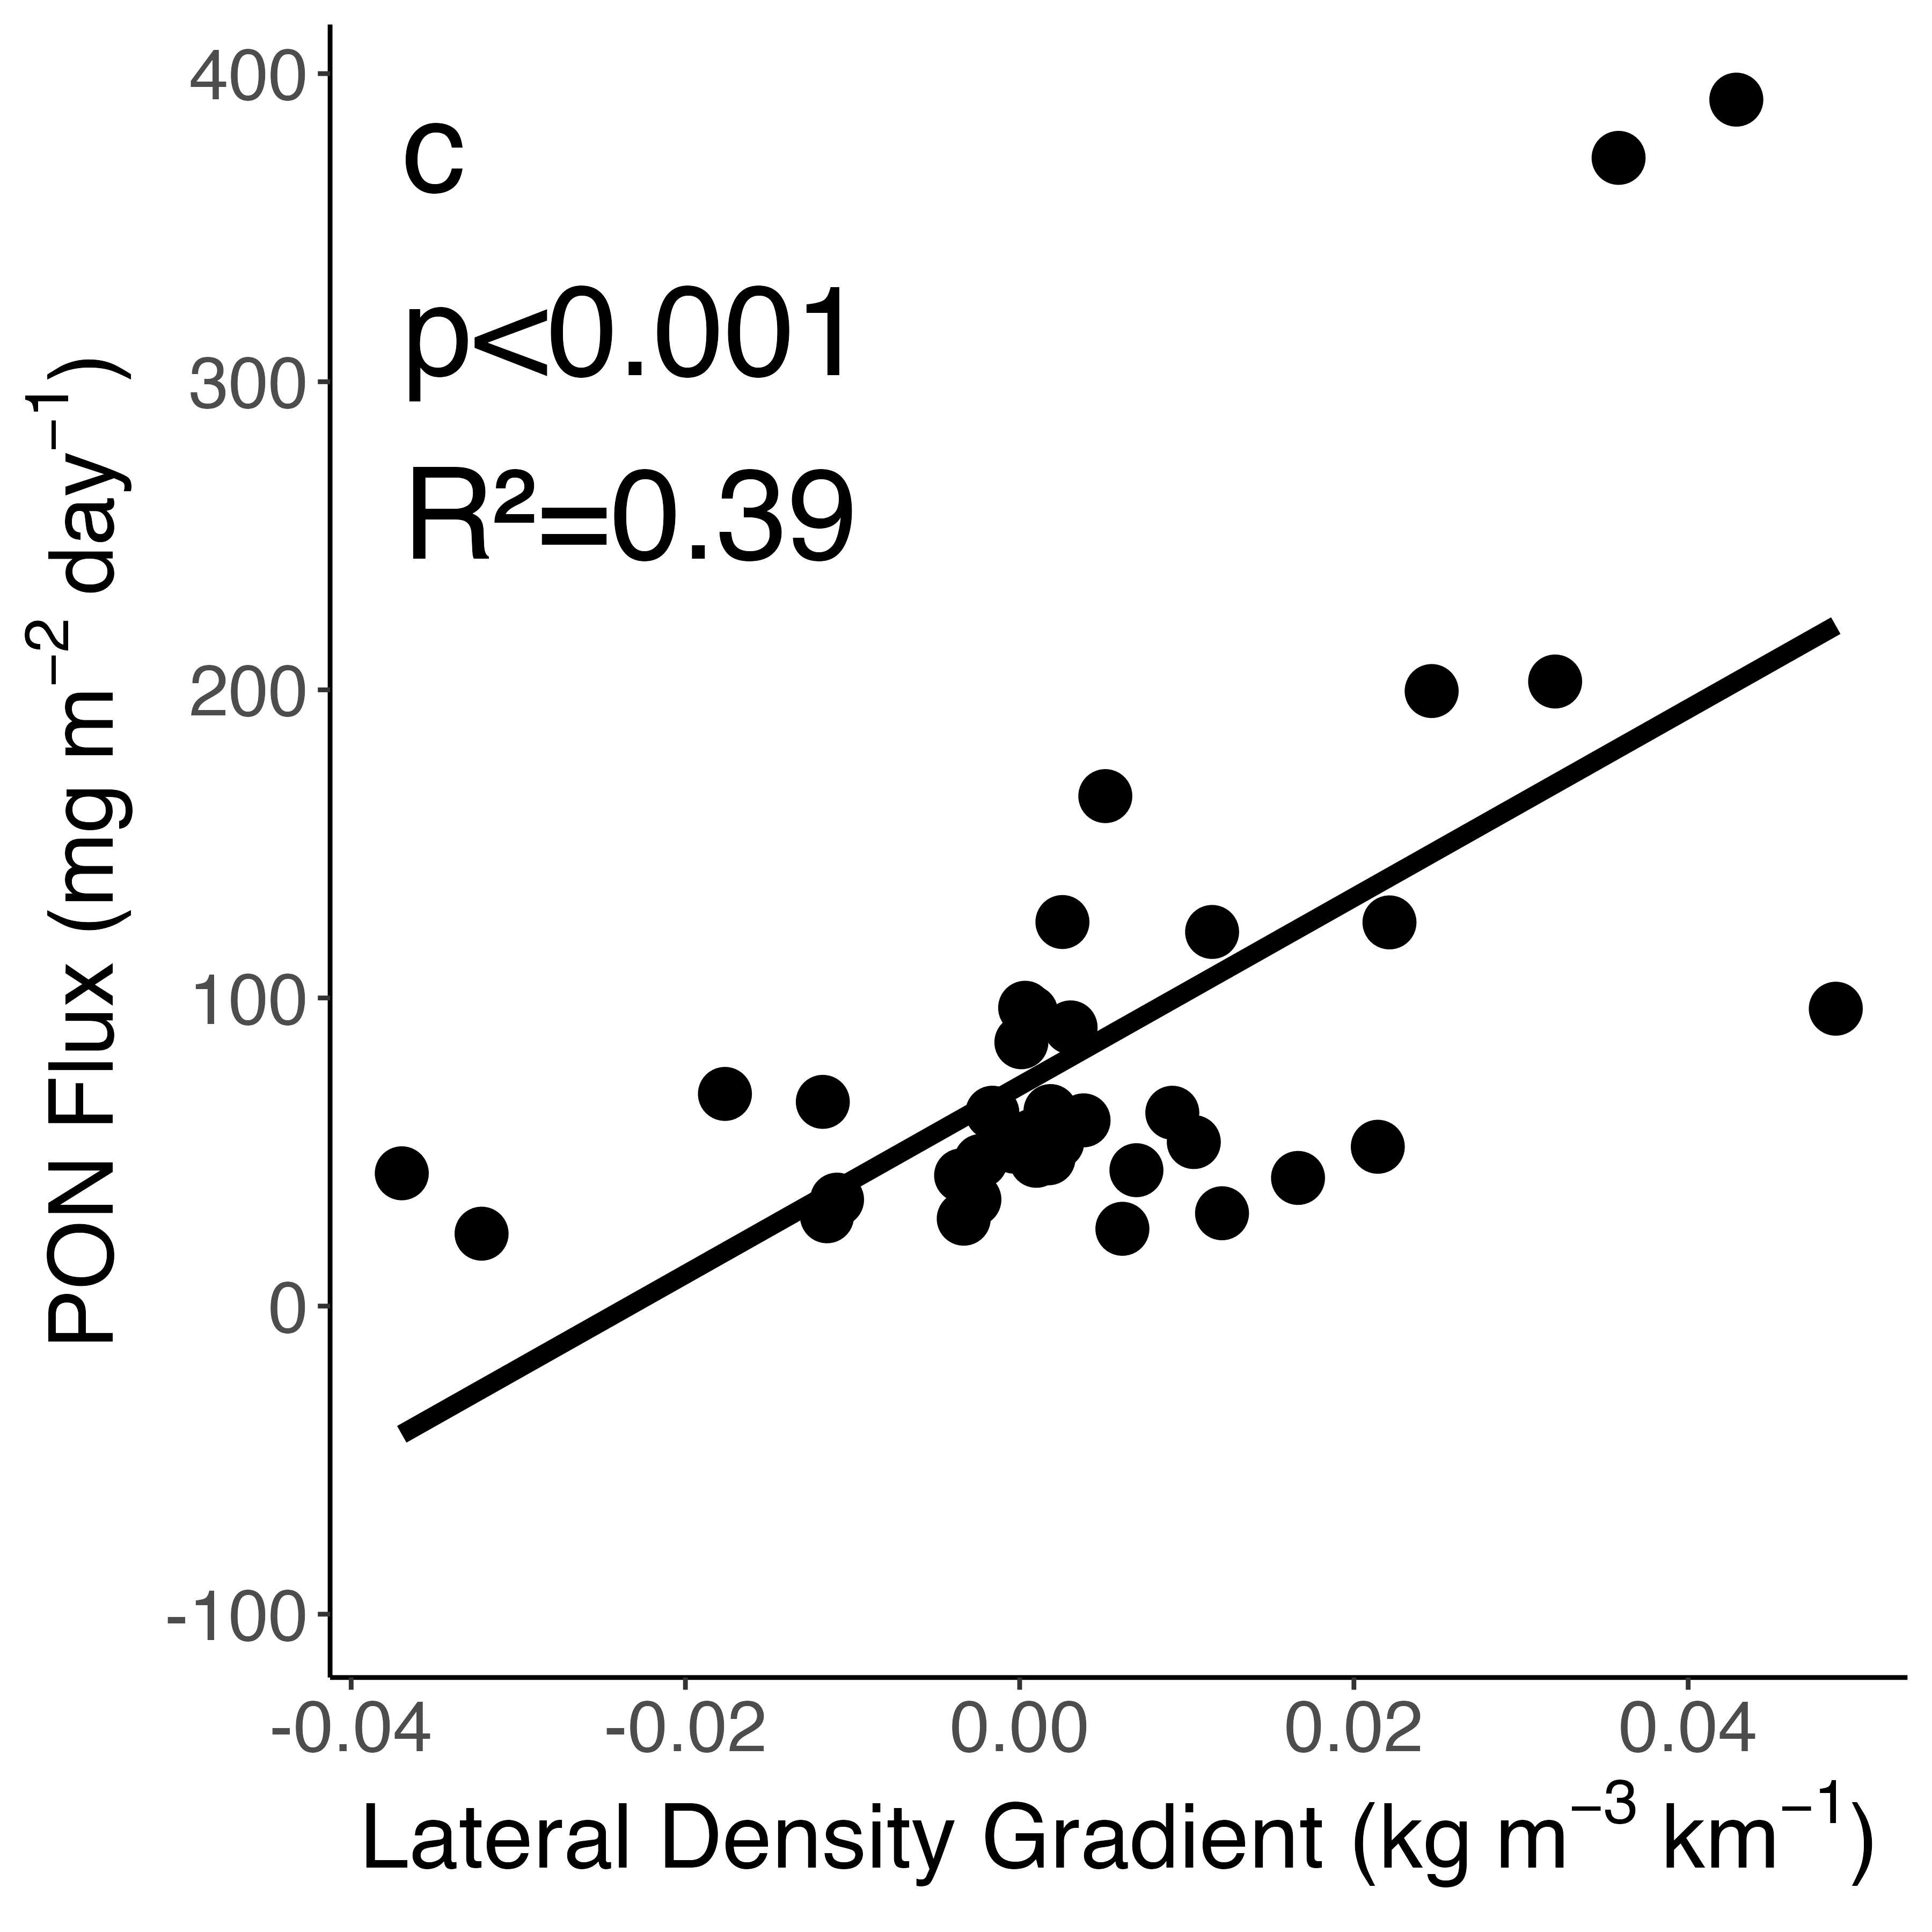
Figure 5: Measured fluxes of Chl a (A), POC (B), and PON (C) plotted against the vertical mean from the surface to the trap depth of the potential density gradient along the HR or HRE transect at the point of trap deployment. Results of a simple linear regression are shown on each plot.

Slide 14
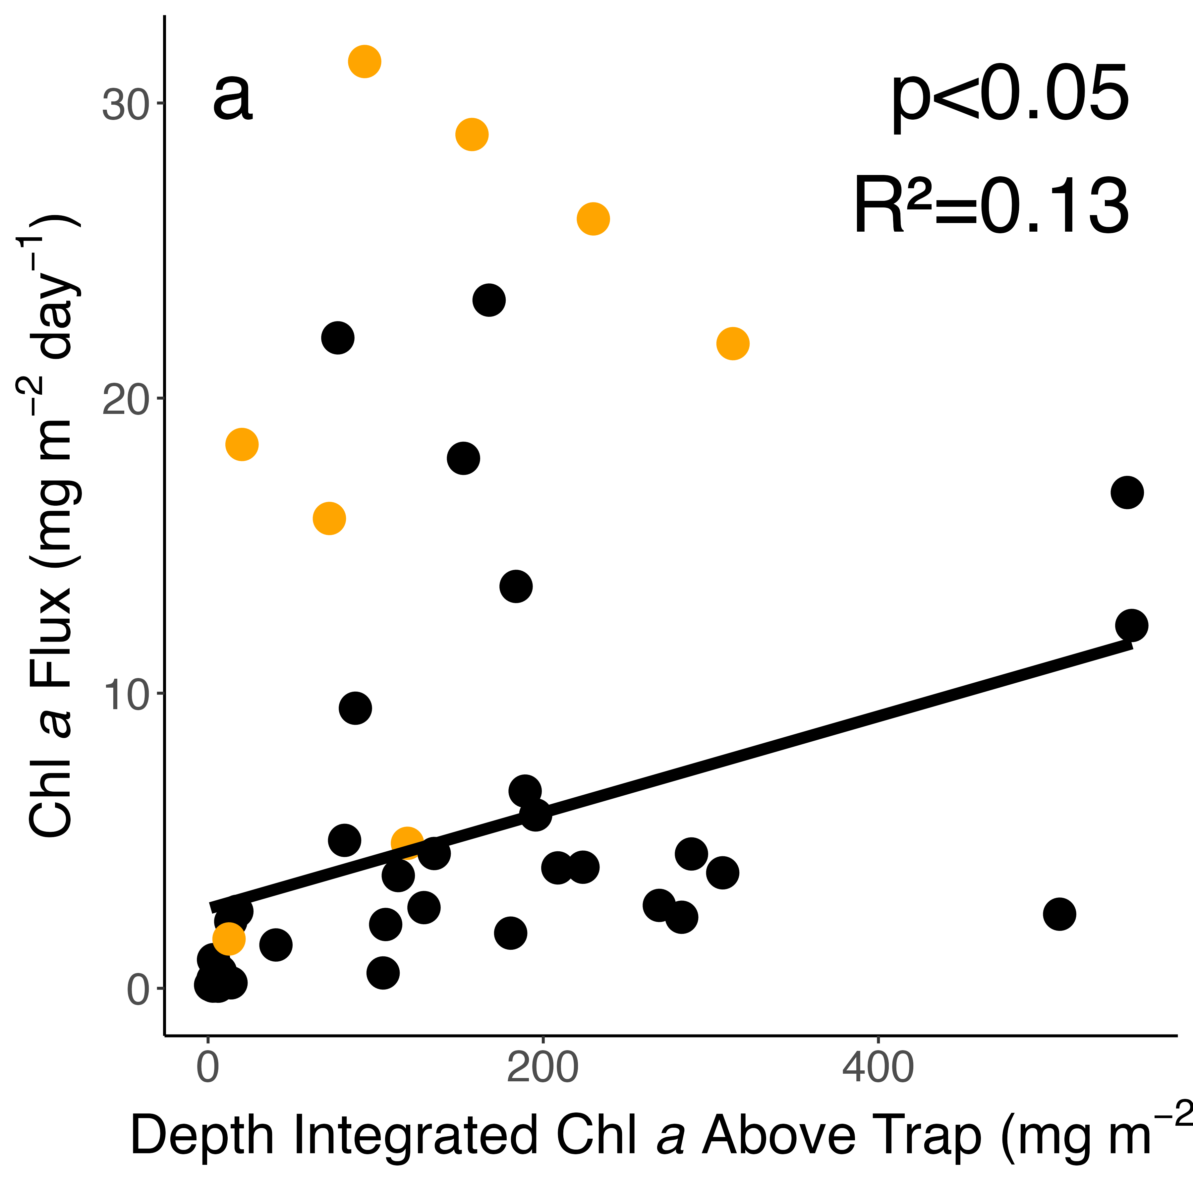
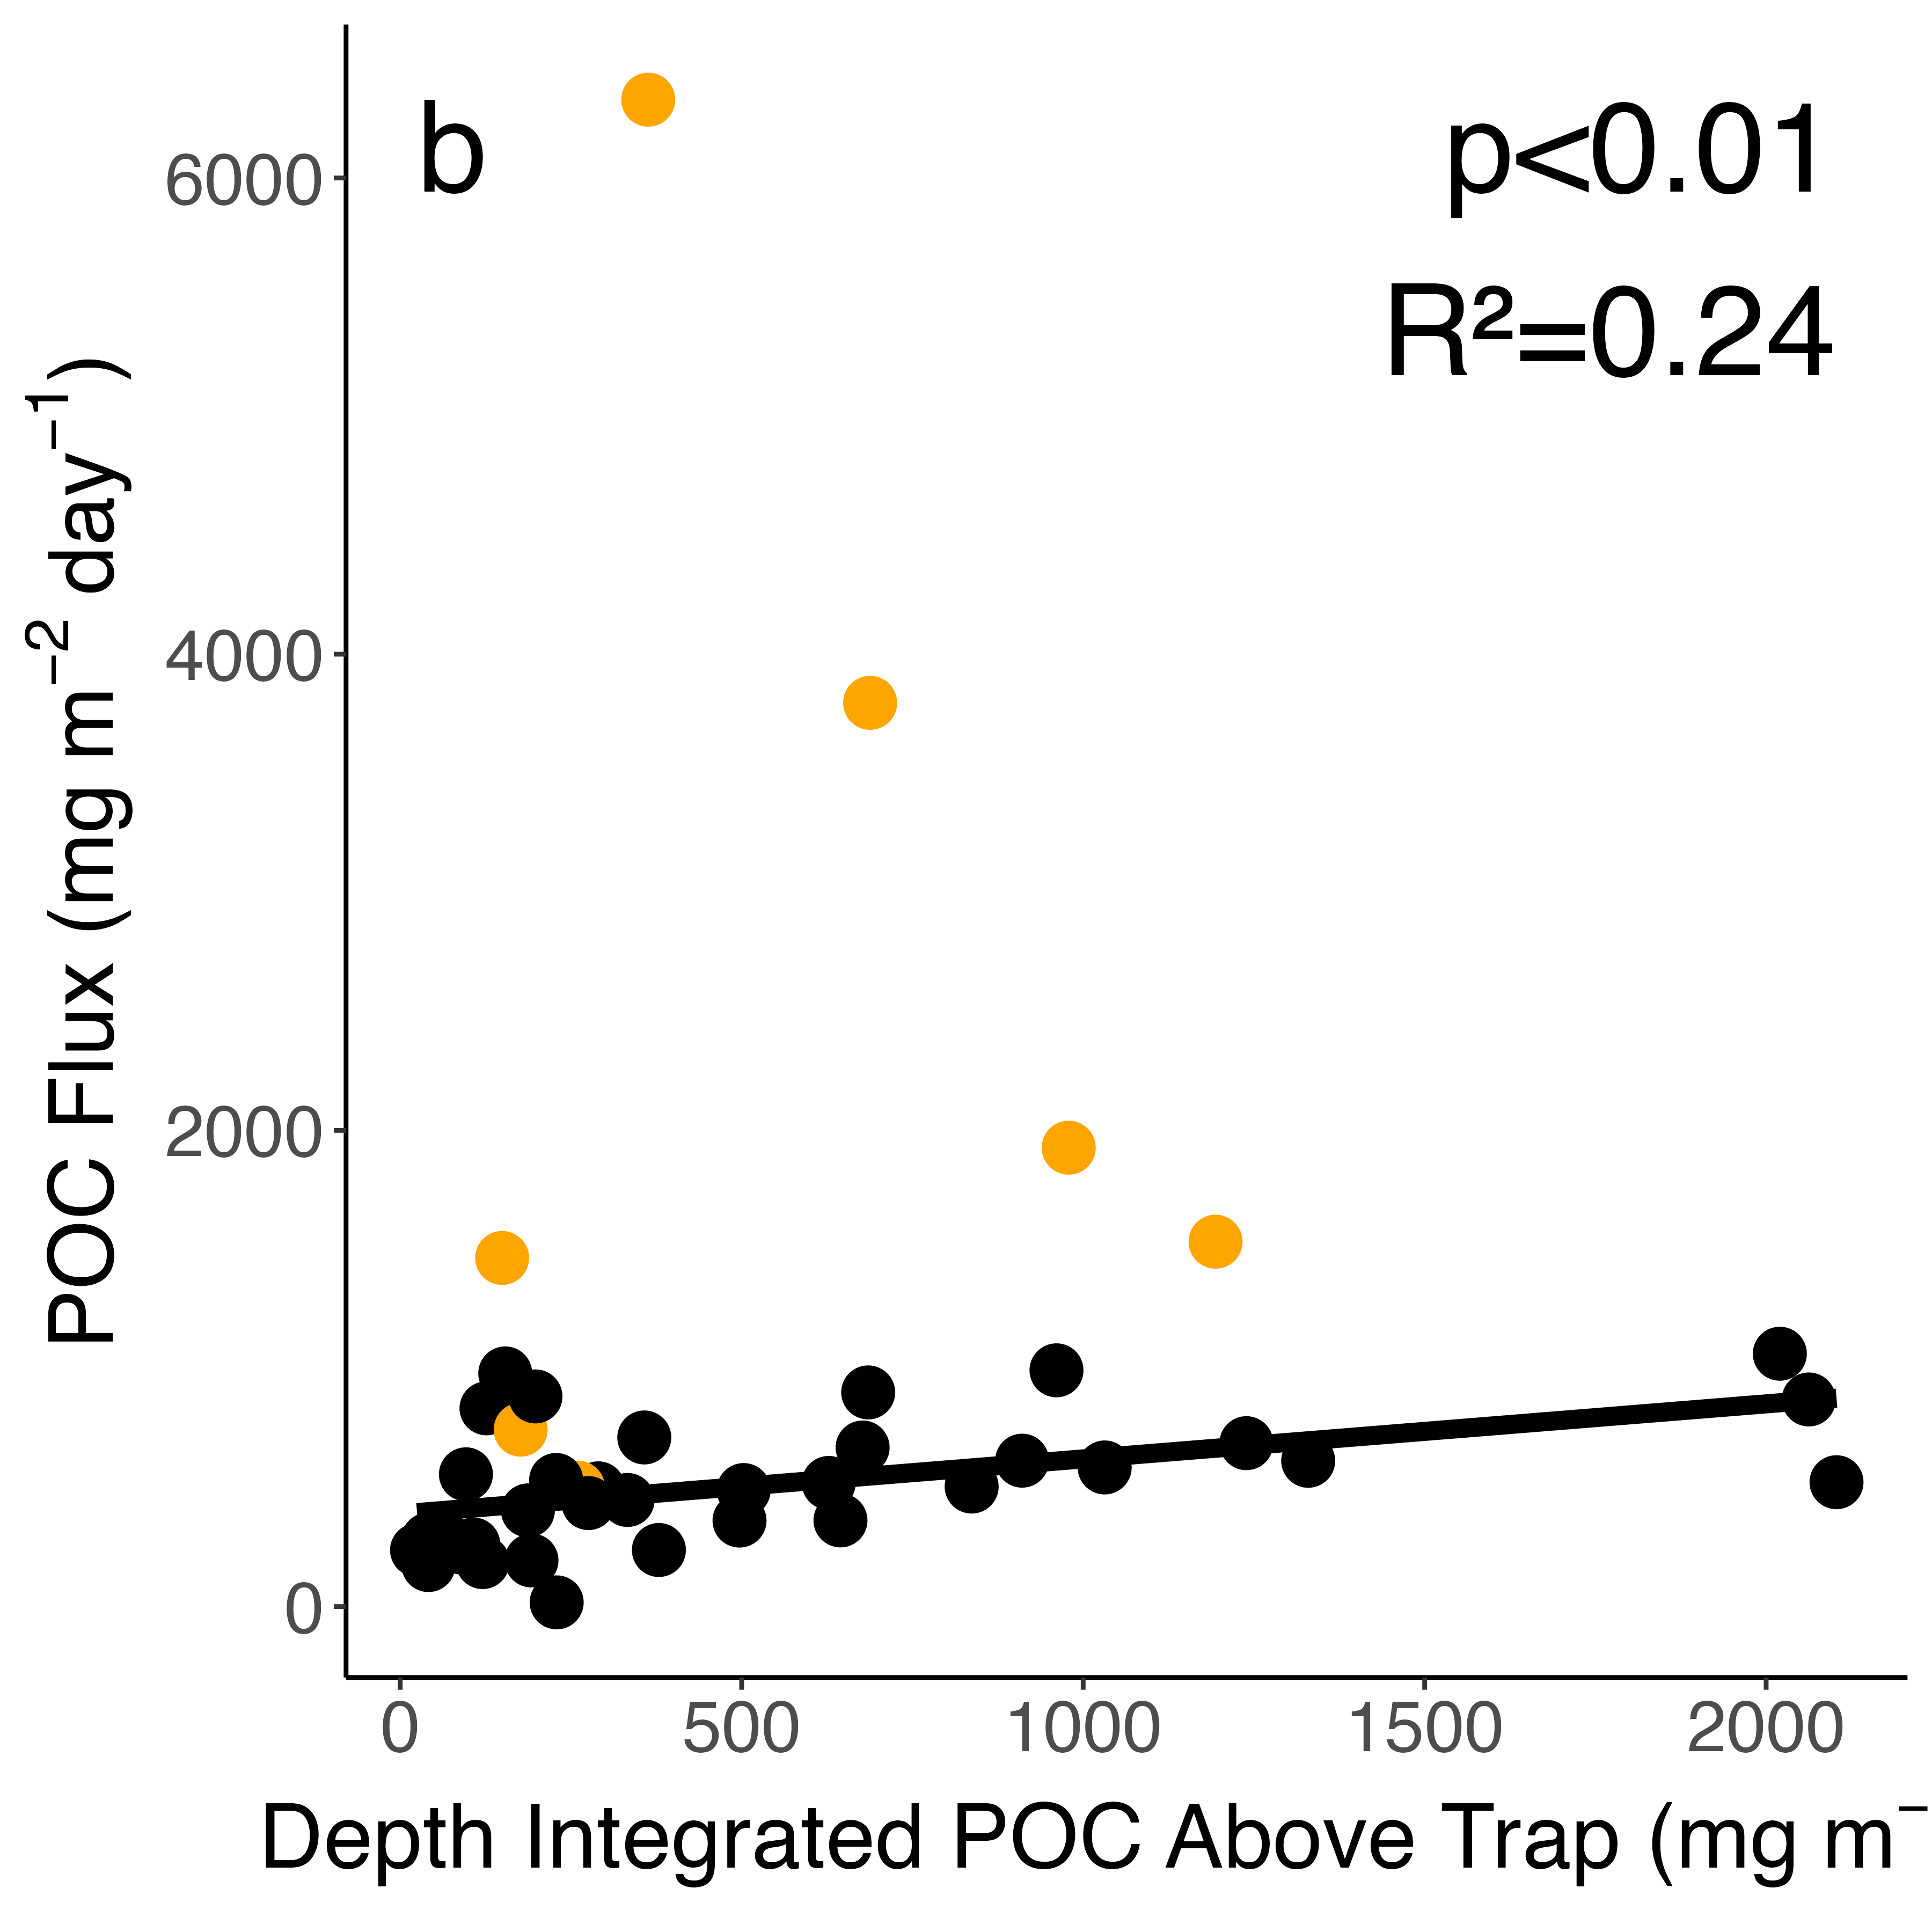
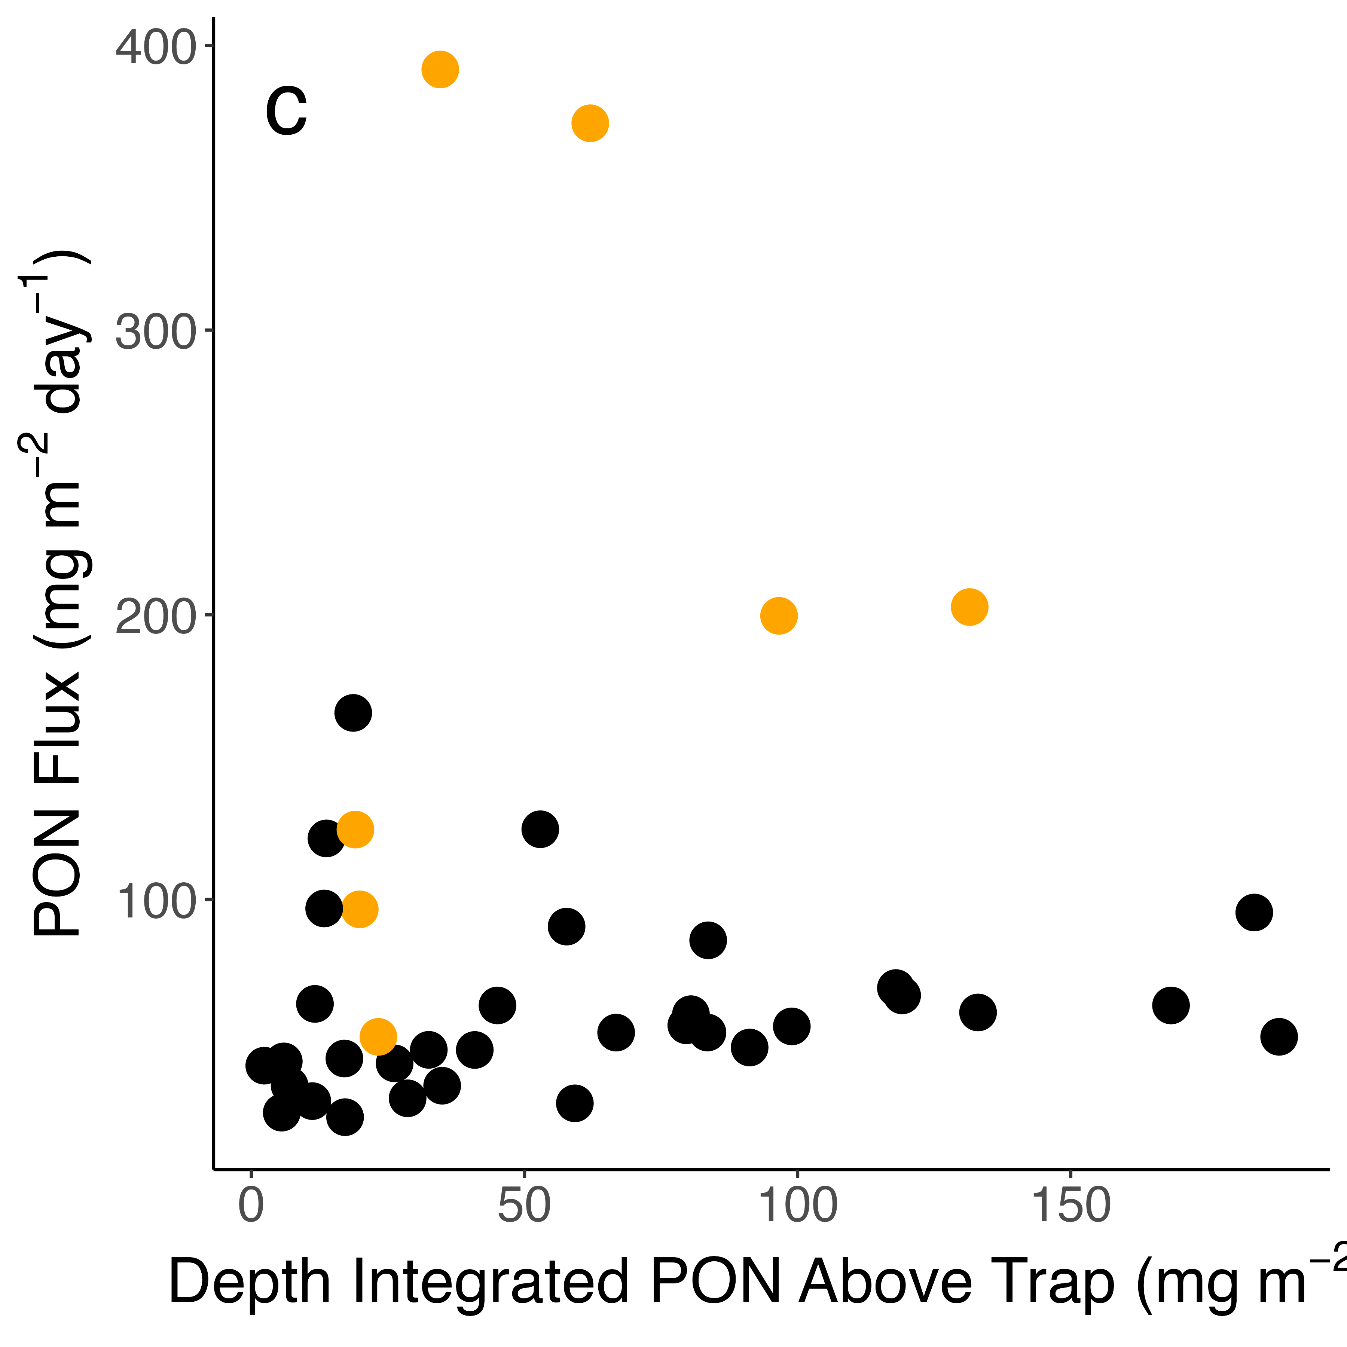
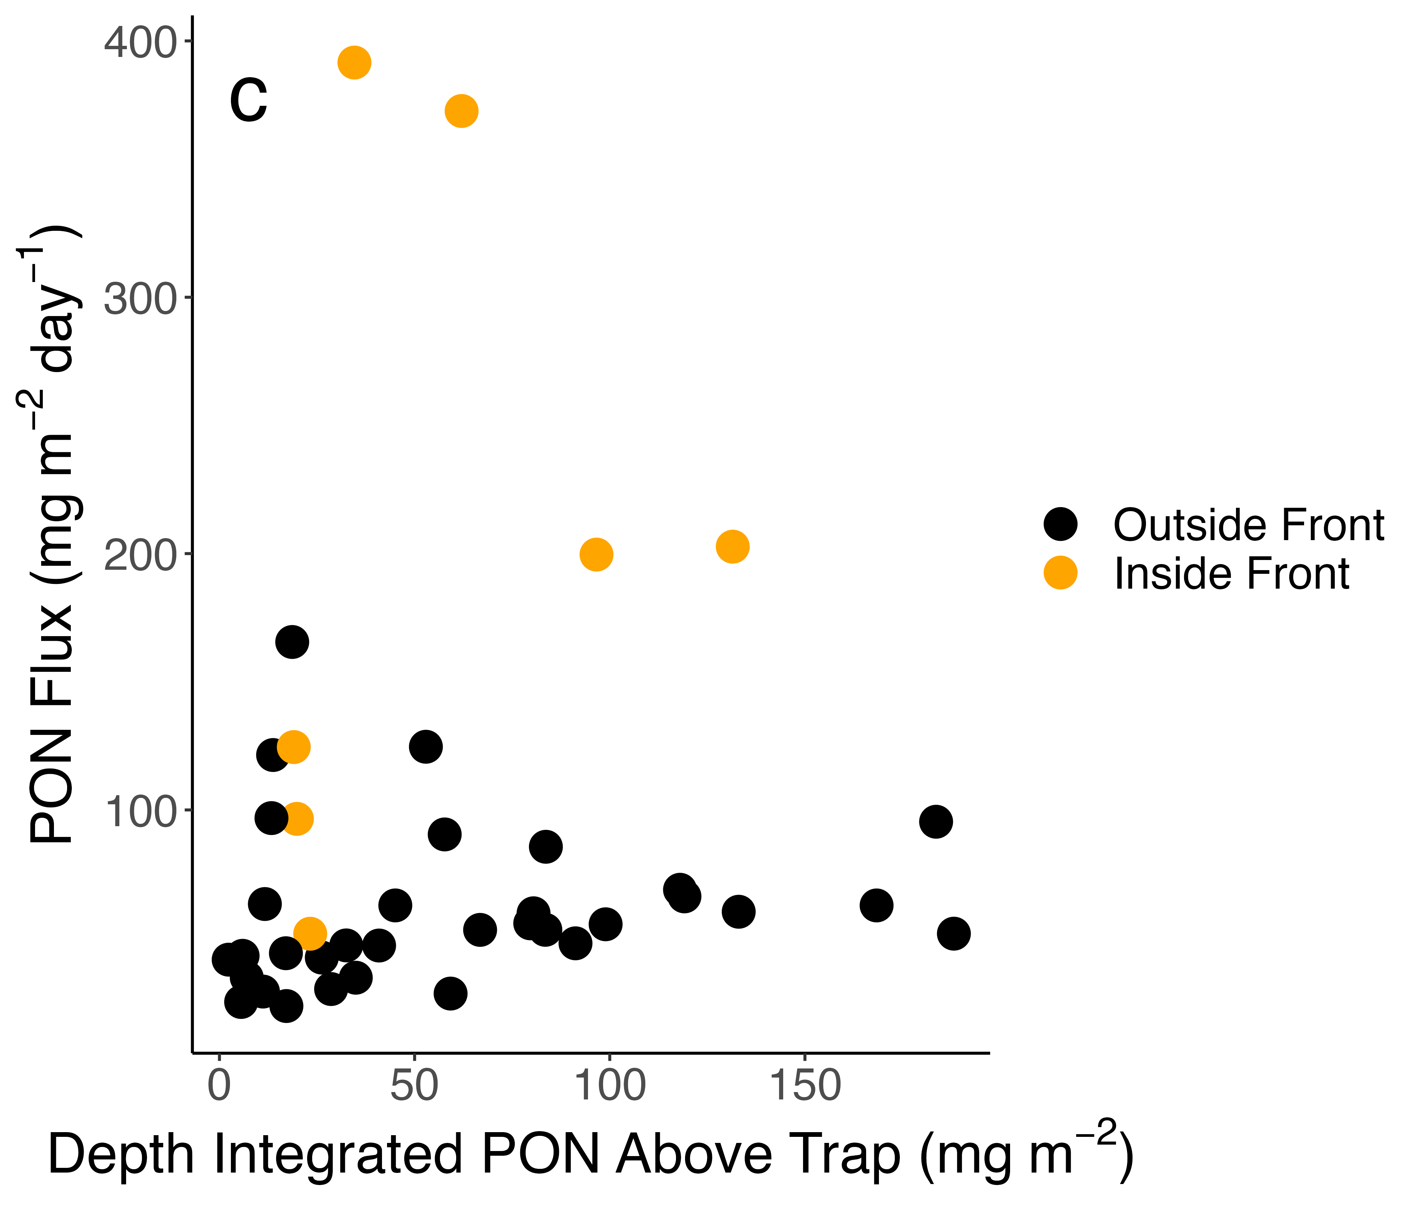
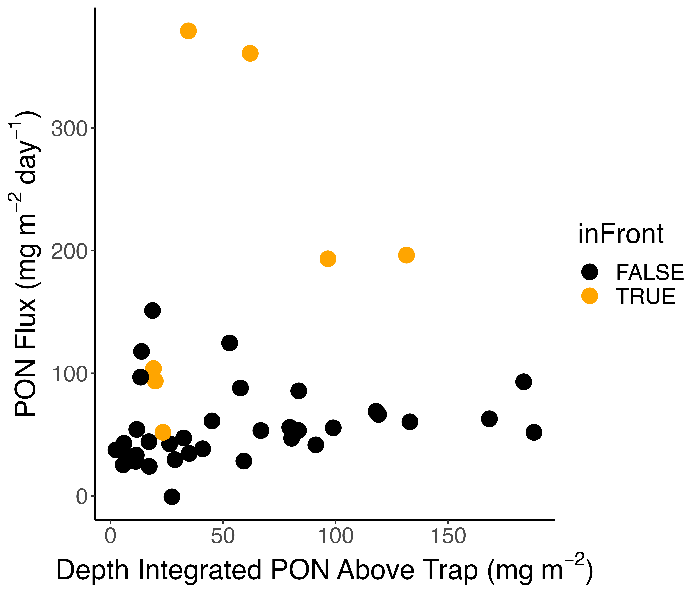
Figure 6: Measured fluxes of Chl a (A), POC (B), and PON (C) plotted against depth integrated Chl a from the sea surface to the trap depth. Traps determined to be impacted by the water mass front are shown in red, and traps that were deployed outside the frontal feature are shown in blue. Results of a simple linear regression are shown on each plot if significant. Shape of the points indicates ice coverage at the deployment station.
Spearman’s correlation agrees with regression analysis
Outside Front
Inside Front

Slide 15
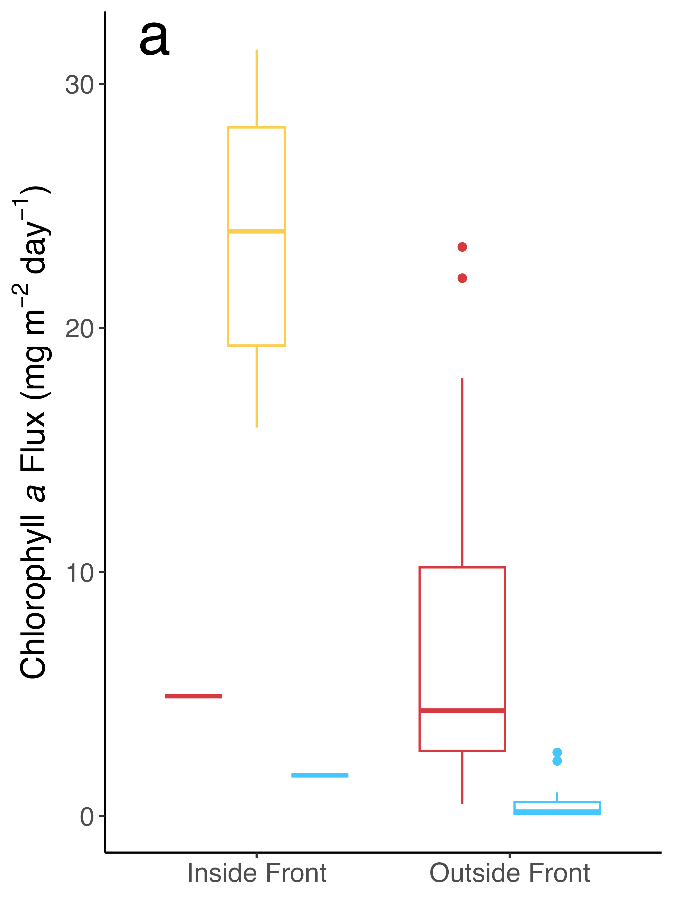
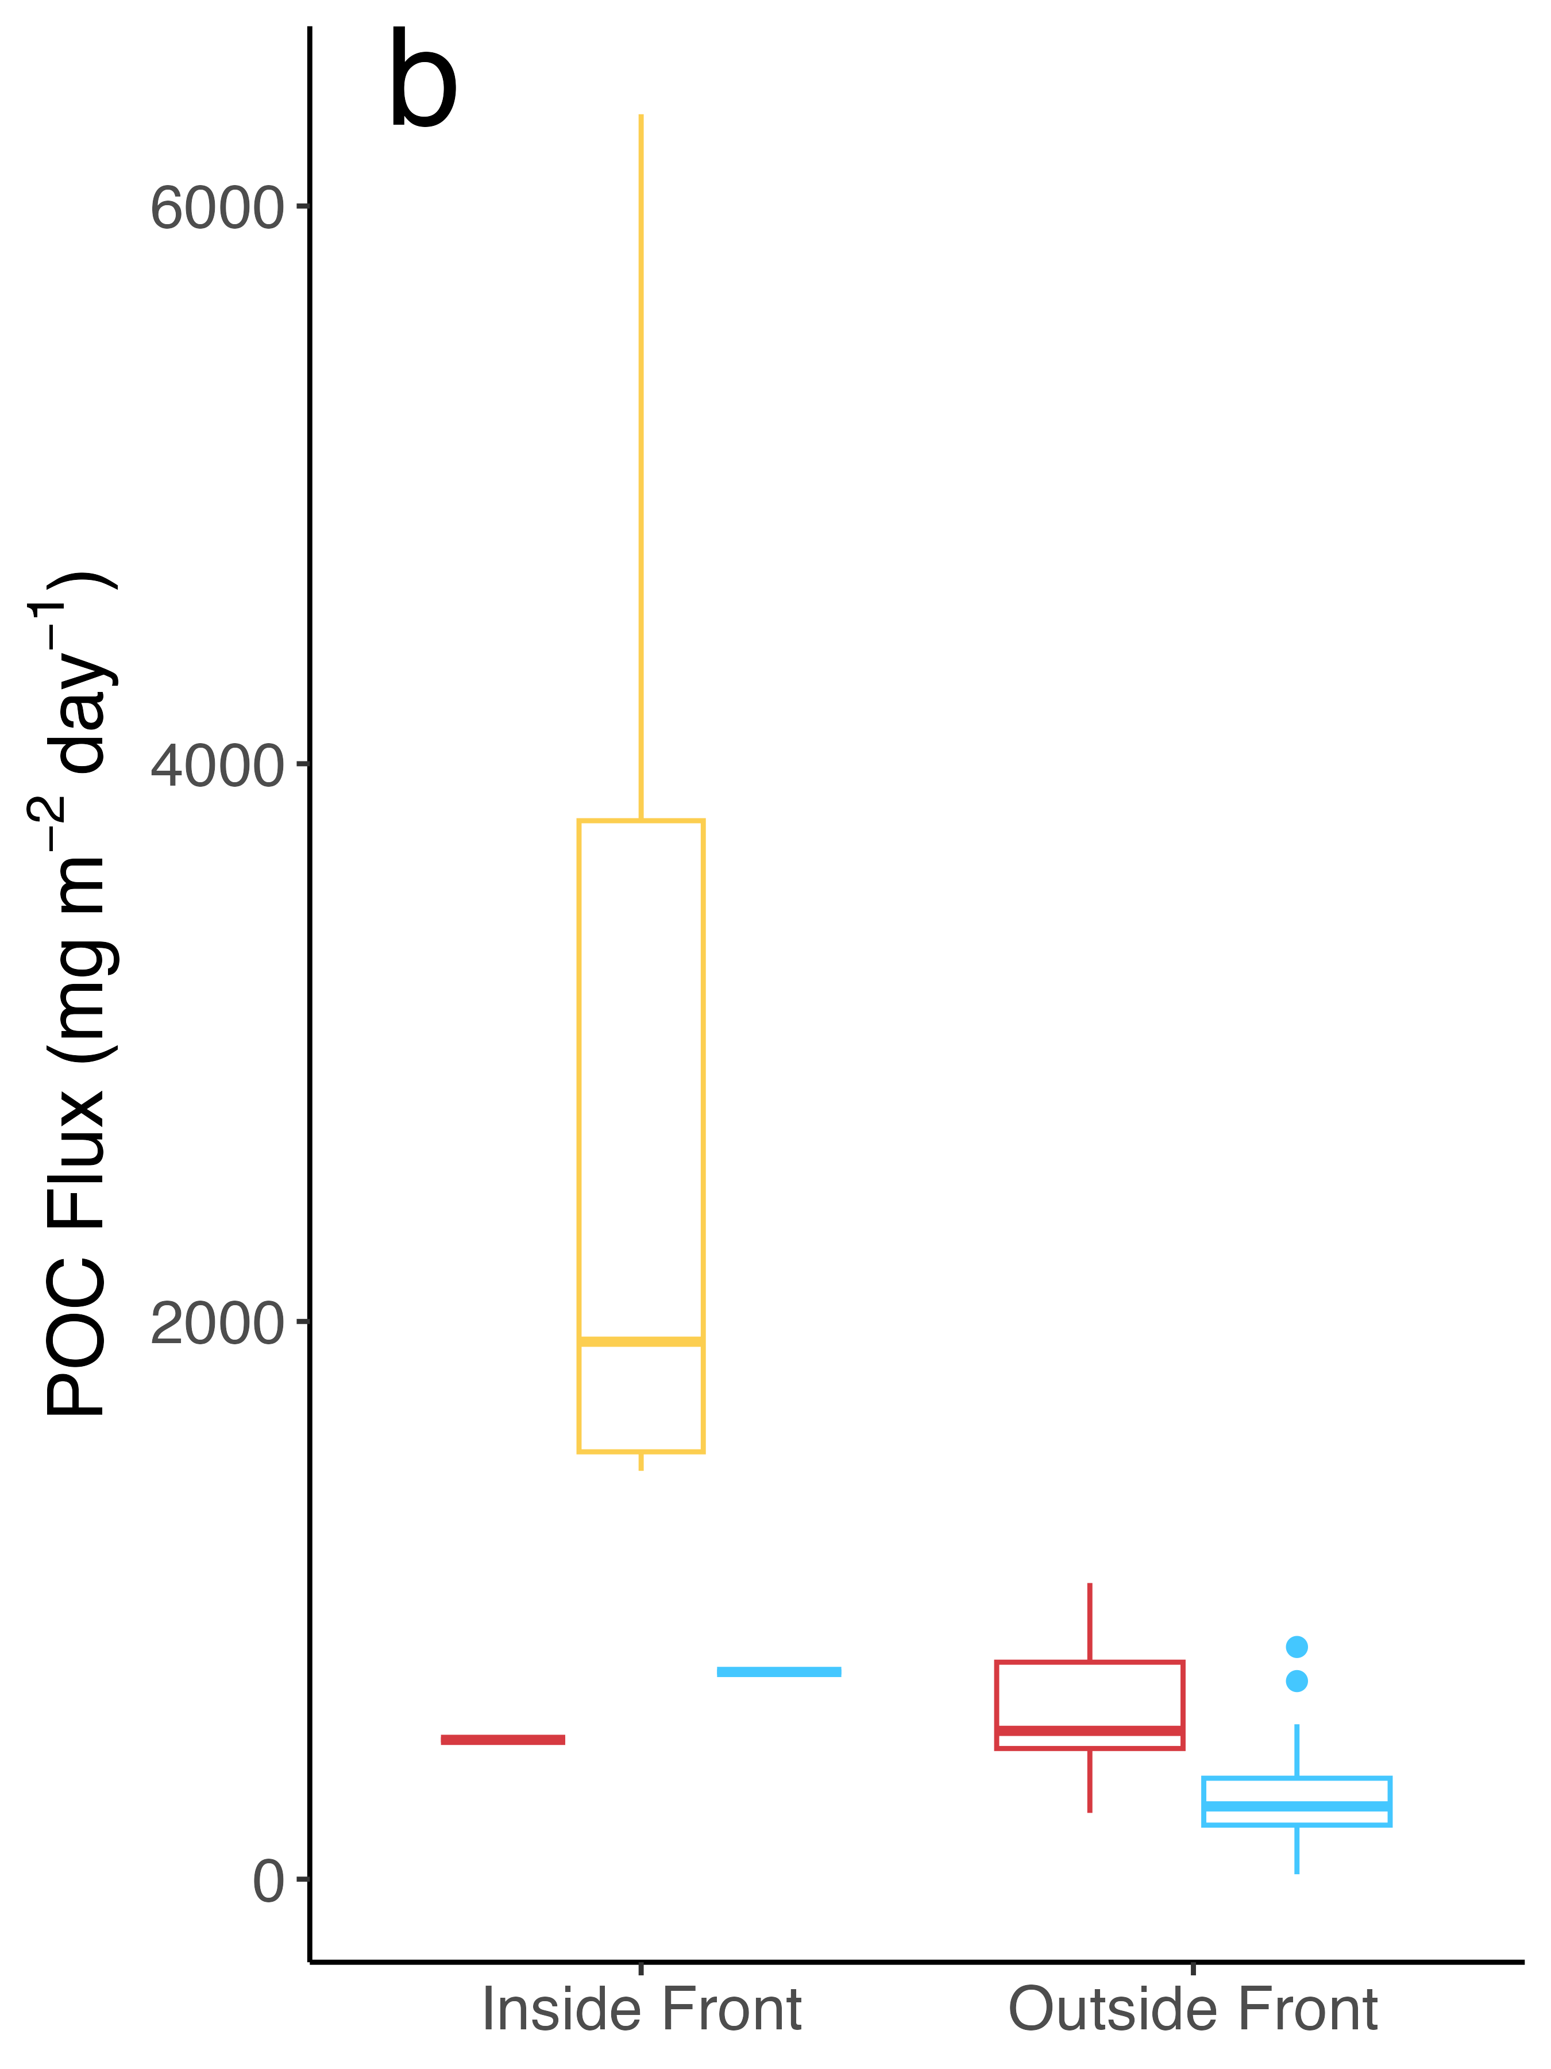
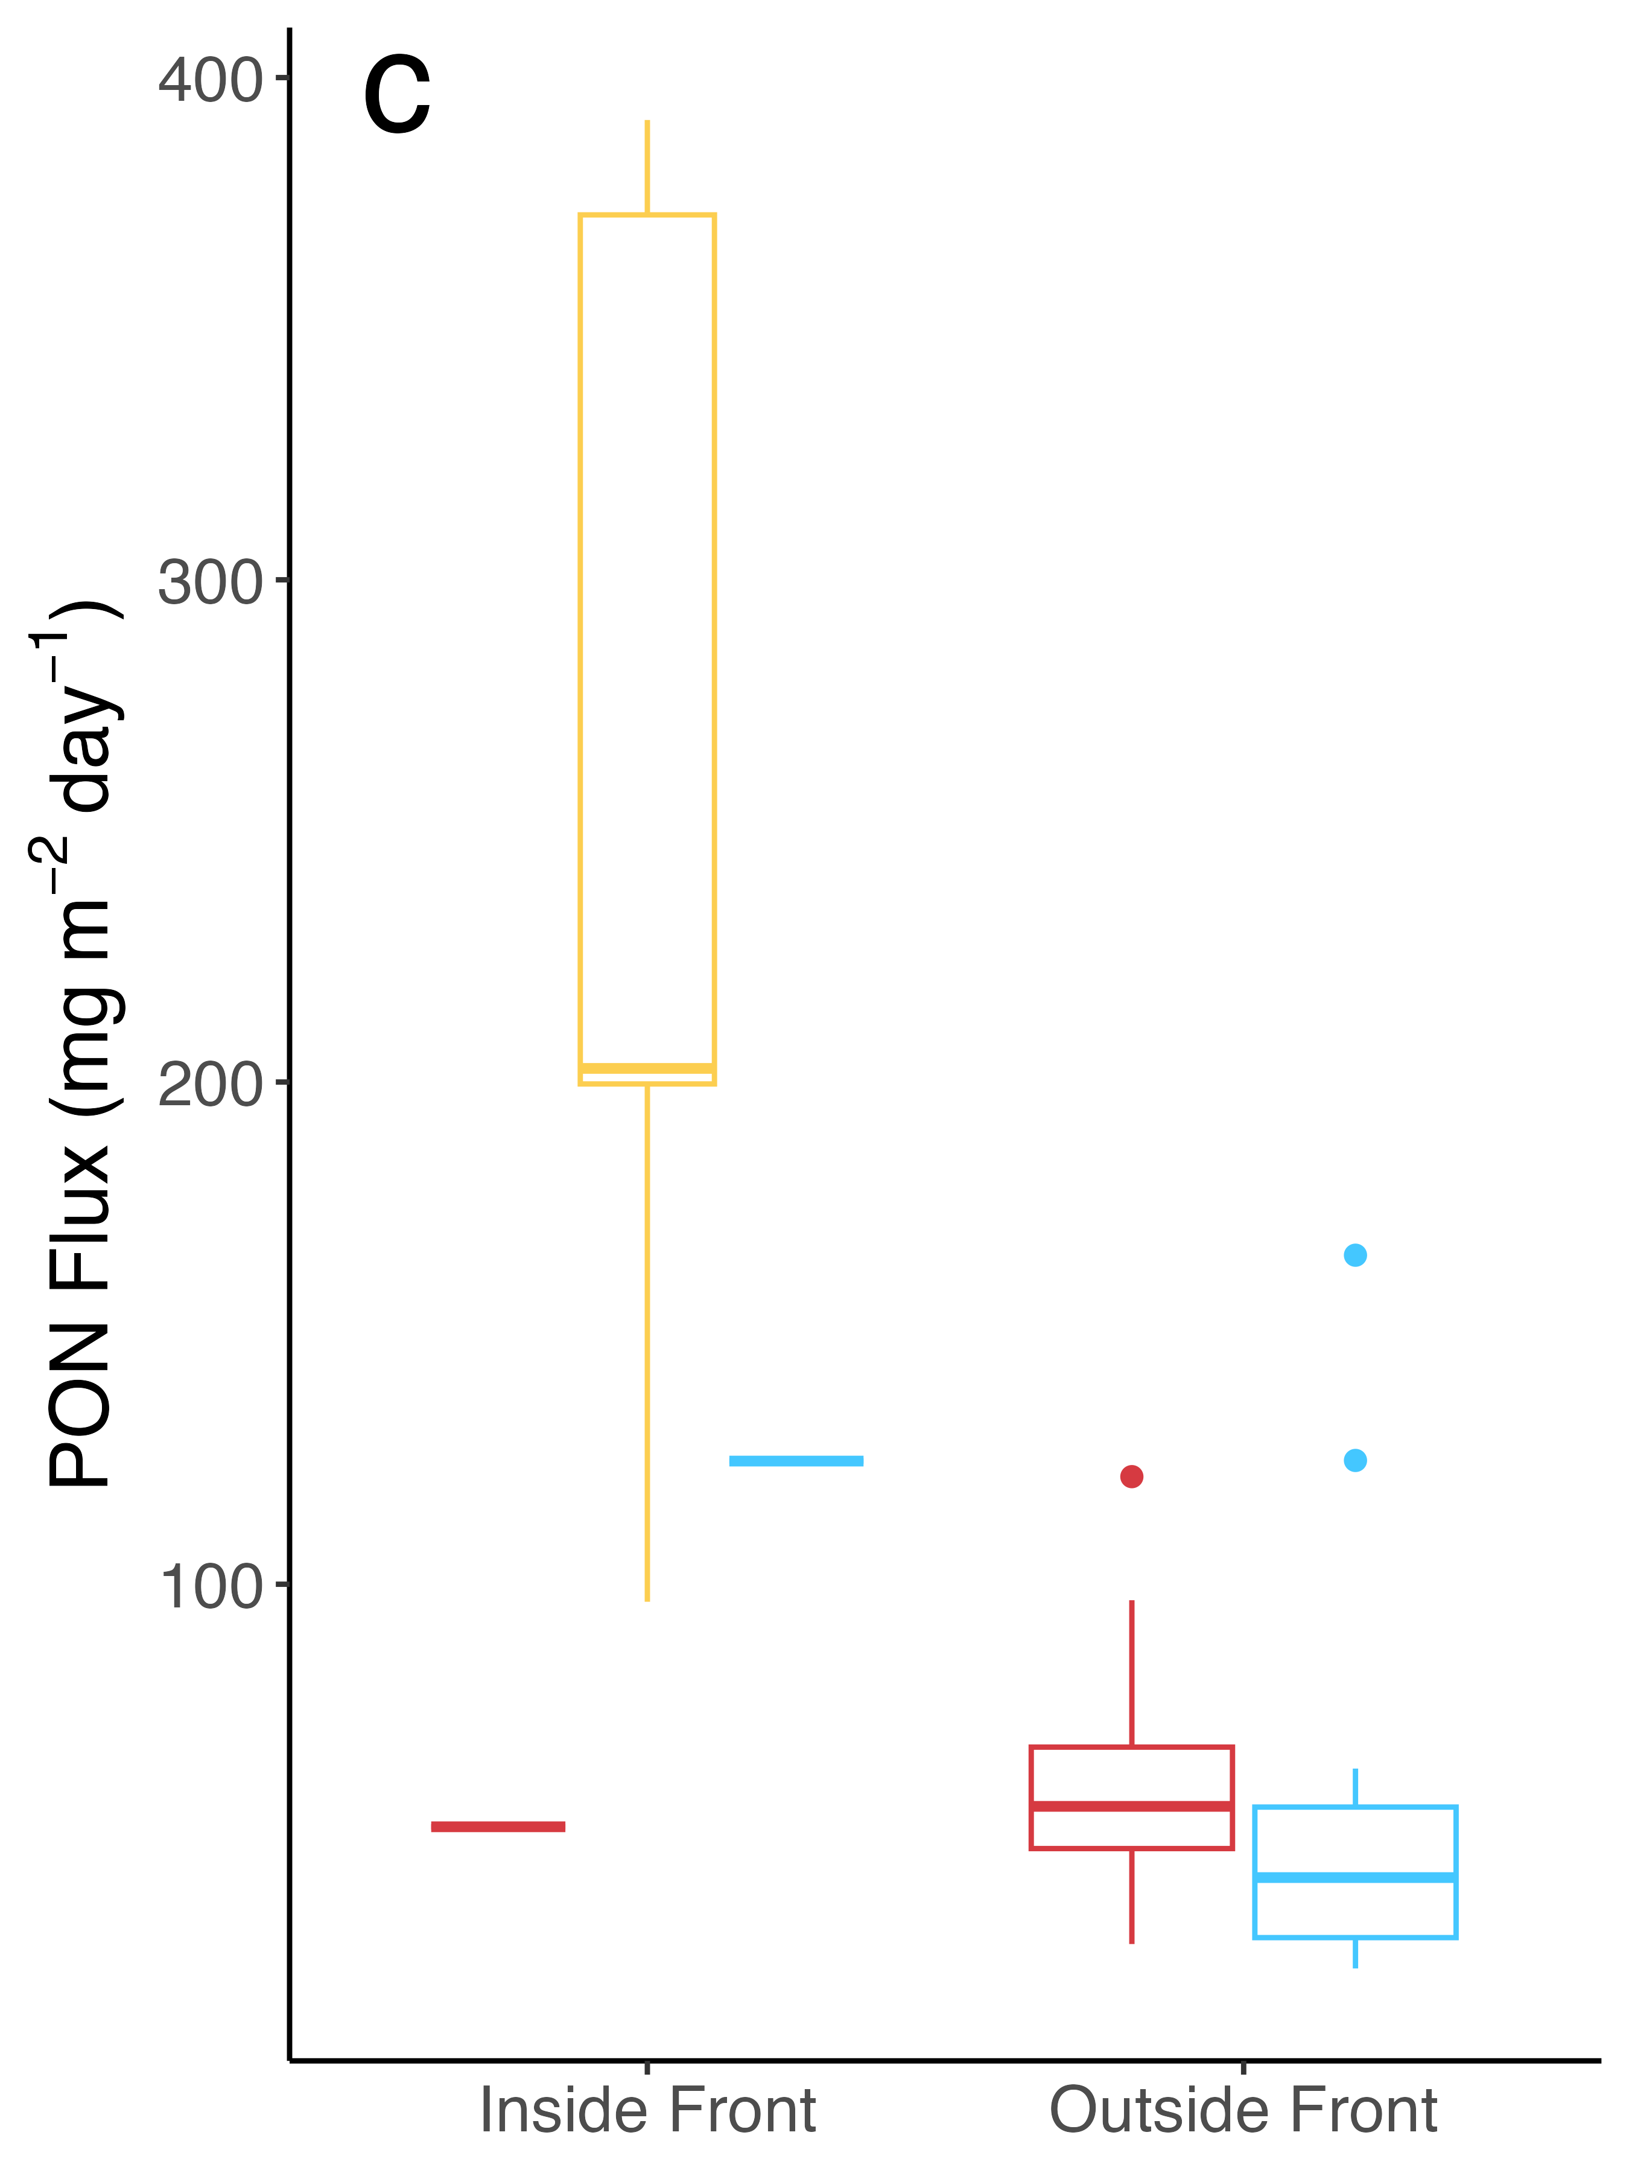
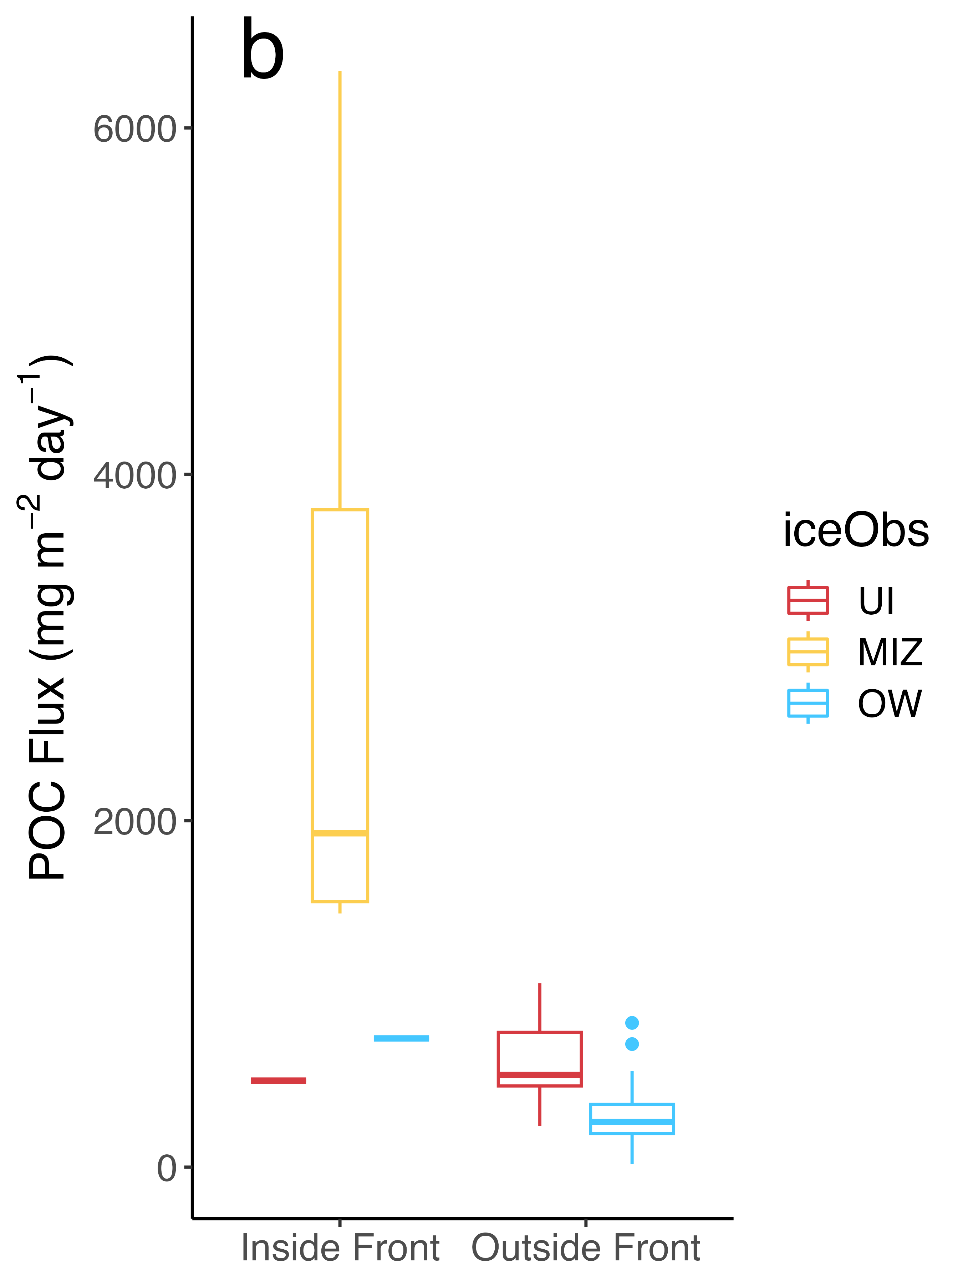
Figure 7: (A) Chl a, (B) POC, and (C) PON flux by ice coverage at the deployment station and deployment inside or outside the frontal feature

Slide 16
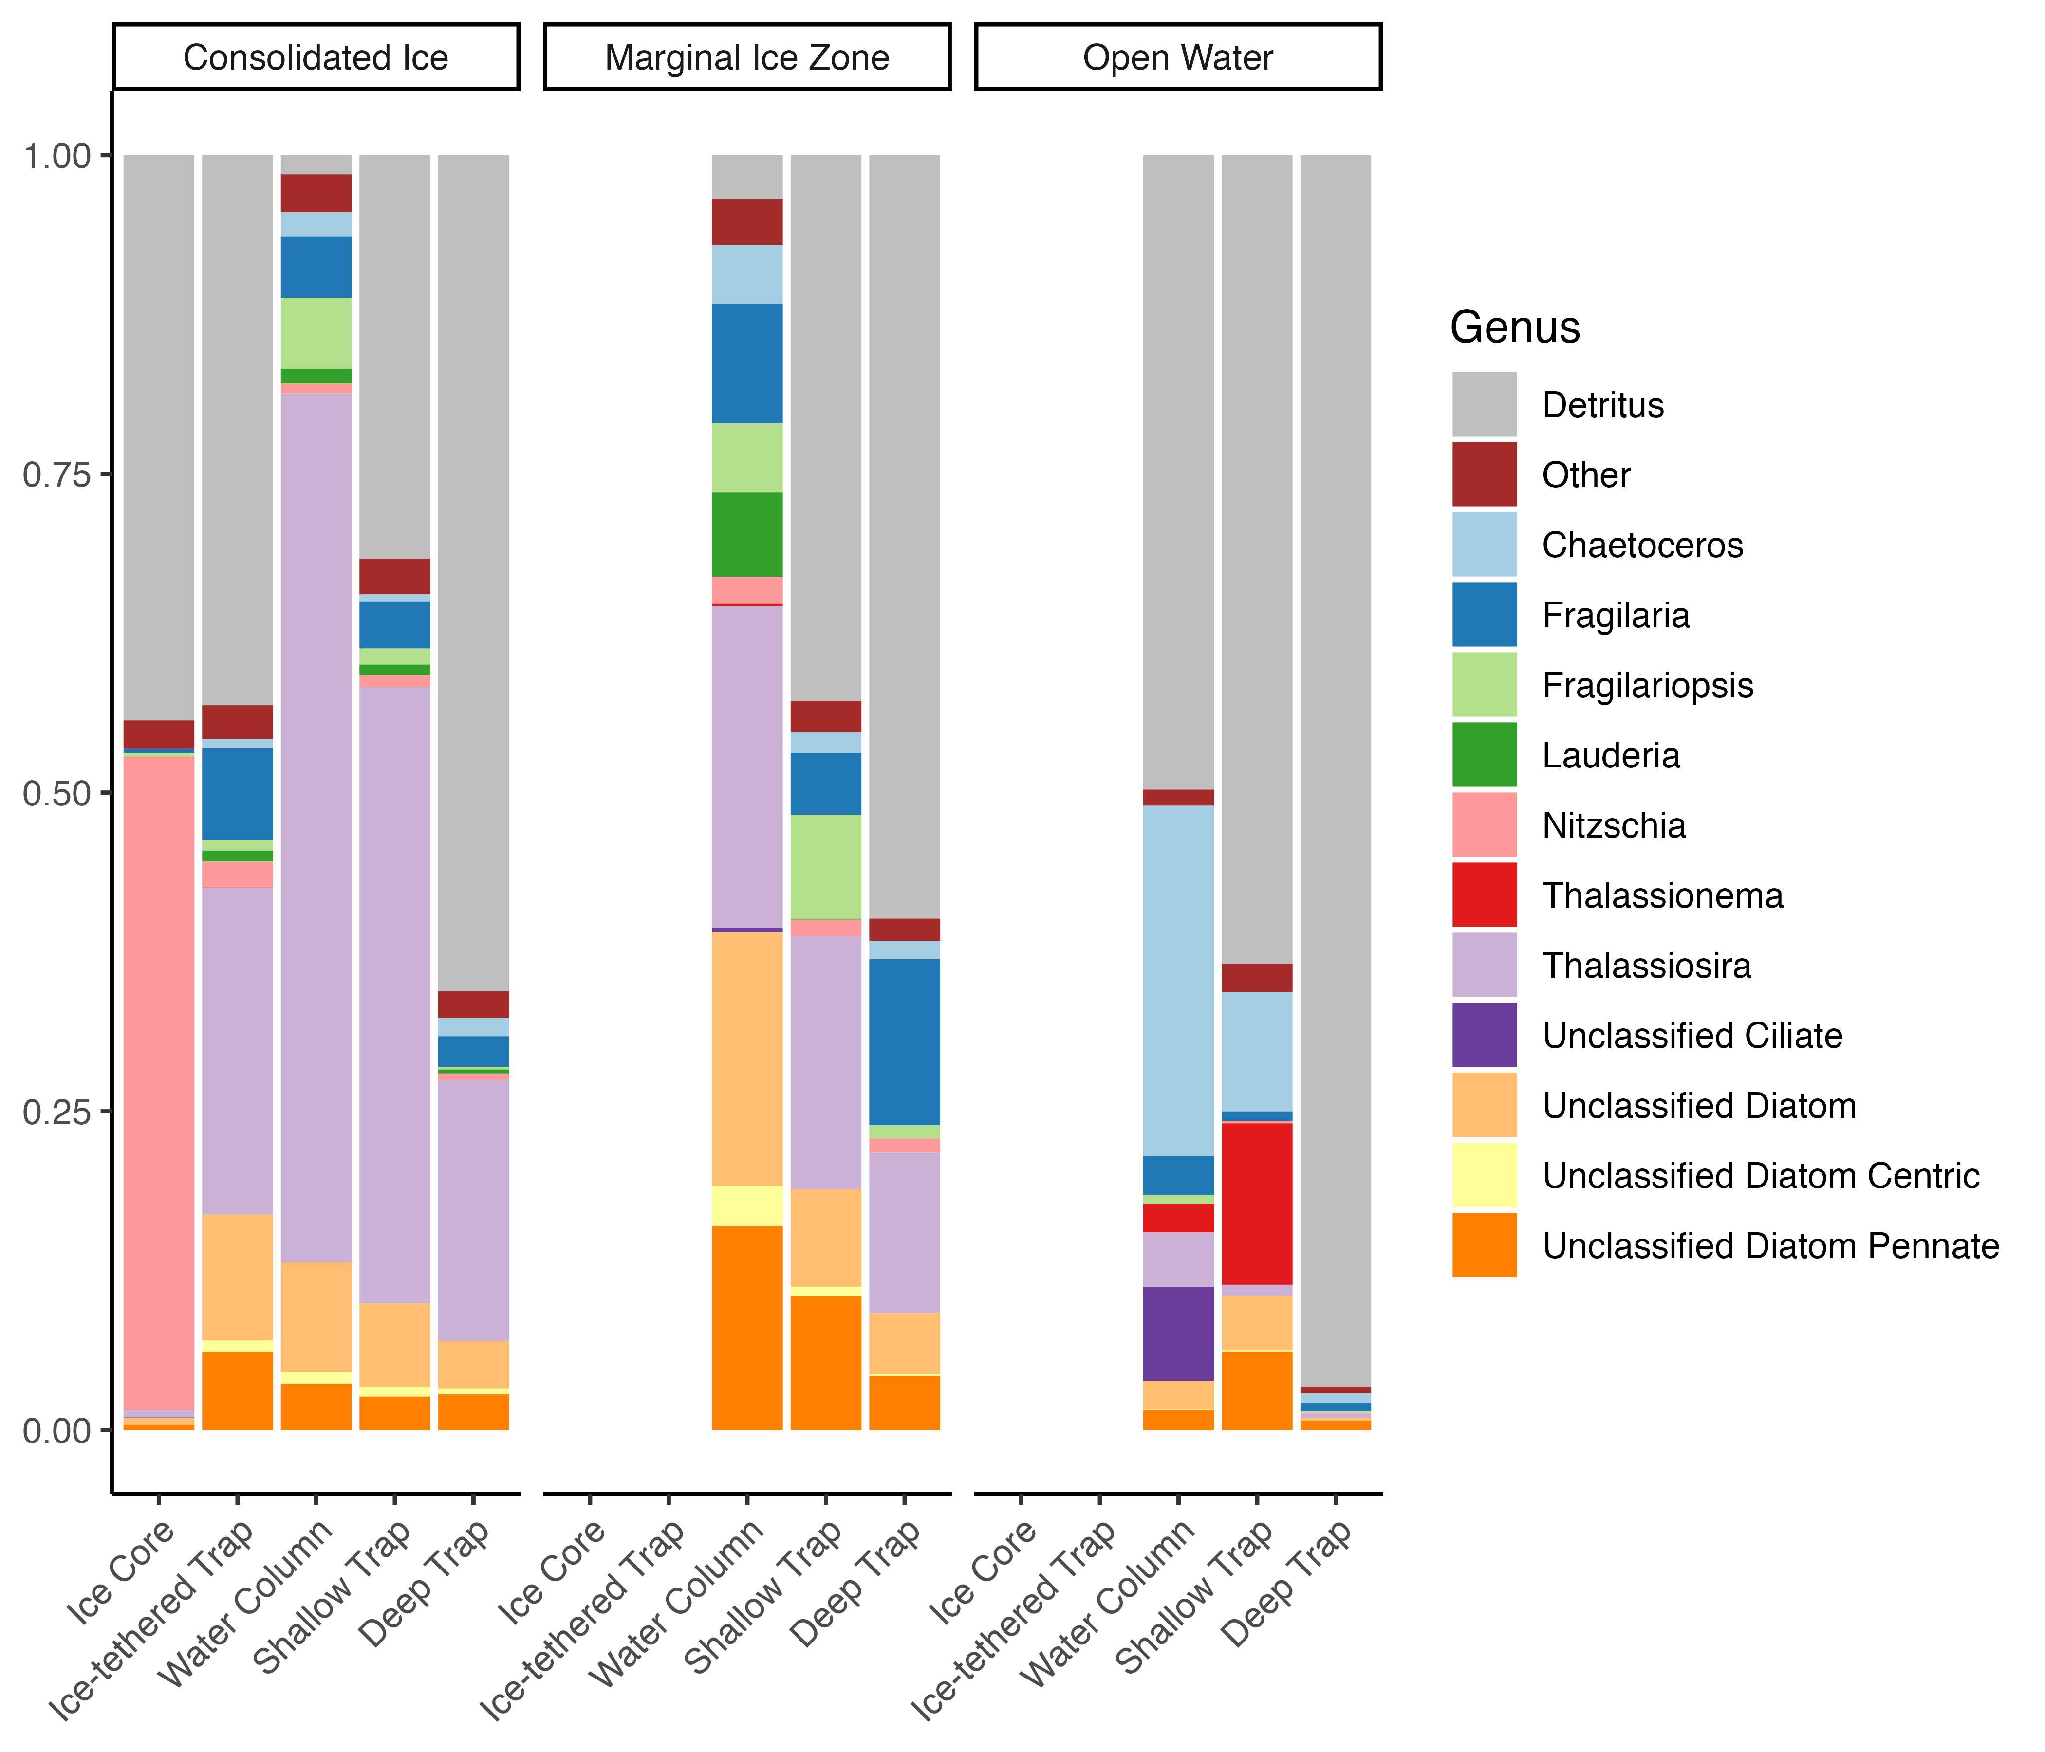
Figure 8: Composition of ice core, water column, and sediment trap samples, displayed as fraction of total sample biovolume. Detritus is indicated in gray. ‘Other’ includes all identifiable genera that did not exceed 2% composition of any sample type under any ice condition.

Slide 17
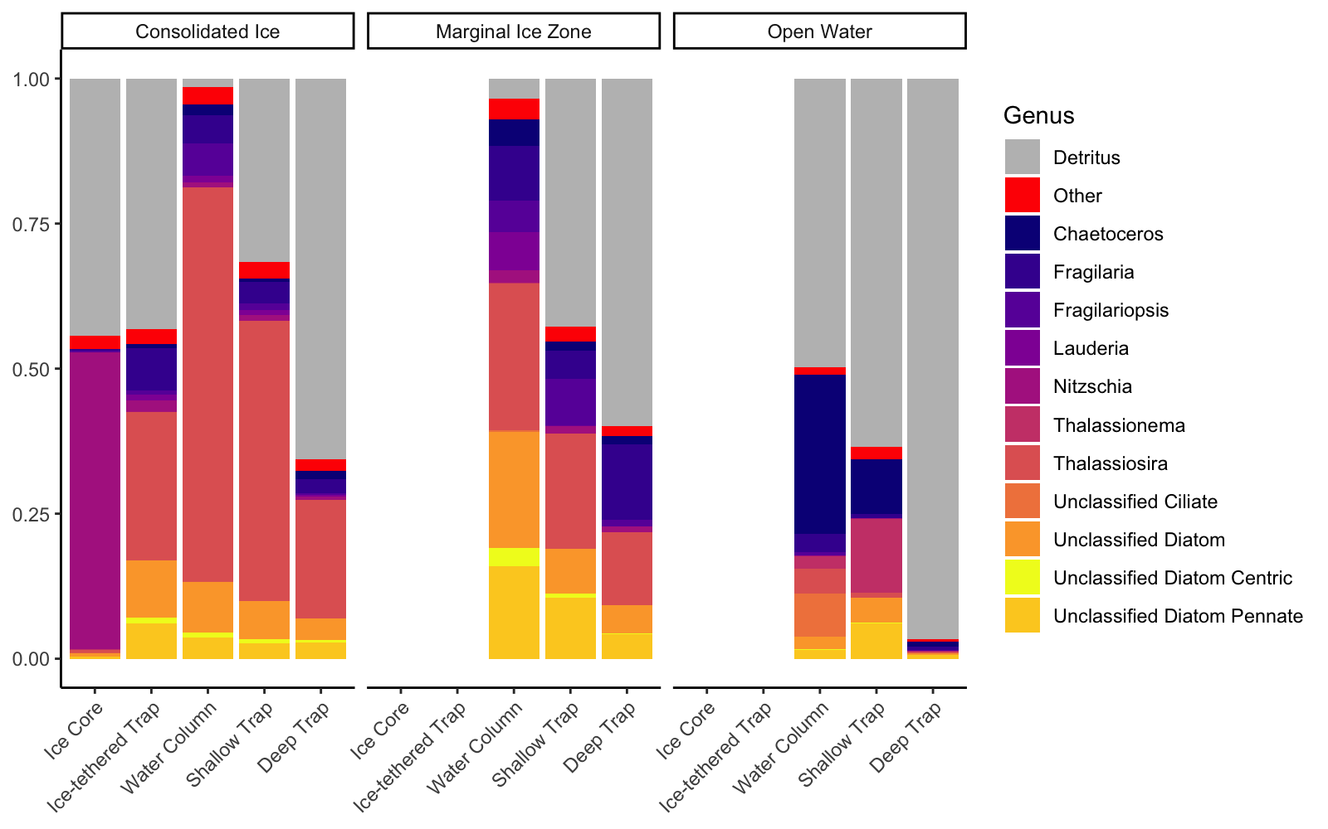
Figure 8: Composition of ice core, water column, and sediment trap samples, displayed as fraction of total sample biovolume. Detritus is indicated in gray. ‘Other’ includes all identifiable genera that did not exceed 2% composition of any sample type under any ice condition.

Slide 18
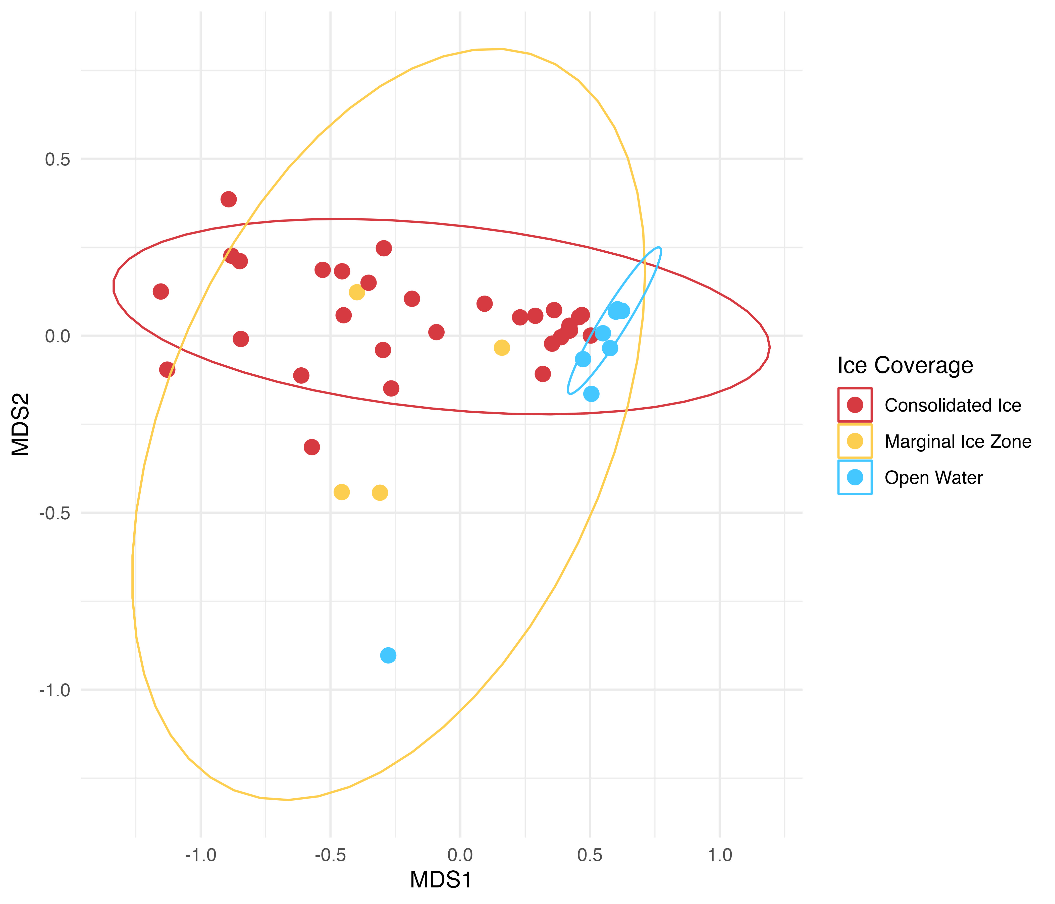
Supplementary Figures Begin Here
Supplementary Figure 1: Non-metric multidimensional scaling (NMDS) analysis of trap sample composition, with traps deployed in consolidated ice shown in blue, in the MIZ in yellow, and open water in red.

Slide 19
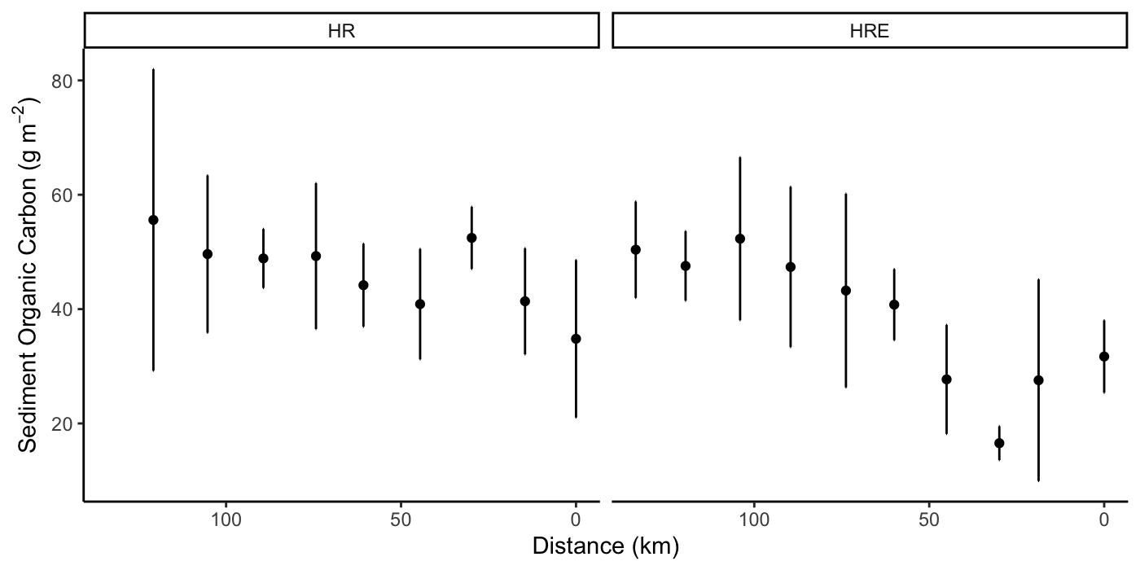
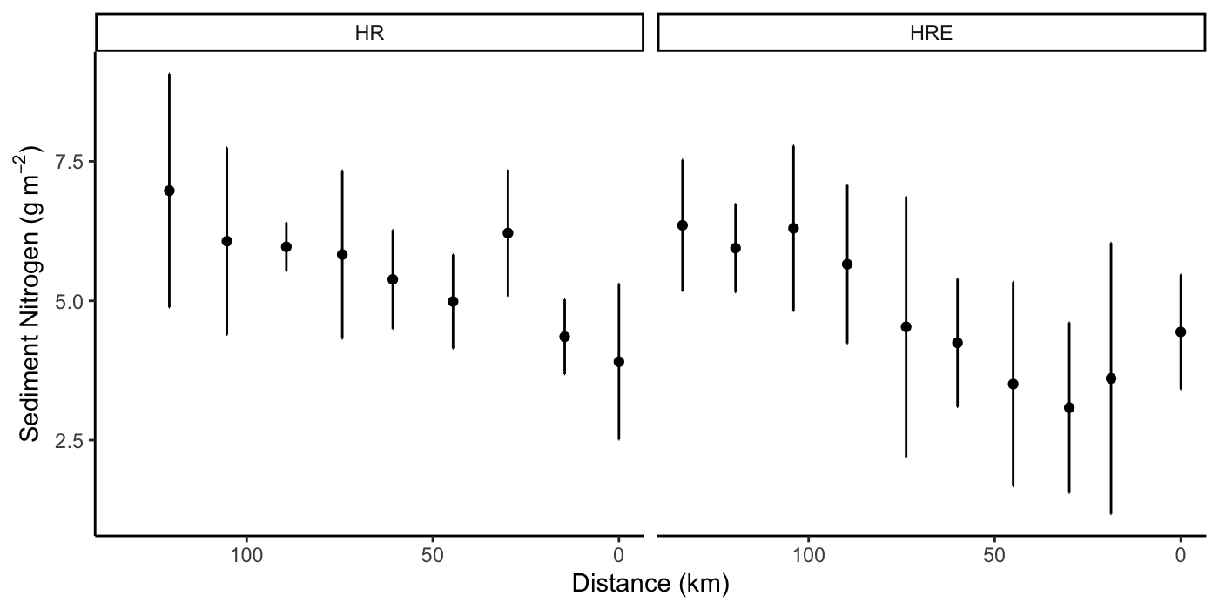
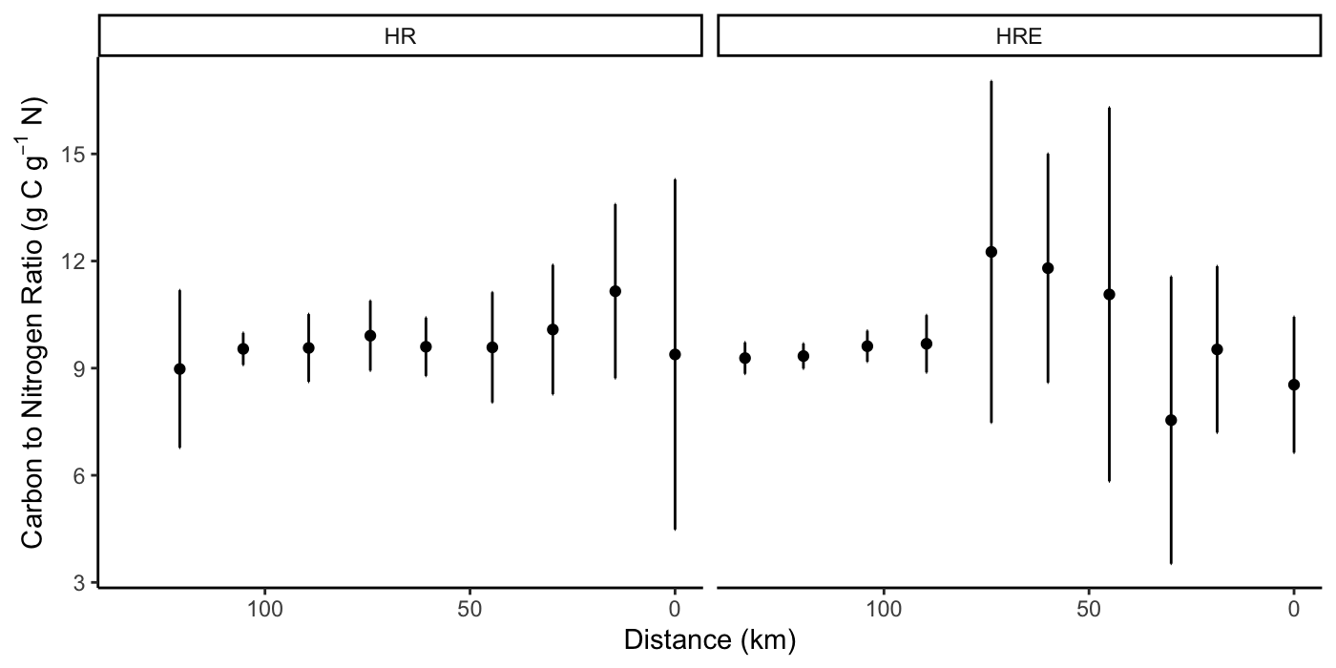
a
b
c
Supplementary Figure 2: Sediment (A) organic carbon (B) nitrogen and (C) C:N ratio by distance along the HR and HRE transects

Slide 20
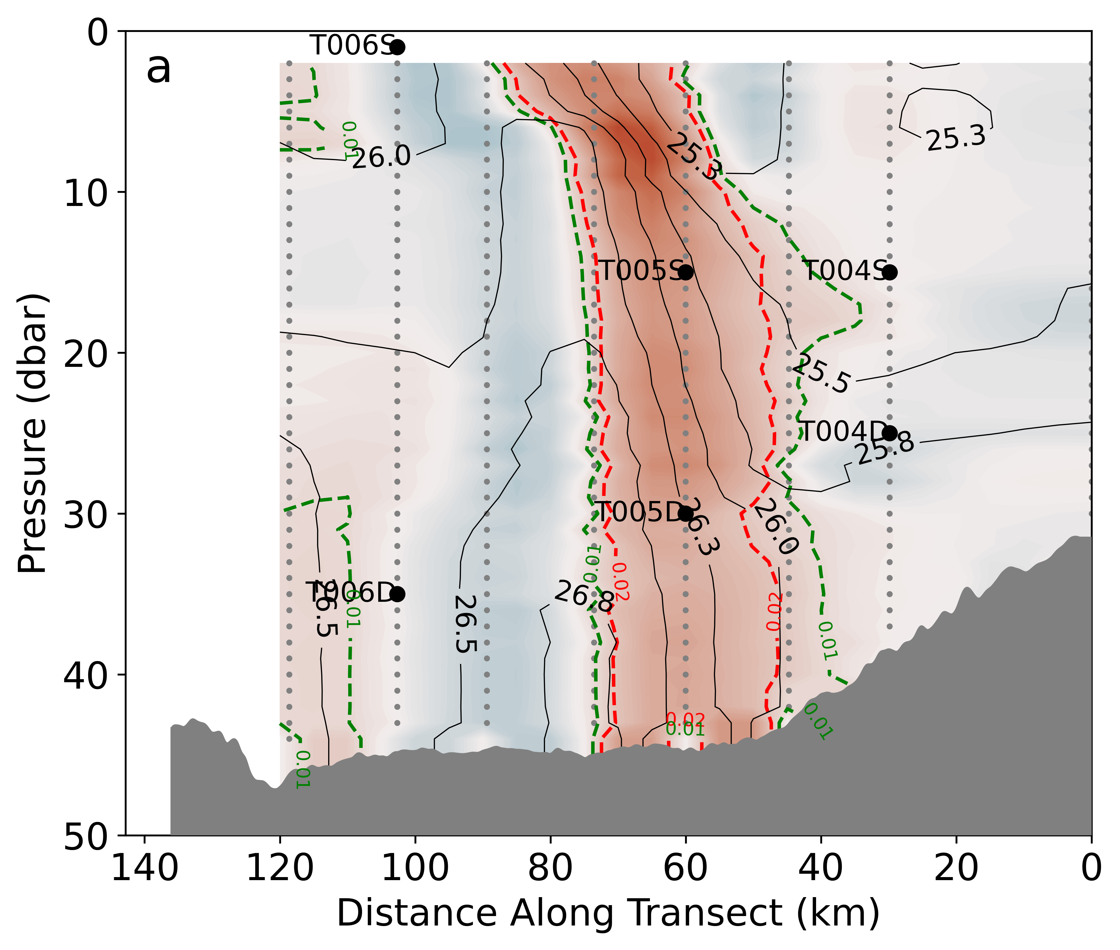
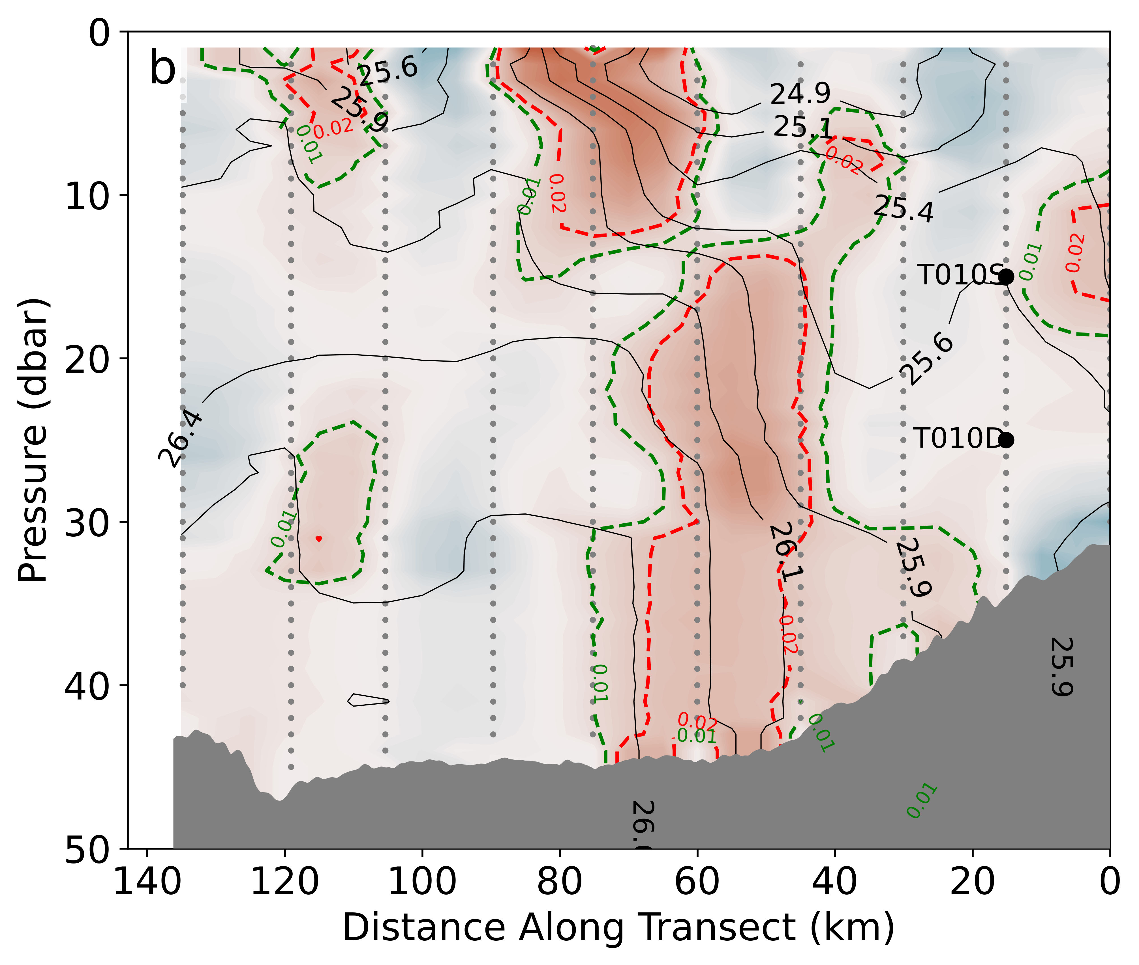
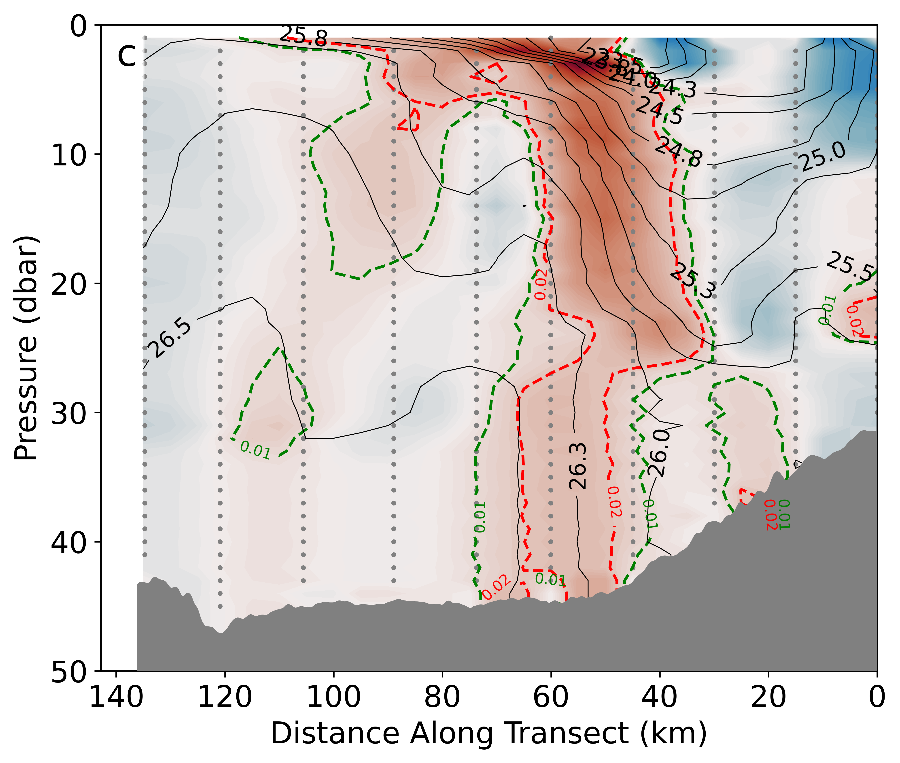
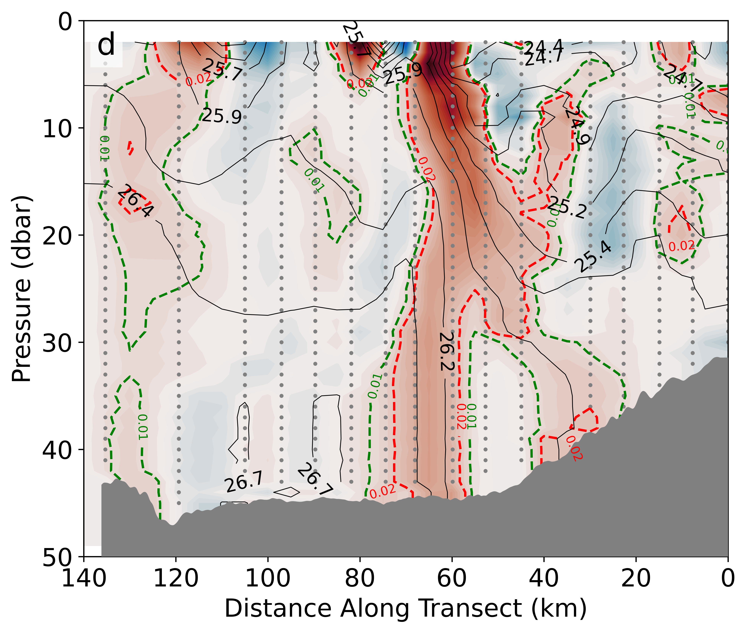
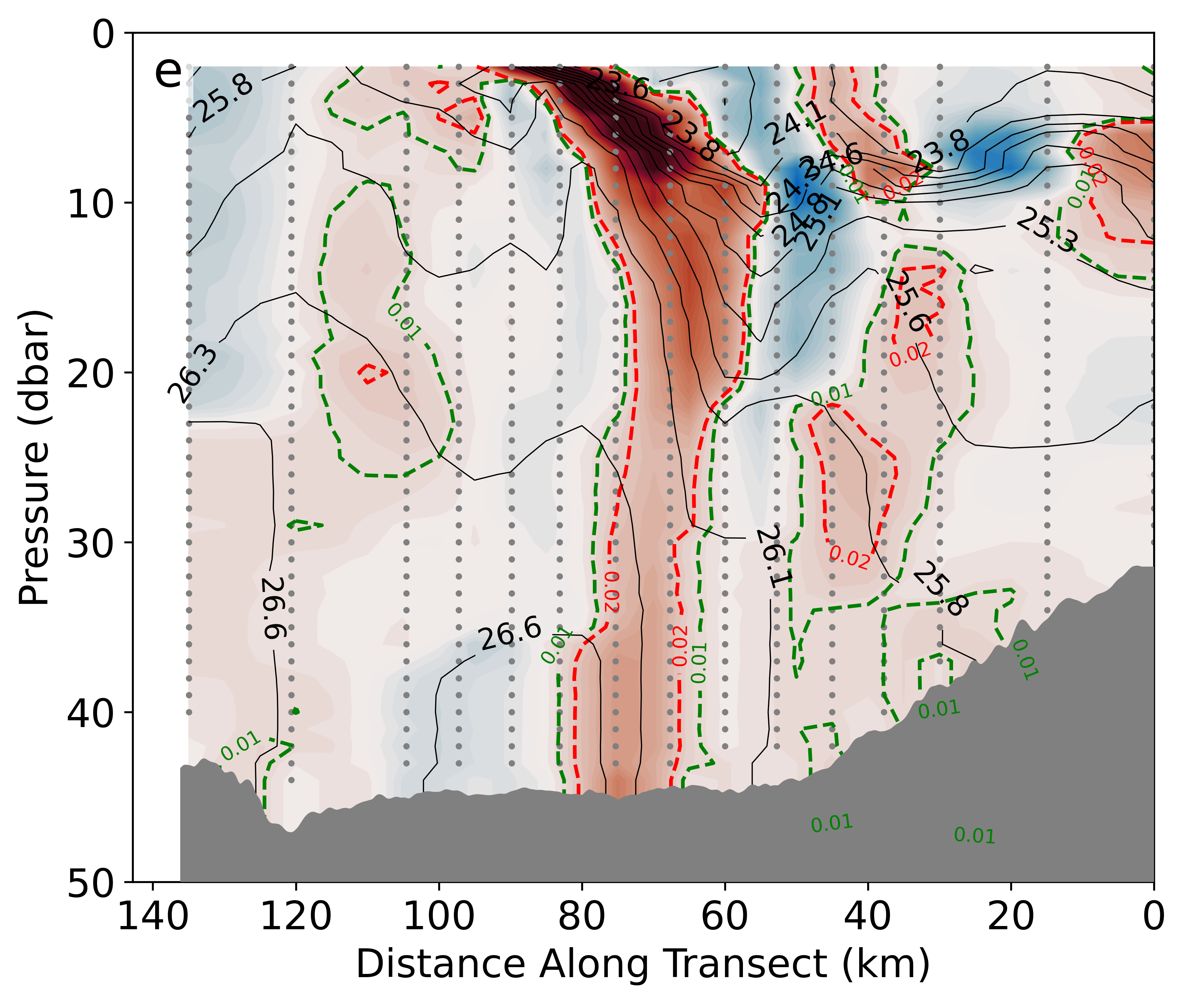
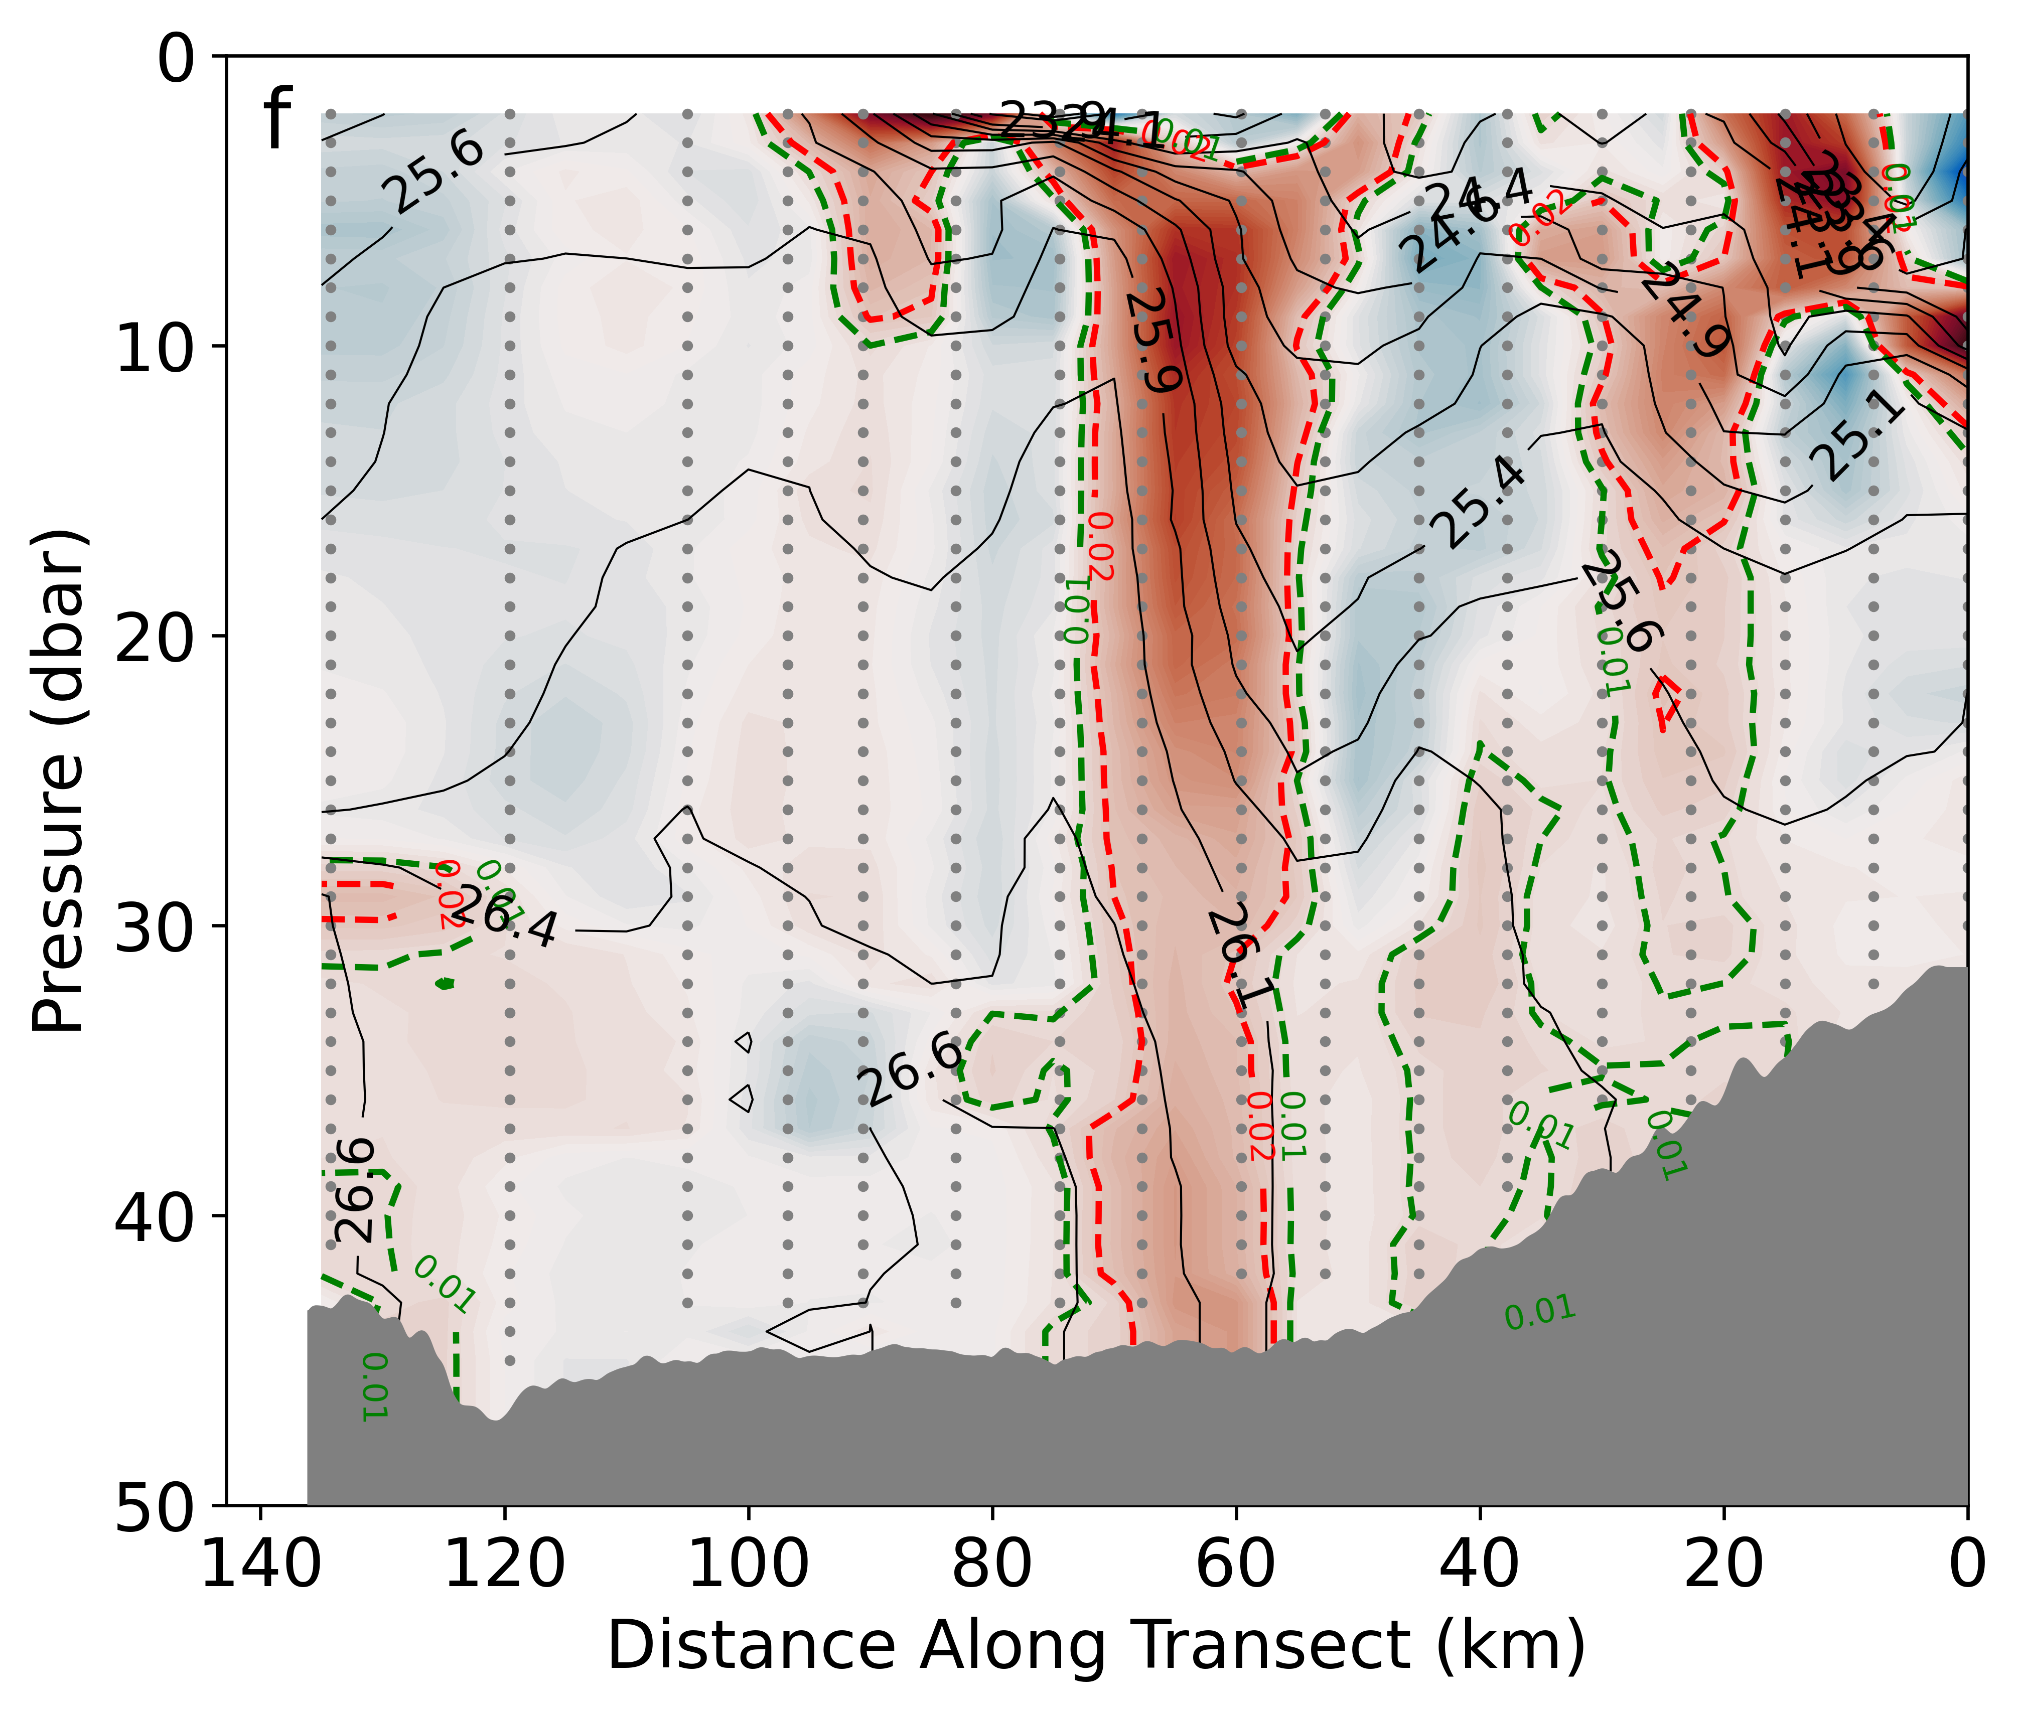
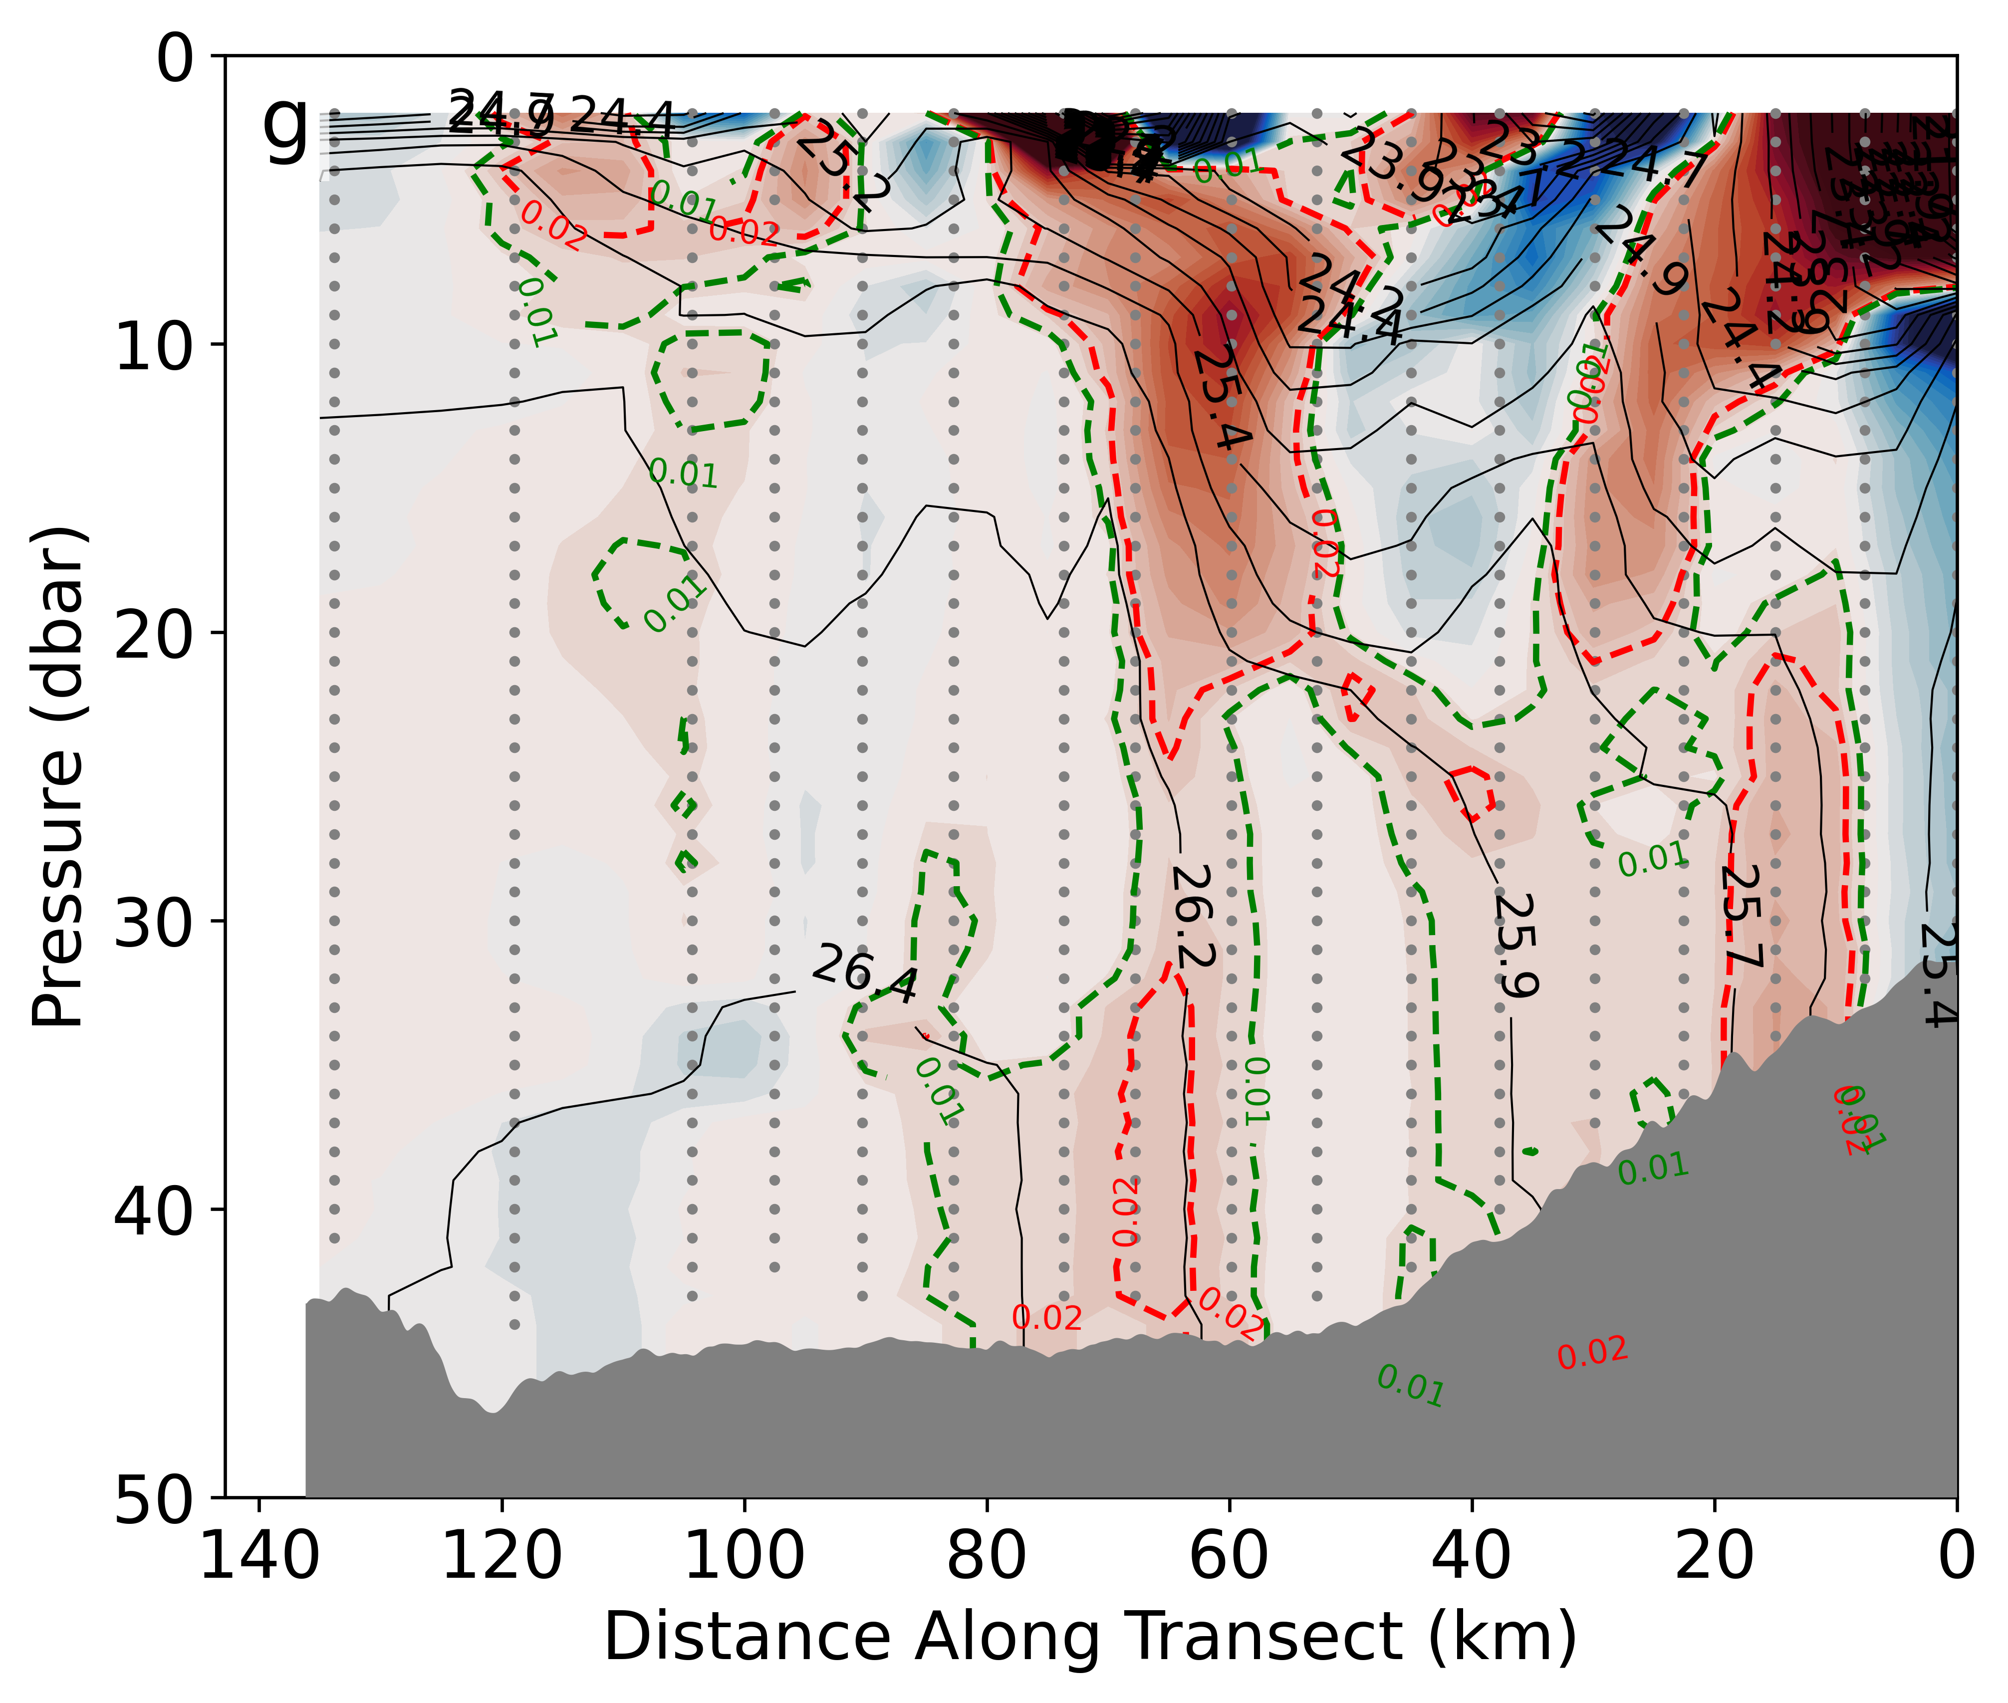
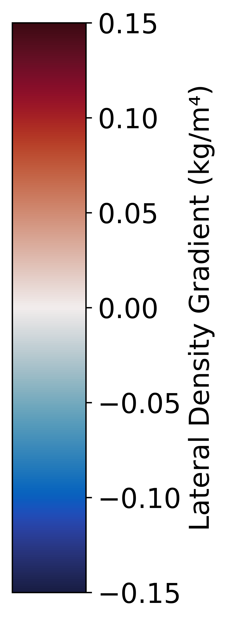
S3: Lateral density gradient for each of the 7 (1-7, A-G) repeats of the HRE transect with the threshold for inclusion inside the front shown in red and the lowest threshold where statistics hold shown in green.

Slide 21
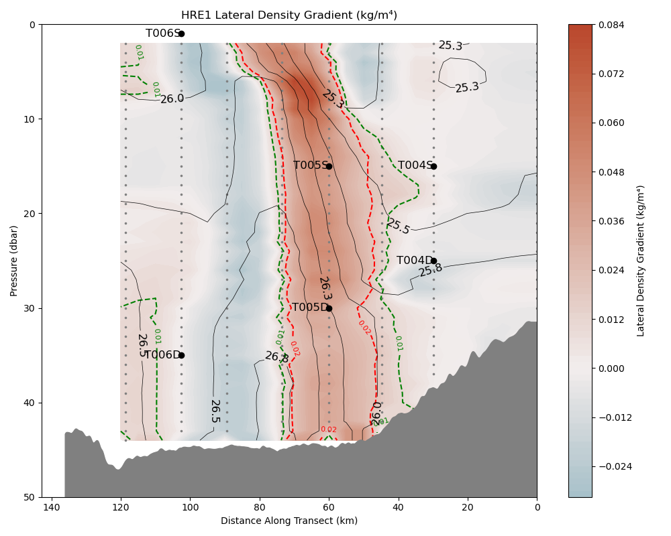
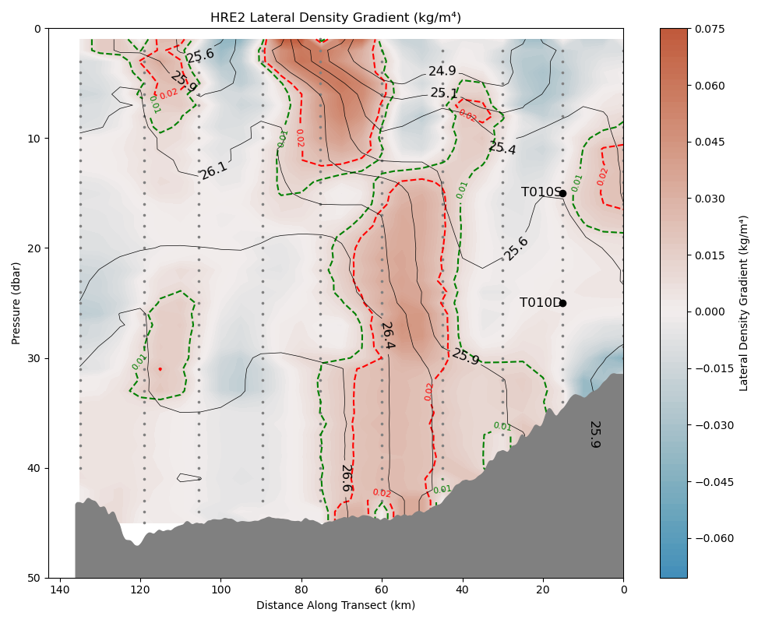
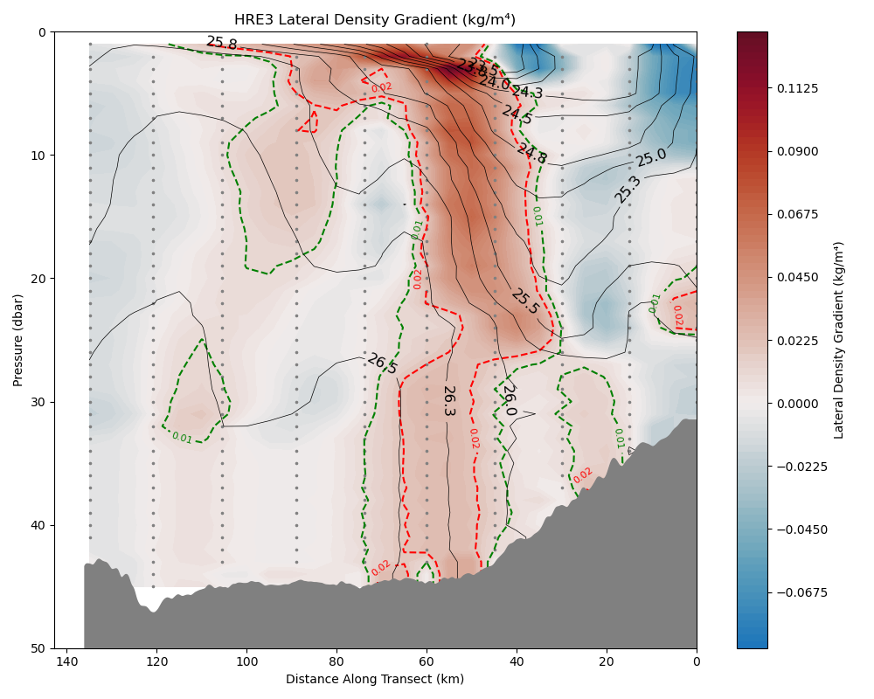
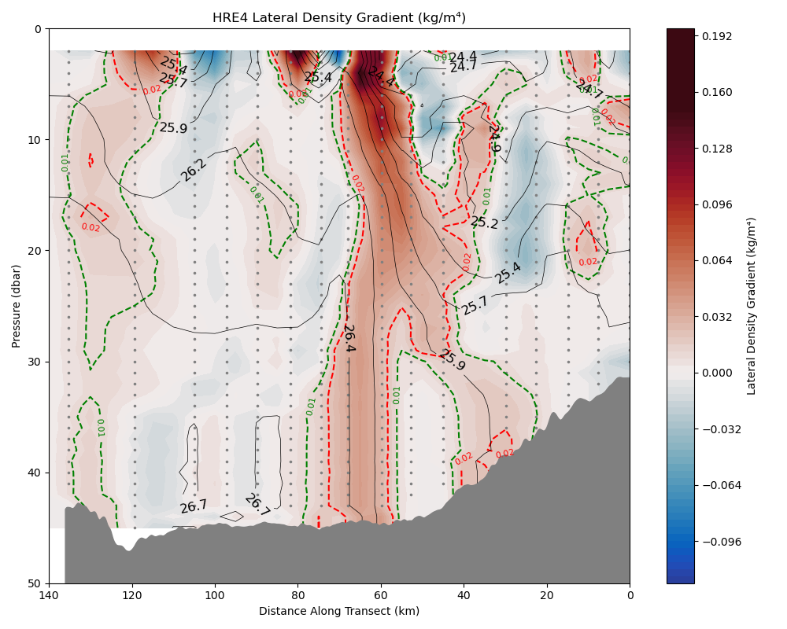
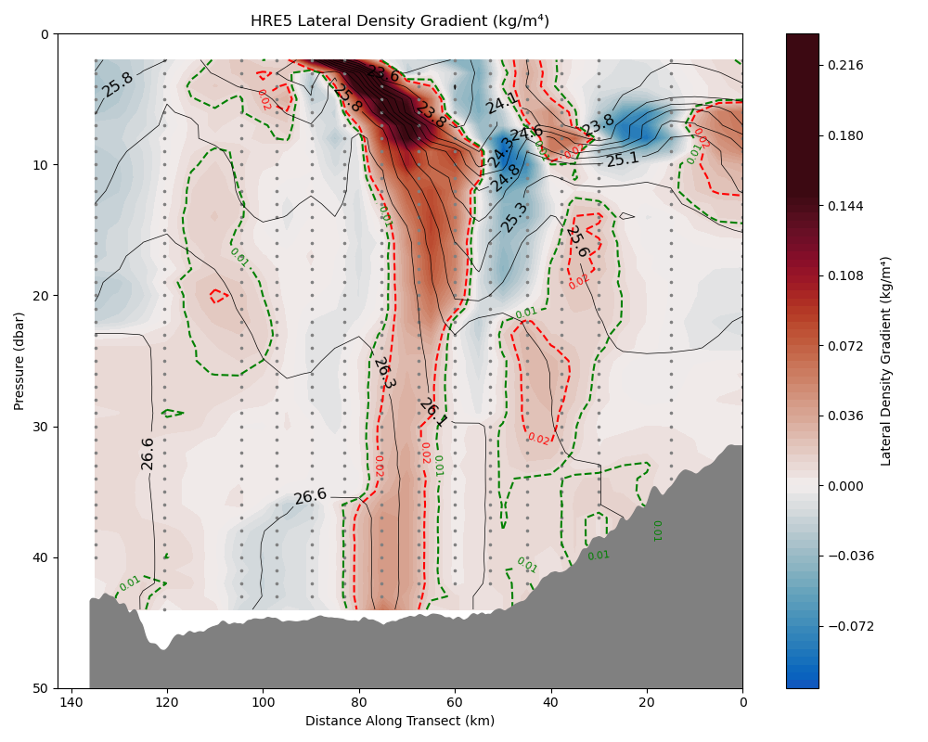


A
B
C
D
E
F
G
S3: Lateral density gradient for each of the 7 (1-7, A-G) repeats of the HRE transect with the threshold for inclusion inside the front shown in red and the lowest threshold where statistics hold shown in green.

Slide 22








S4: Lateral density gradient for each of the 8 (1-8, A-H) repeats of the HR transect with the threshold for inclusion inside the front shown in red and the lowest threshold where statistics hold shown in green.

Slide 23








A
B
C
D
E
F
G
H
S4: Lateral density gradient for each of the 8 (1-8, A-H) repeats of the HR transect with the threshold for inclusion inside the front shown in red and the lowest threshold where statistics hold shown in green.

